Slide 1
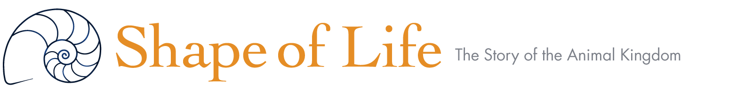
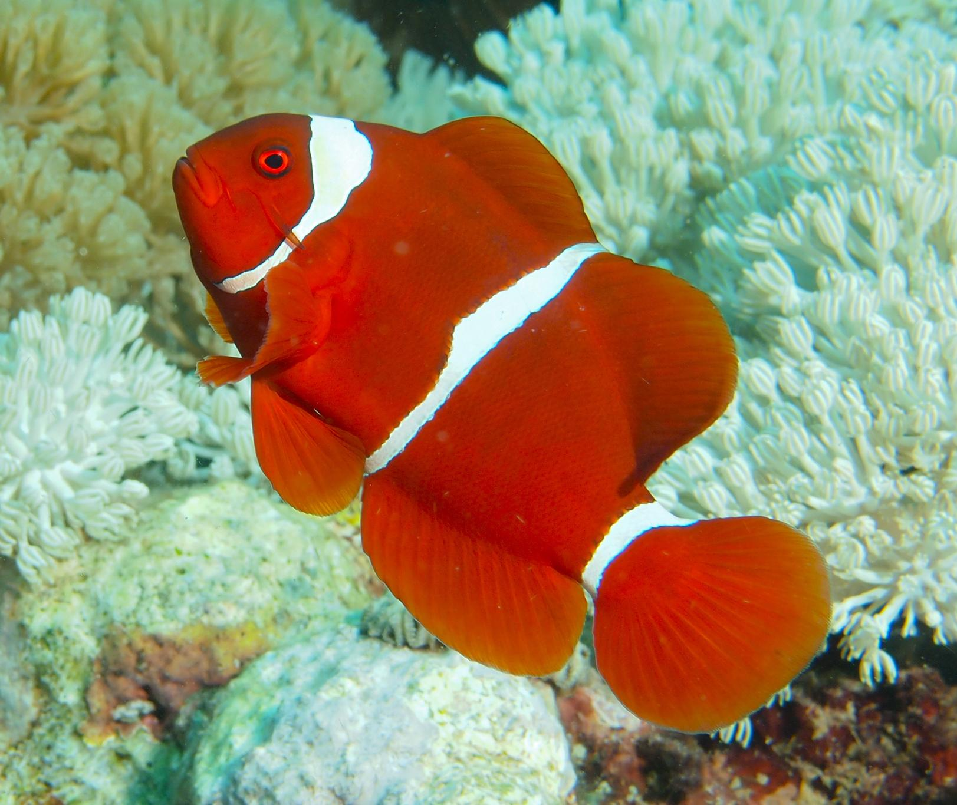
Chordates: We’re All Family

Slide 2
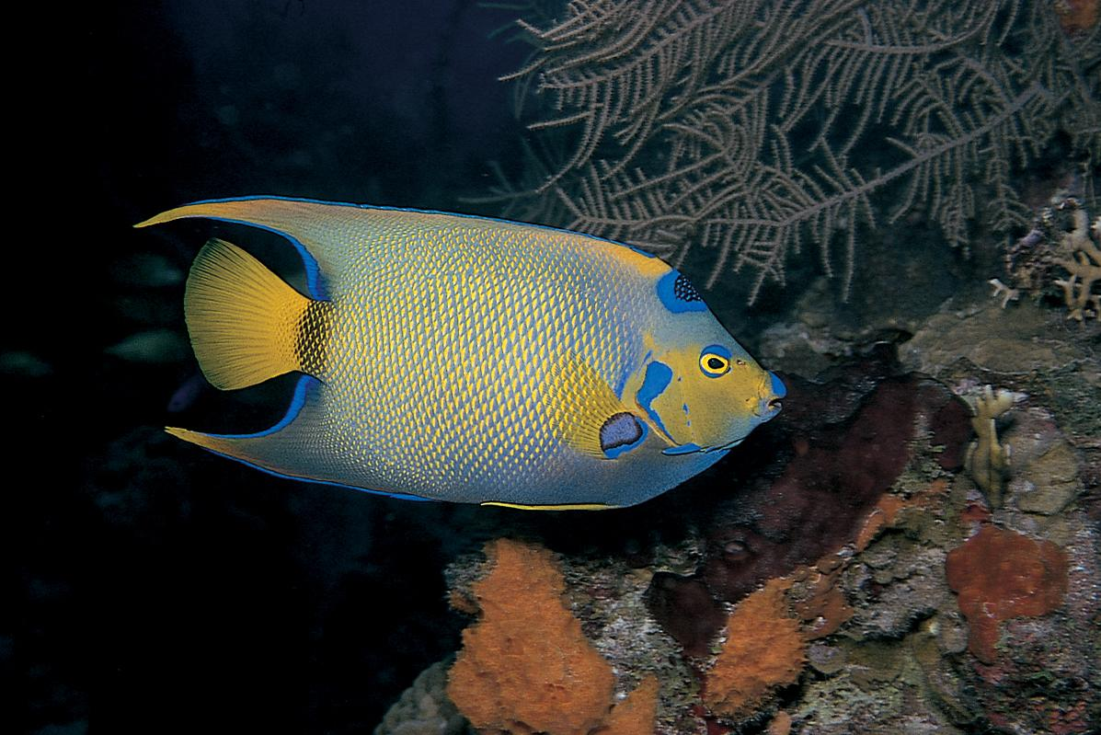
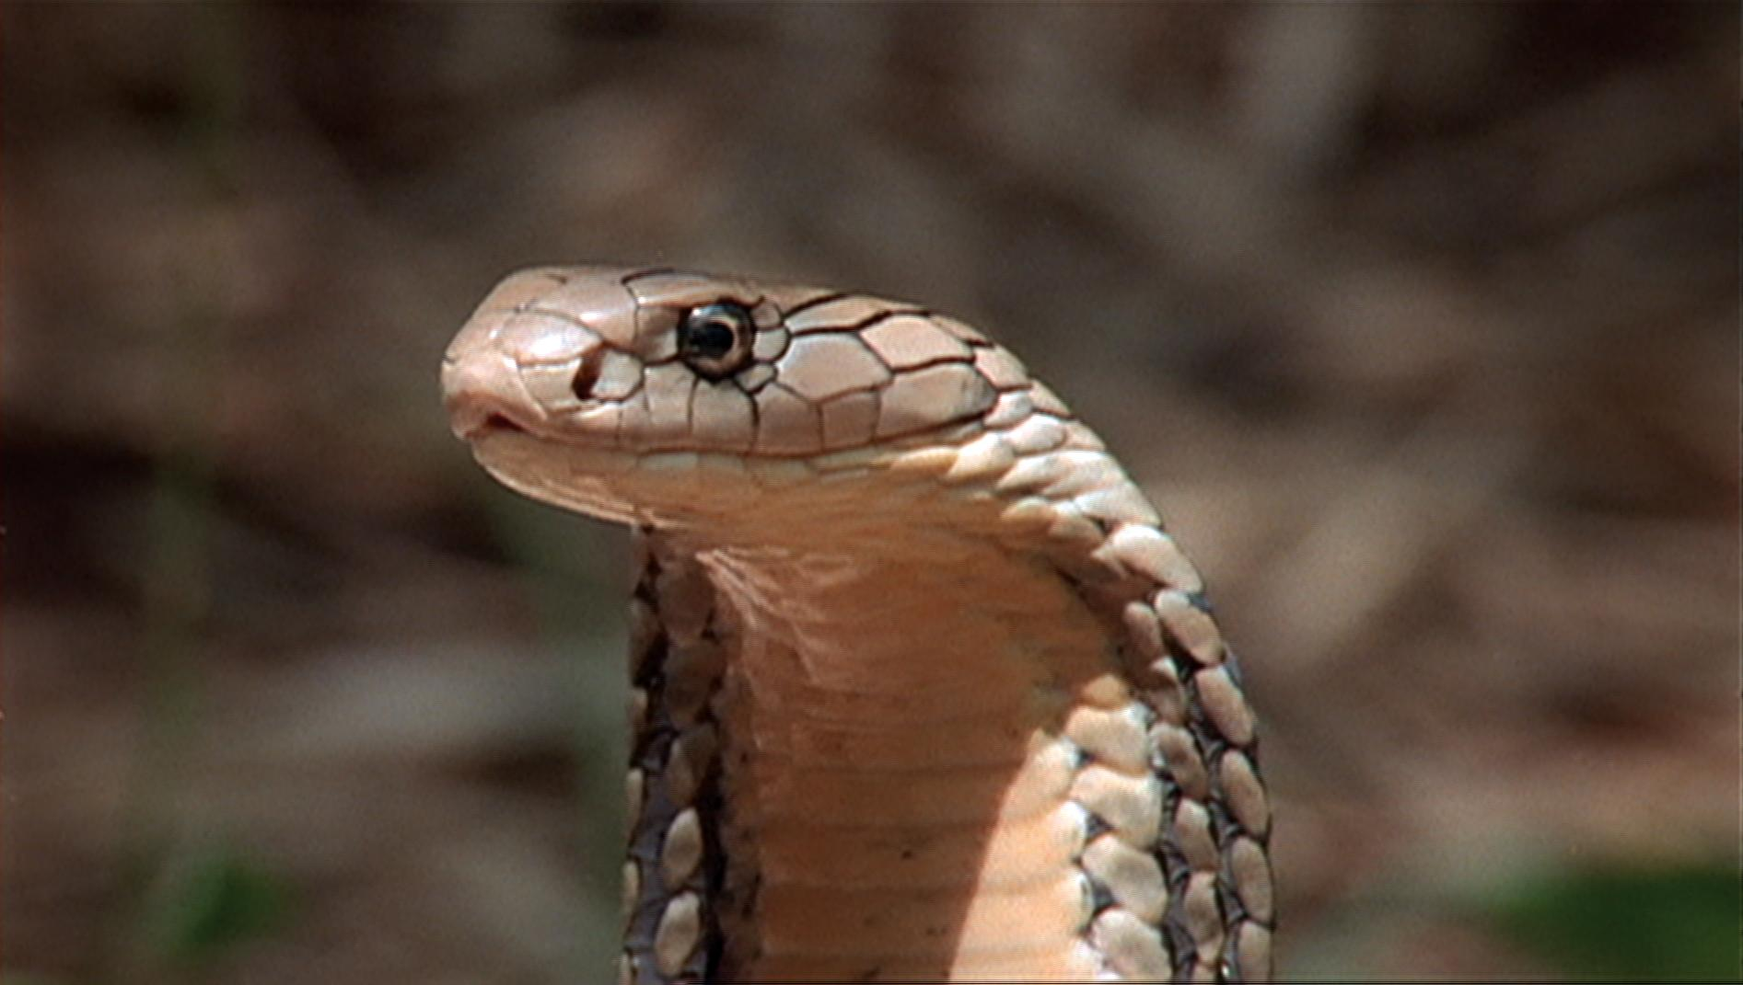
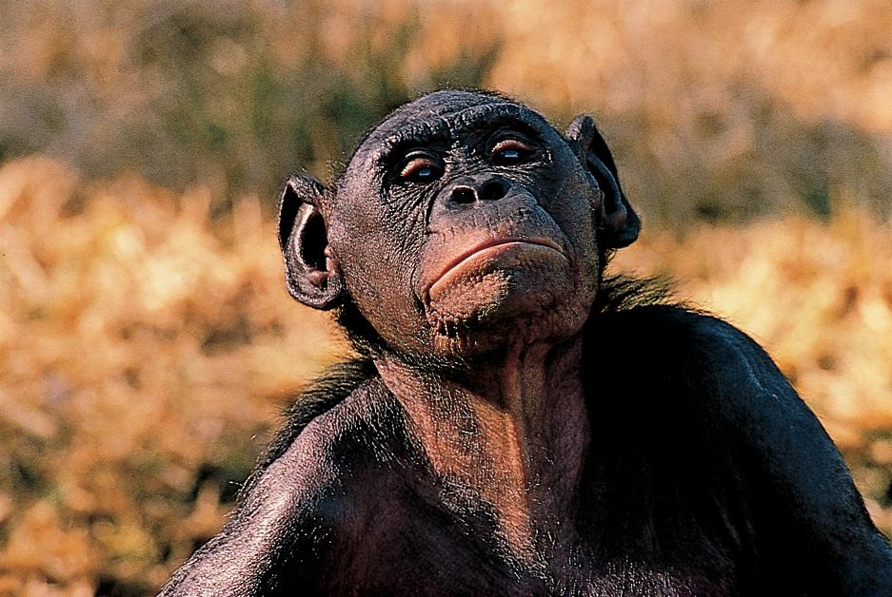
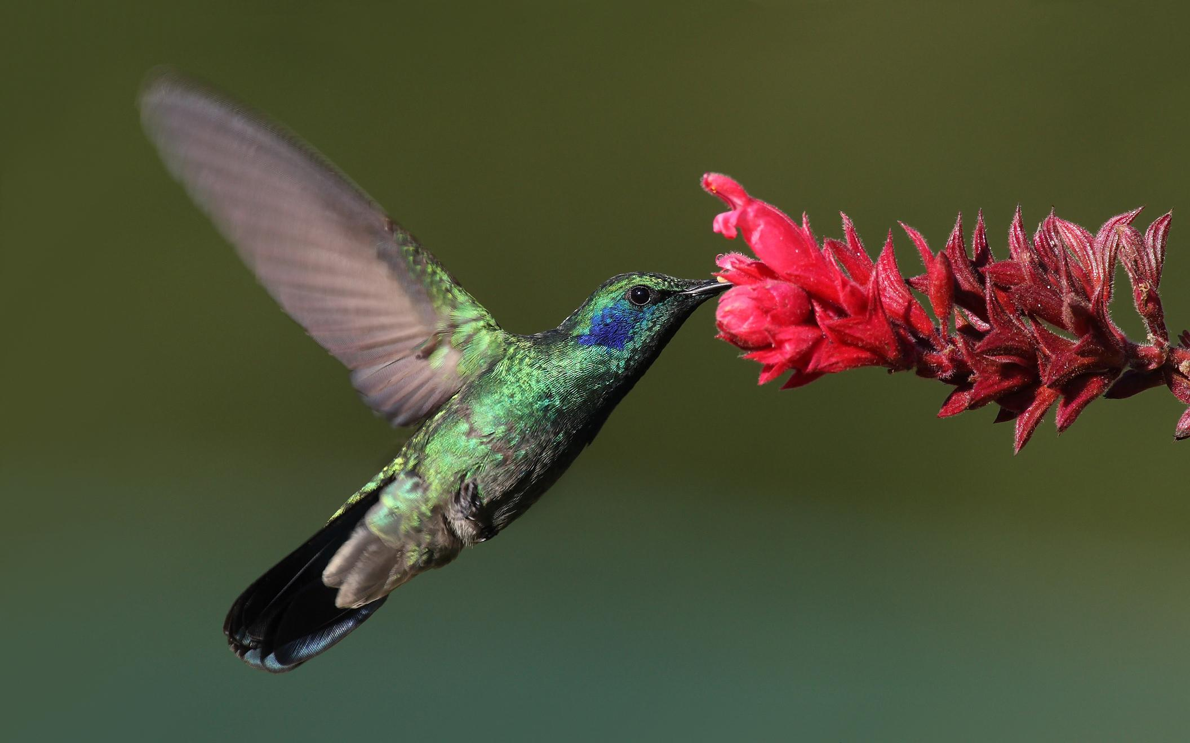
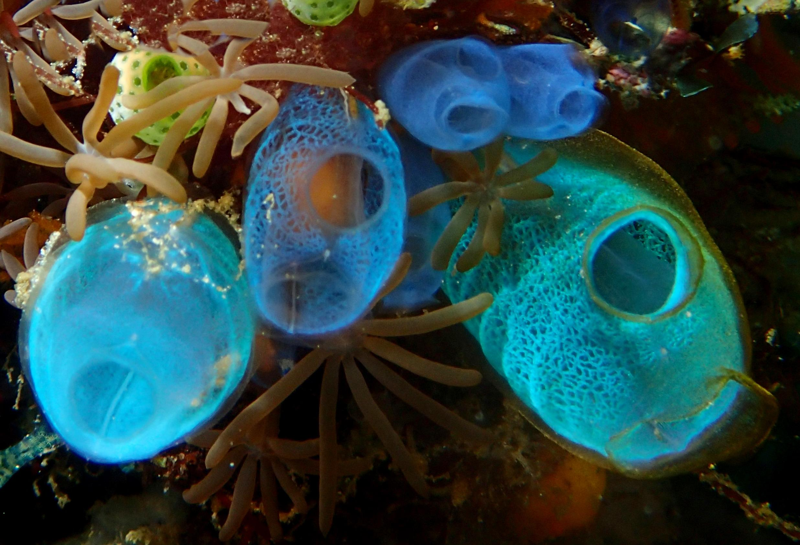
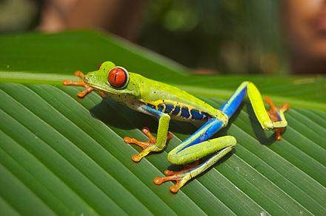
These Are All Chordates

Slide 3
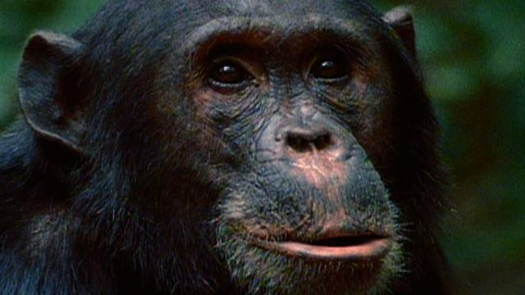
Watch Chordates: We’re All Family. Take Notes And Answer the Following Questions
Watch this video

Slide 4
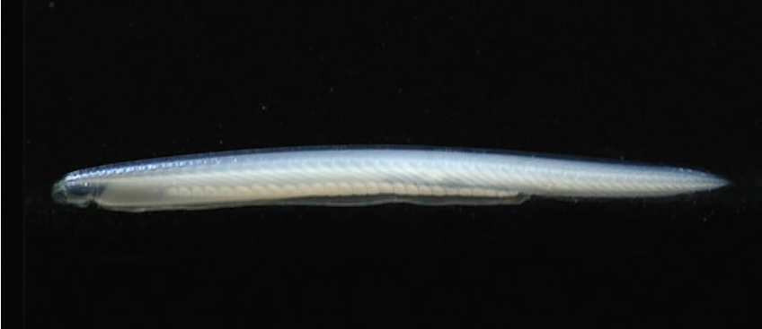
Amphioxus
What four body parts does Amphioxus have in common with us?
Why is Amphioxus described as a simple organism?

Slide 5
Notochord
What is the function of the notochord in Amphioxus?
What vestige of the notochord is found in vertebrates?

Slide 6
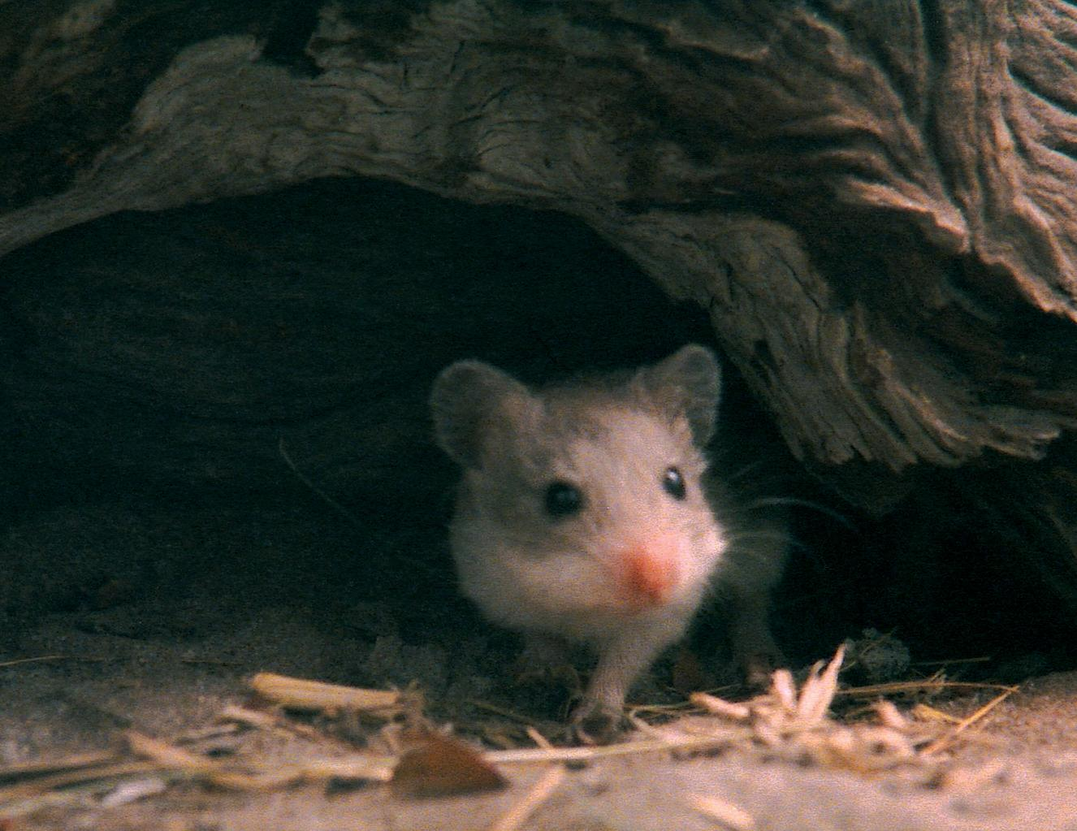
Vertebrates
What distinguishes vertebrates from other chordates?
Name one positive benefit of having vertebrae for Chordates.
Name the five major groups of vertebrate animals.
Vertebrates have four times the number of genes as other chordates. What advantage did it give them?

Slide 7
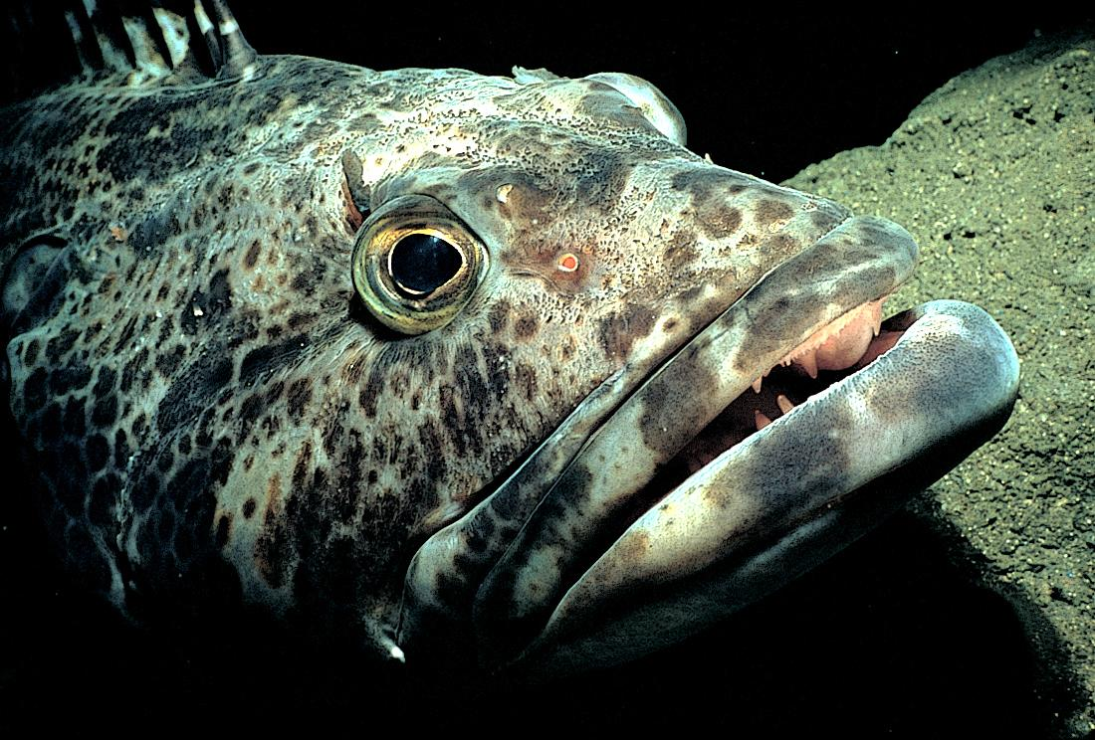
Jaws
What were the first animals with bony jaws?
What advantages do animals with jaws have?
What happened during evolution that led to the appearance of jaws and skulls in Chordates?

Slide 8
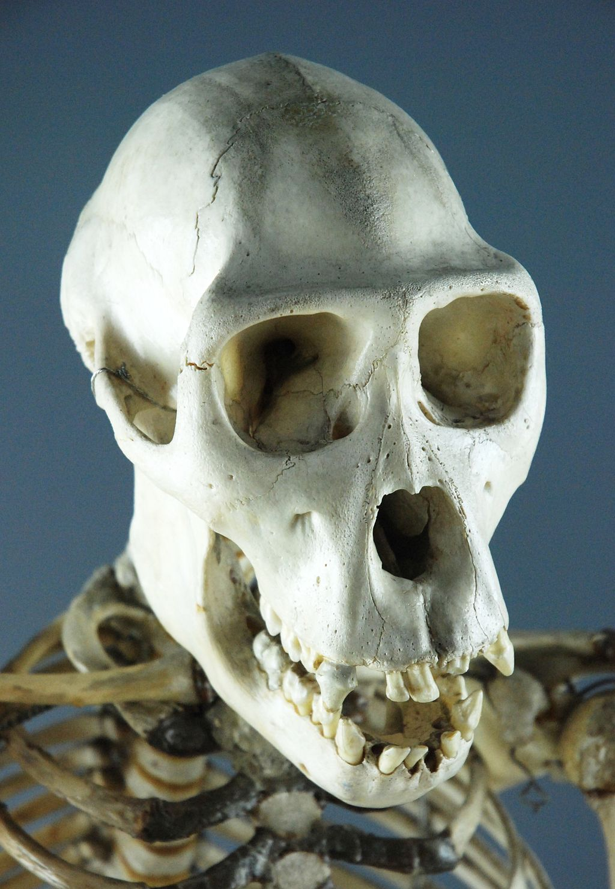
Skulls
What is the benefit of a skull?

Slide 9
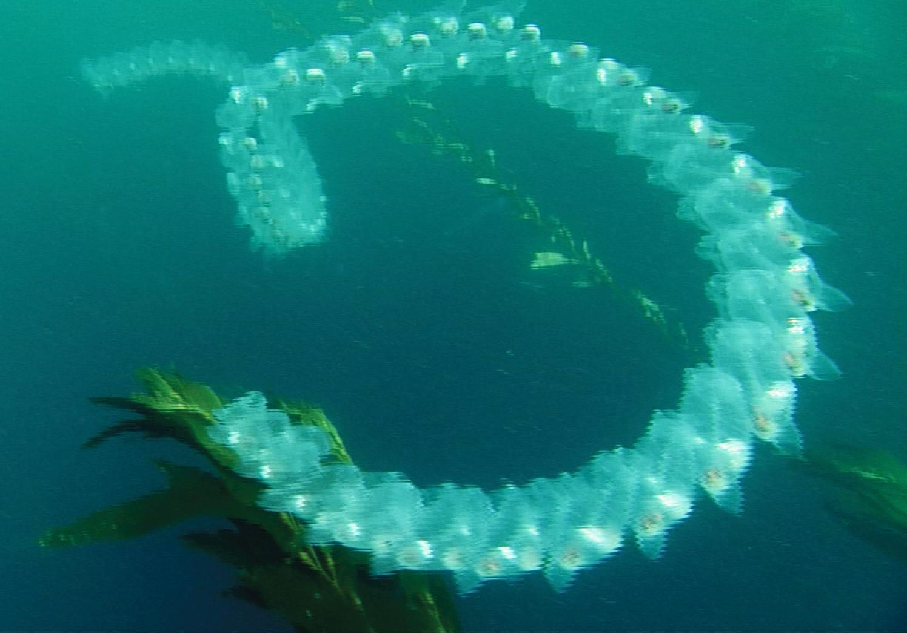
Non-vertebrate Chordates
Why does the narrator say, “Evolution is not a straight march forward”?
Name two (or three) Chordates that are very different from vertebrates.

Slide 10
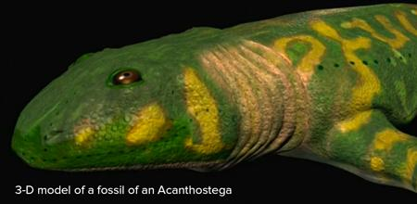
Tetrapods
Watch video about the first tetrapods
Describe the probable features of the first limbed vertebrate to exit the ocean and succeed on land?

Slide 11
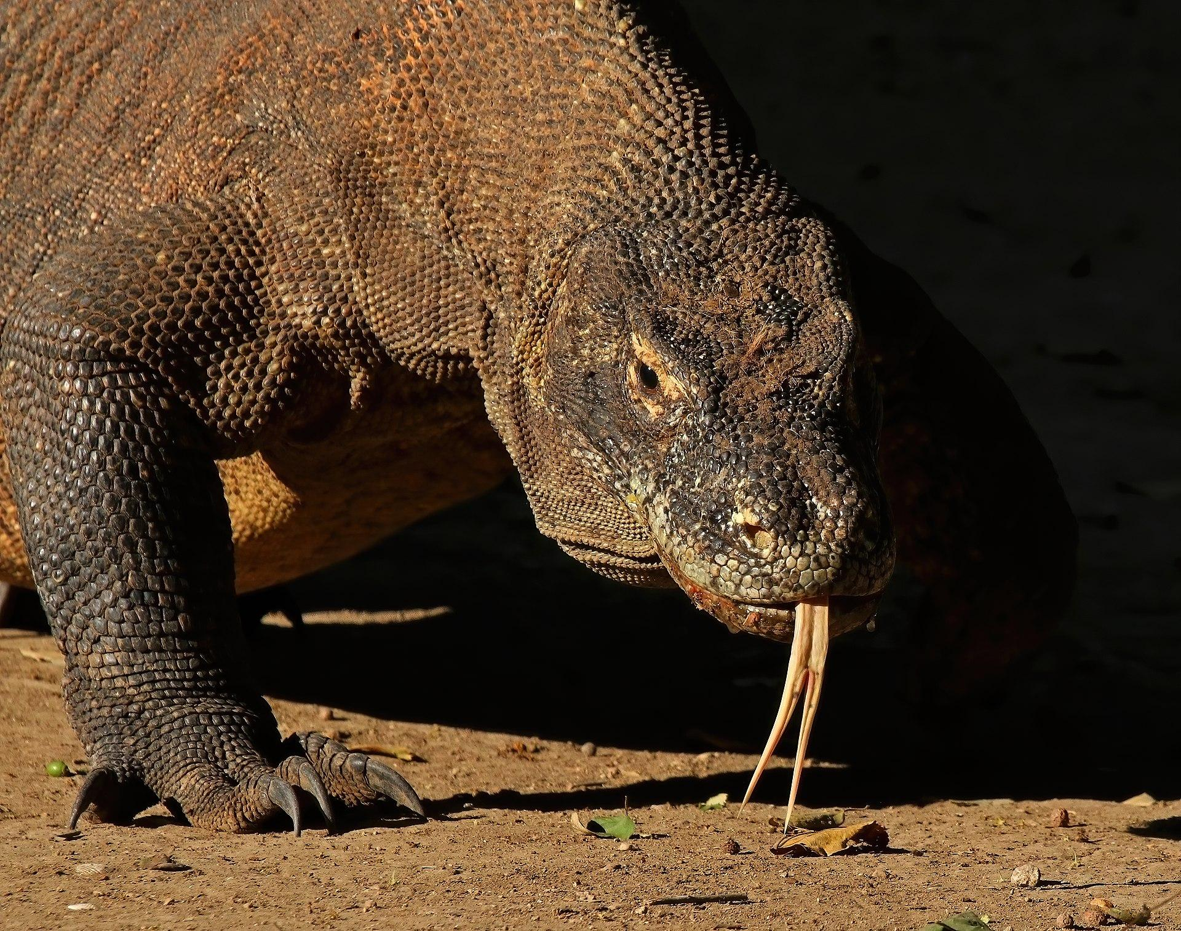
Reptiles
Why does the narrator say that reptiles are like fish out of water?
What kind of reptile abandoned the ability to walk?
What is the advantage of laying eggs?
What do snakes accomplish with their mouths that other vertebrates do with their limbs?

Slide 12
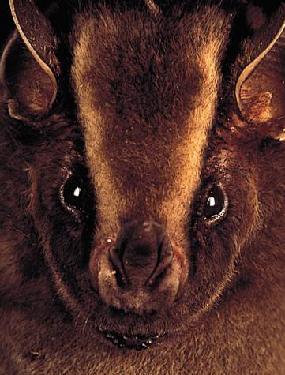
Mammals
What natural disaster wiped out half of the Earth’s animals 65 million years ago?
Why was this event important for the evolution of vertebrates?
What are the advantages and disadvantages of being a warm blooded powerful mammal?

Slide 13
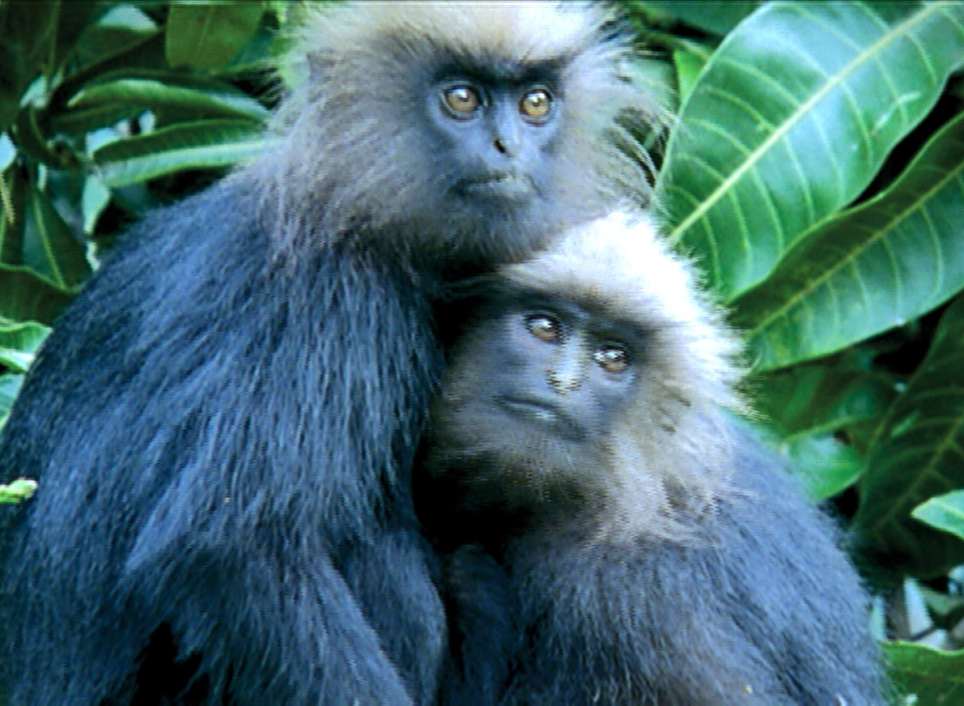
Our Cousins
Which vertebrate group are humans most closely related to?
Name three similarities between humans and great apes.
Name three ways in which humans and great apes are dissimilar.

Slide 14
Unity of Life
In the video what does the opening line “unity of life” mean?

Slide 15
Vocabulary Page 1
Define in your own words these vocabulary words at the end of the video.
Nerve cord Notochord
Gill slit Vertebrate
Segmented muscles Scaffolding
Scaffolding

Slide 16
Vocabulary Page 2
Asteroid
Metabolism
Primate

