Slide 1
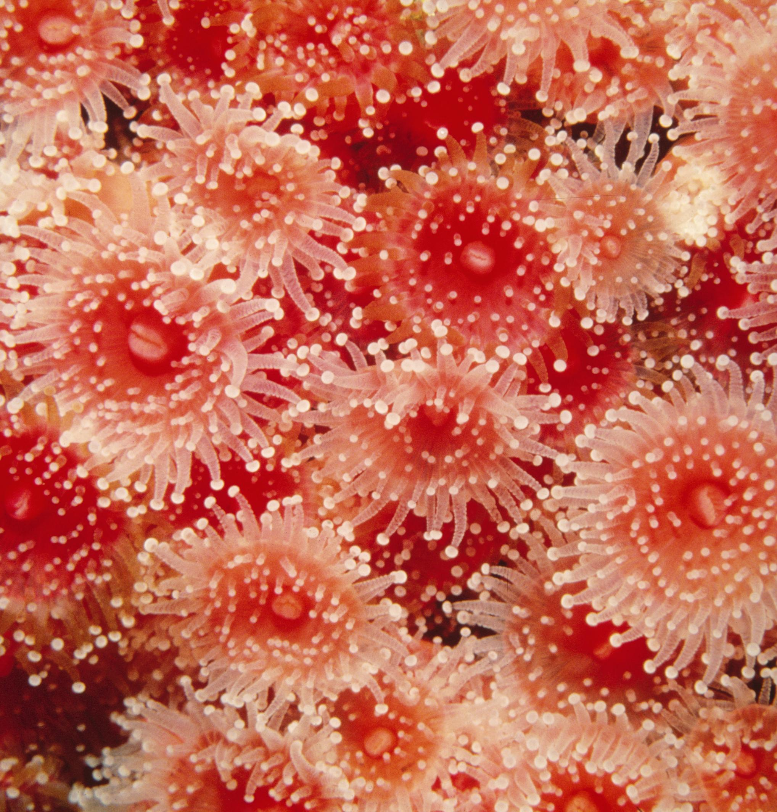
Cnidarians:
Life On the Move

Slide 2
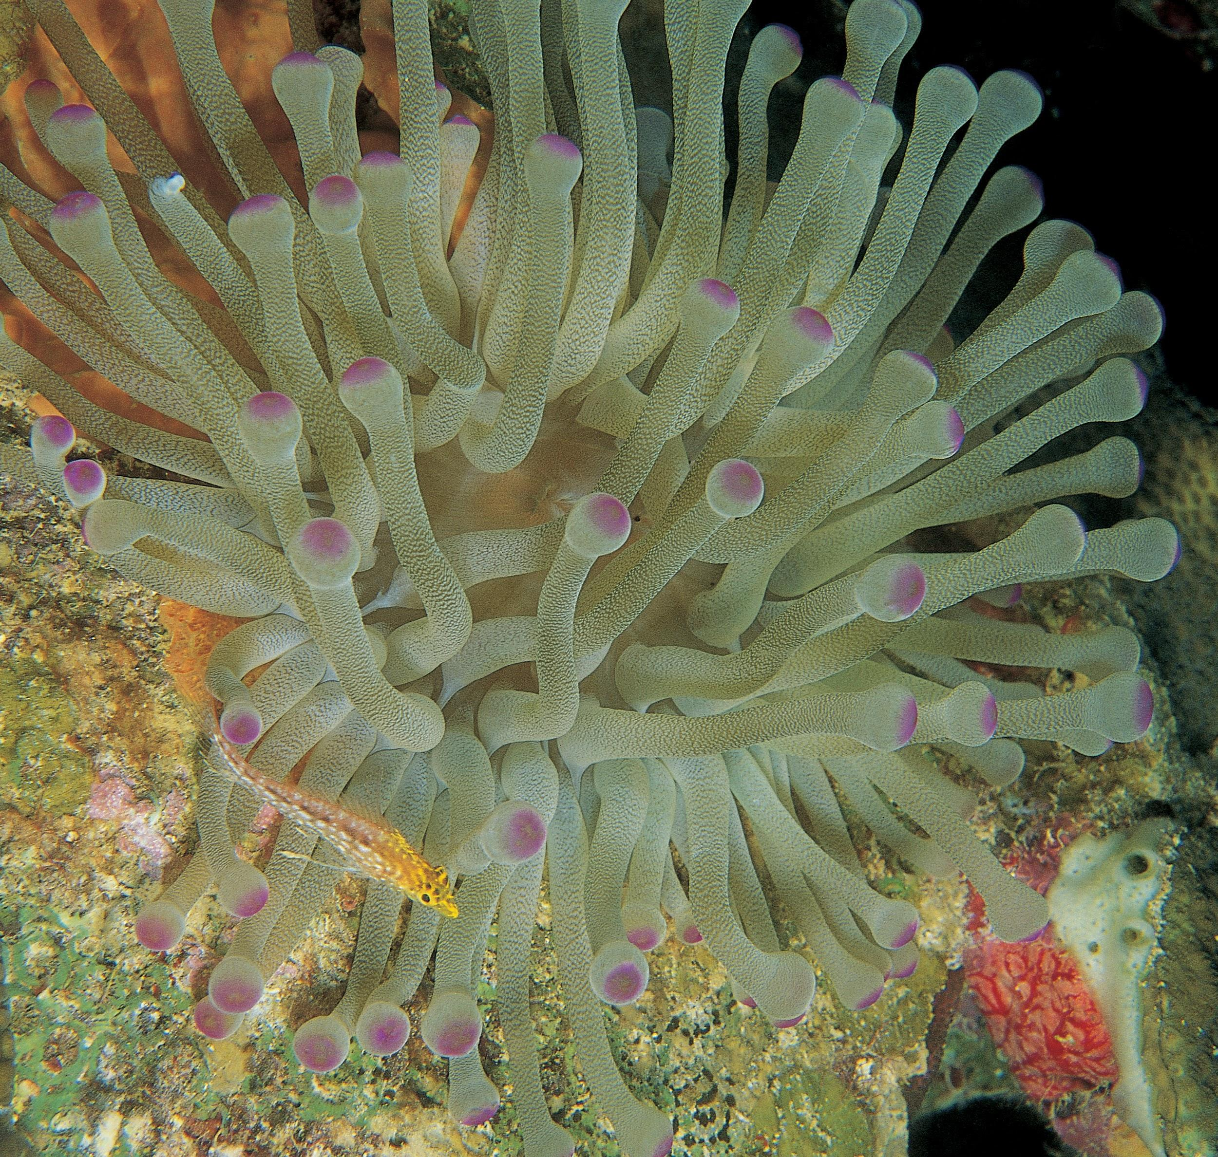
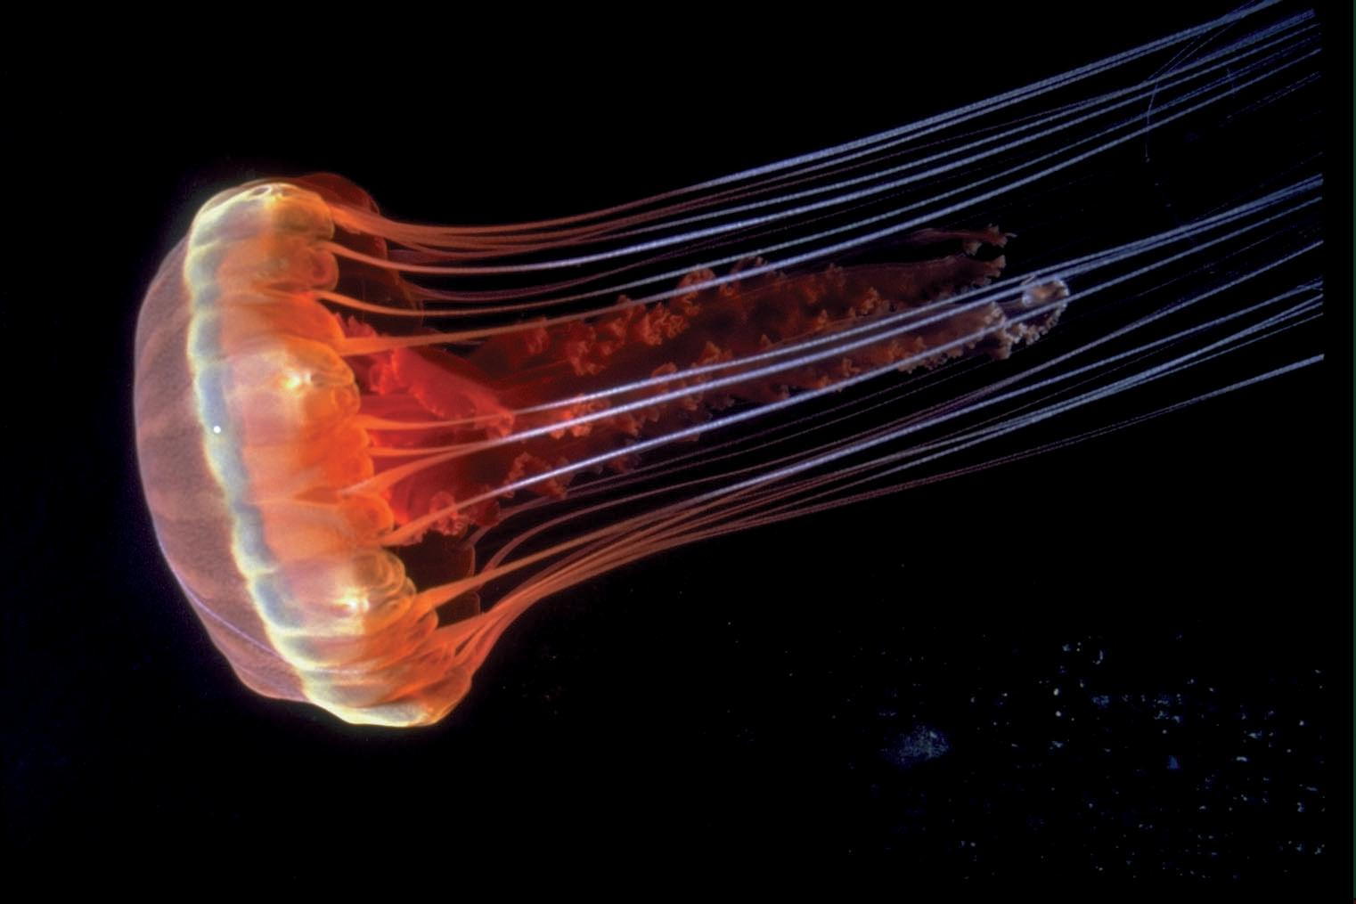
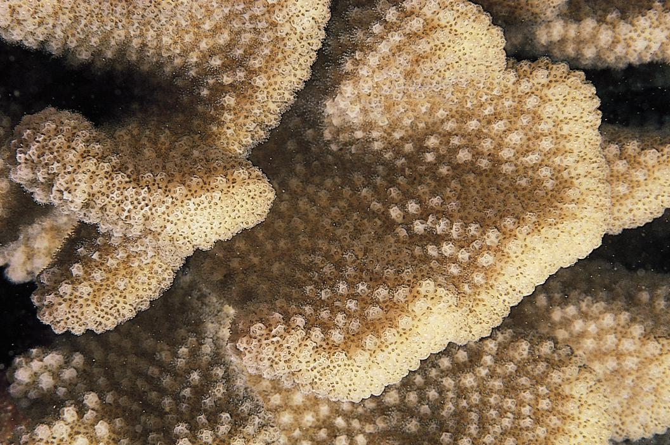
These Are All Cnidarians

Slide 3
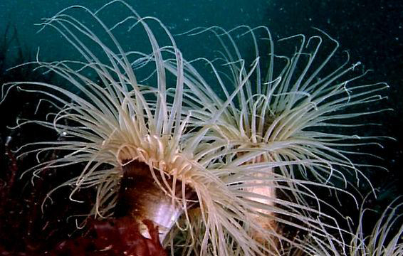
Watch Cnidarians: Life On the Move. Take Notes And Answer the Following Questions
Watch this video

Slide 4
Cnidarian Body Plan
In what way are cnidarians more complex than sponges?
What do these additions allow cnidarians to do?
How do tentacles give a cnidarian an advantage?
What two digestive system structures appeared first in the cnidarians?

Slide 5
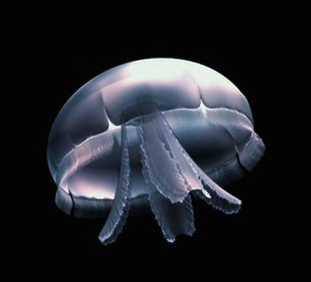
Body Plan: Polyp and Medusa
Watch this video
Name and describe the two different versions
of the cnidarian body plan.

Slide 6
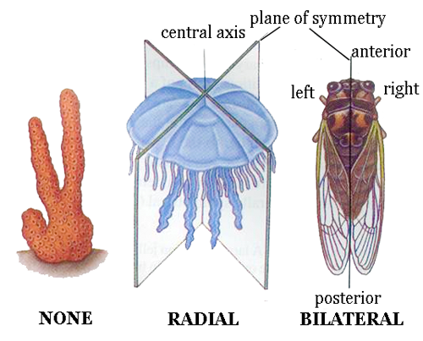
Symmetry
What is “symmetry?
What kind of symmetry do cnidarians have?
How is it different from the
symmetry of your own body?

Slide 7
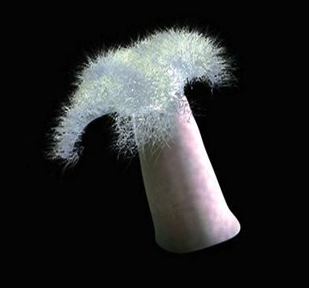
Movement
Watch this video
What allows anemones to be able to
bend in different directions?
How do nerve cells work with muscle cells
to give cnidarians movement?
What kind of a skeleton does an
anemone have?

Slide 8
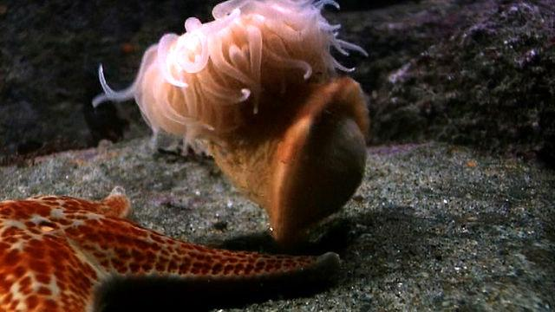
Watch An Anemone Swim Away
When attacked by a sea star, an anemone called Stomphia releases itself and contracts its body to swim away.
Watch this video

Slide 9
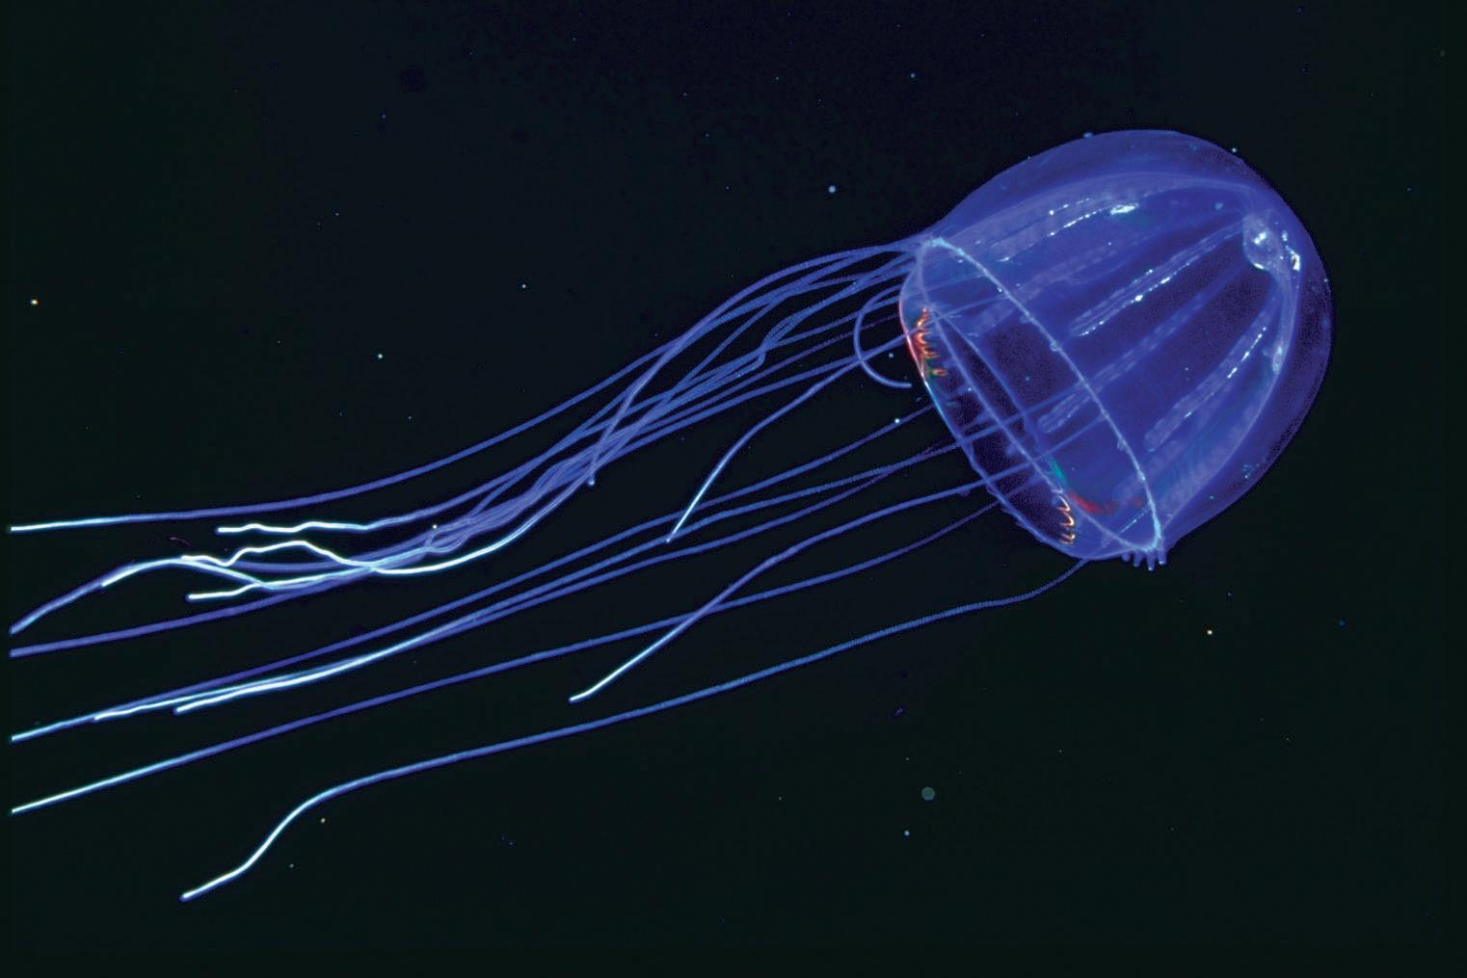
Why Do Jellyfish Swim?
Watch this video

Slide 10
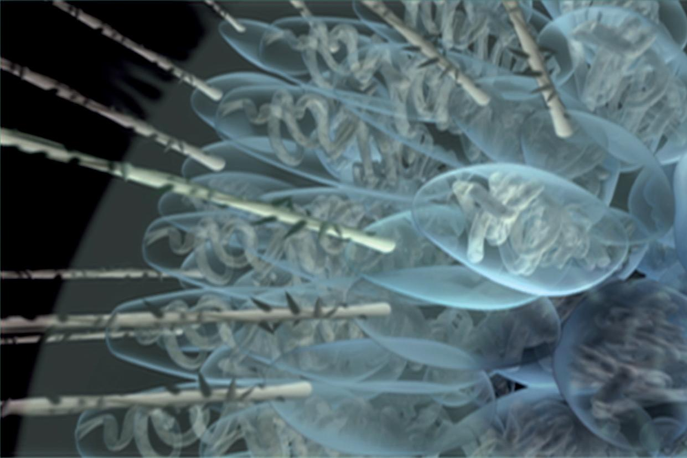
Nematocysts
What are nematocysts? What do they do?
How do anemones fight for space on a rock?

Slide 11
Feeding
Watch this video
How does an anemone catch a fish?

Slide 12
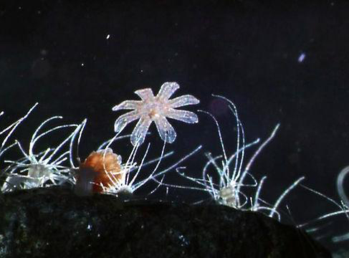
Reproduction: Moon Jelly Life Cycle
Watch this video

Slide 13
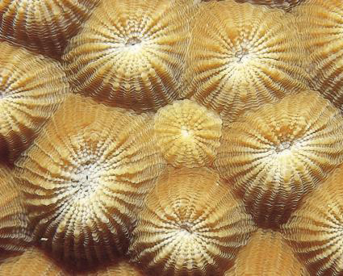
Corals
What do coral polyps eat?
What do we call a community of coral polyps?

Slide 14
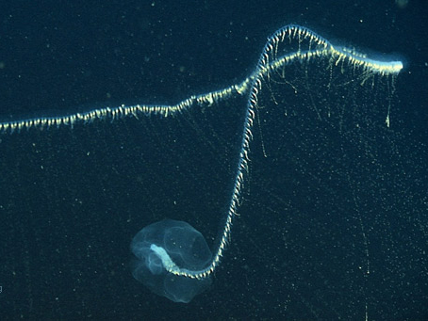
Deep Sea Cnidarians
What kind of cnidarians live in the deep sea?
What is Praya?

Slide 15
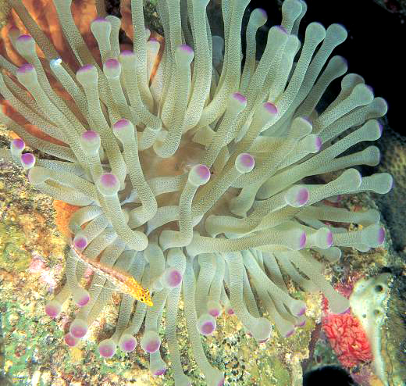
Cnidarian Innovations
Why are cnidarians a turning point for behavior?

Slide 16
Vocabulary Page 1
Define in your own words these vocabulary words at the end of the video.
nematocyst medusa
toxin polyp
arsenal decoy
troll

