Slide 1
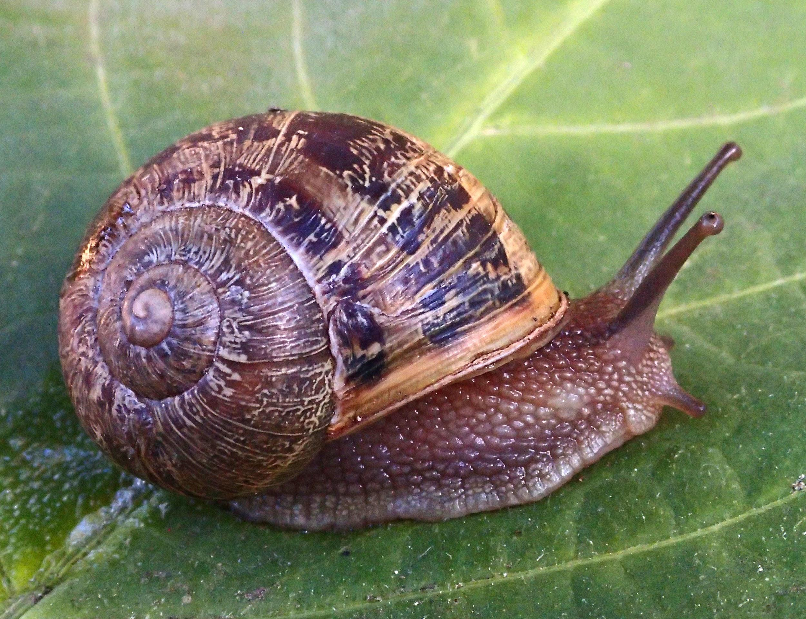
Molluscs:
The Survival Game

Slide 2
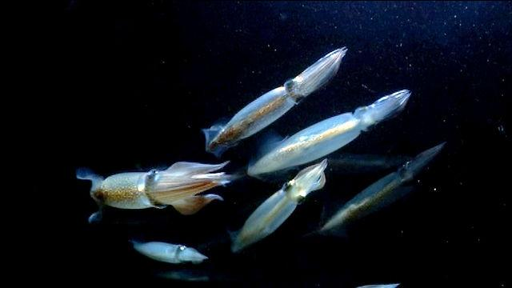
Watch Molluscs: The Survival Game. Take Notes And Answer the Following Questions
Click here to watch

Slide 3
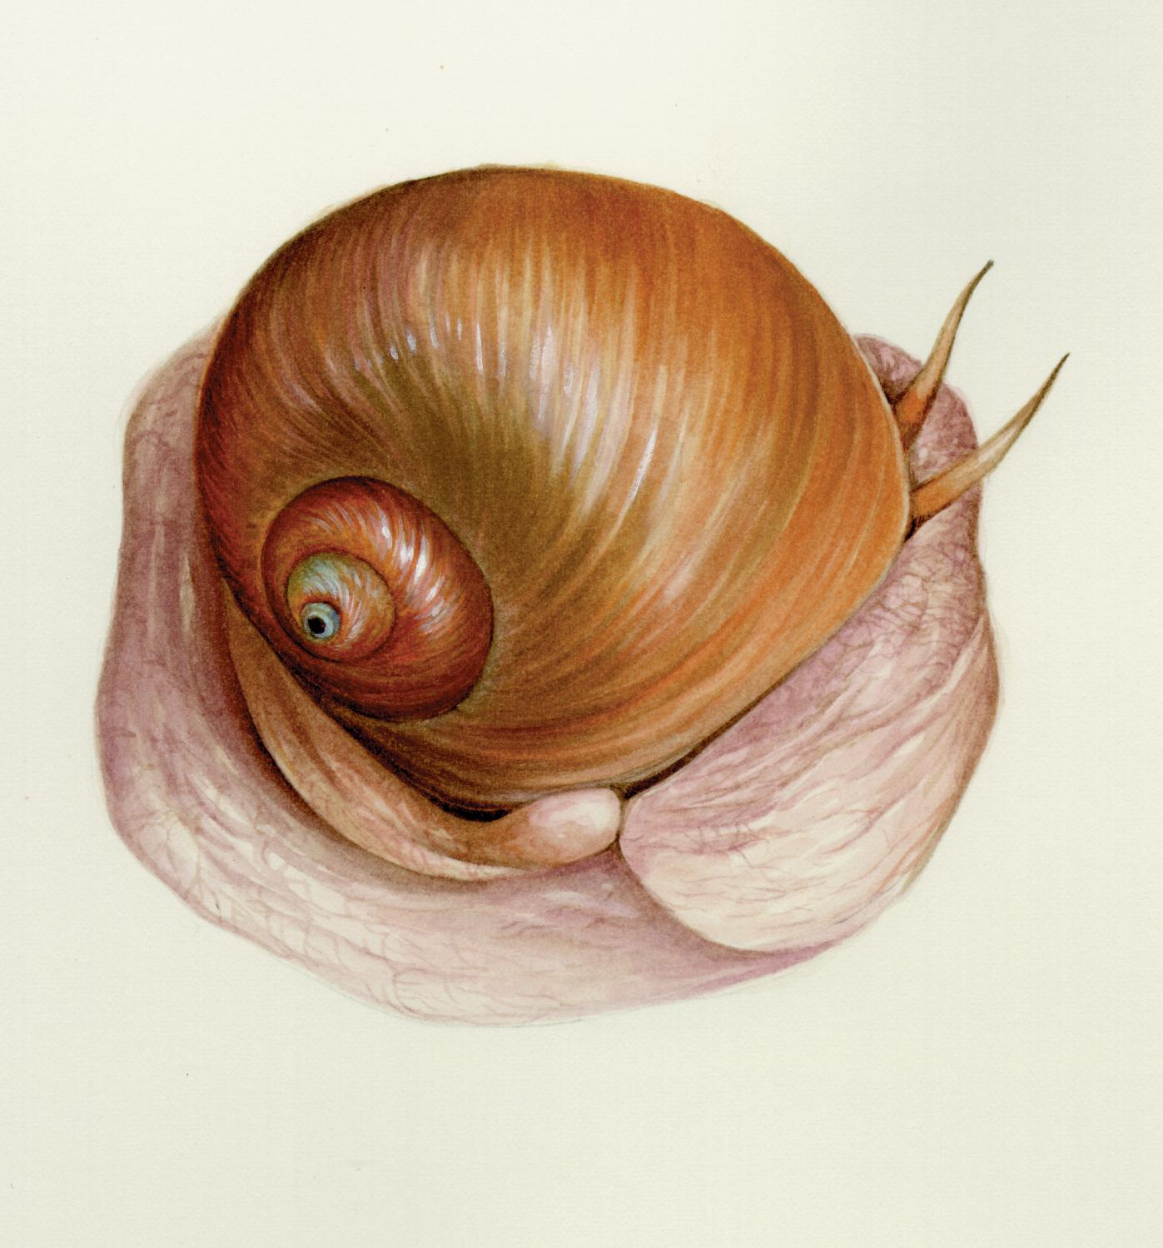
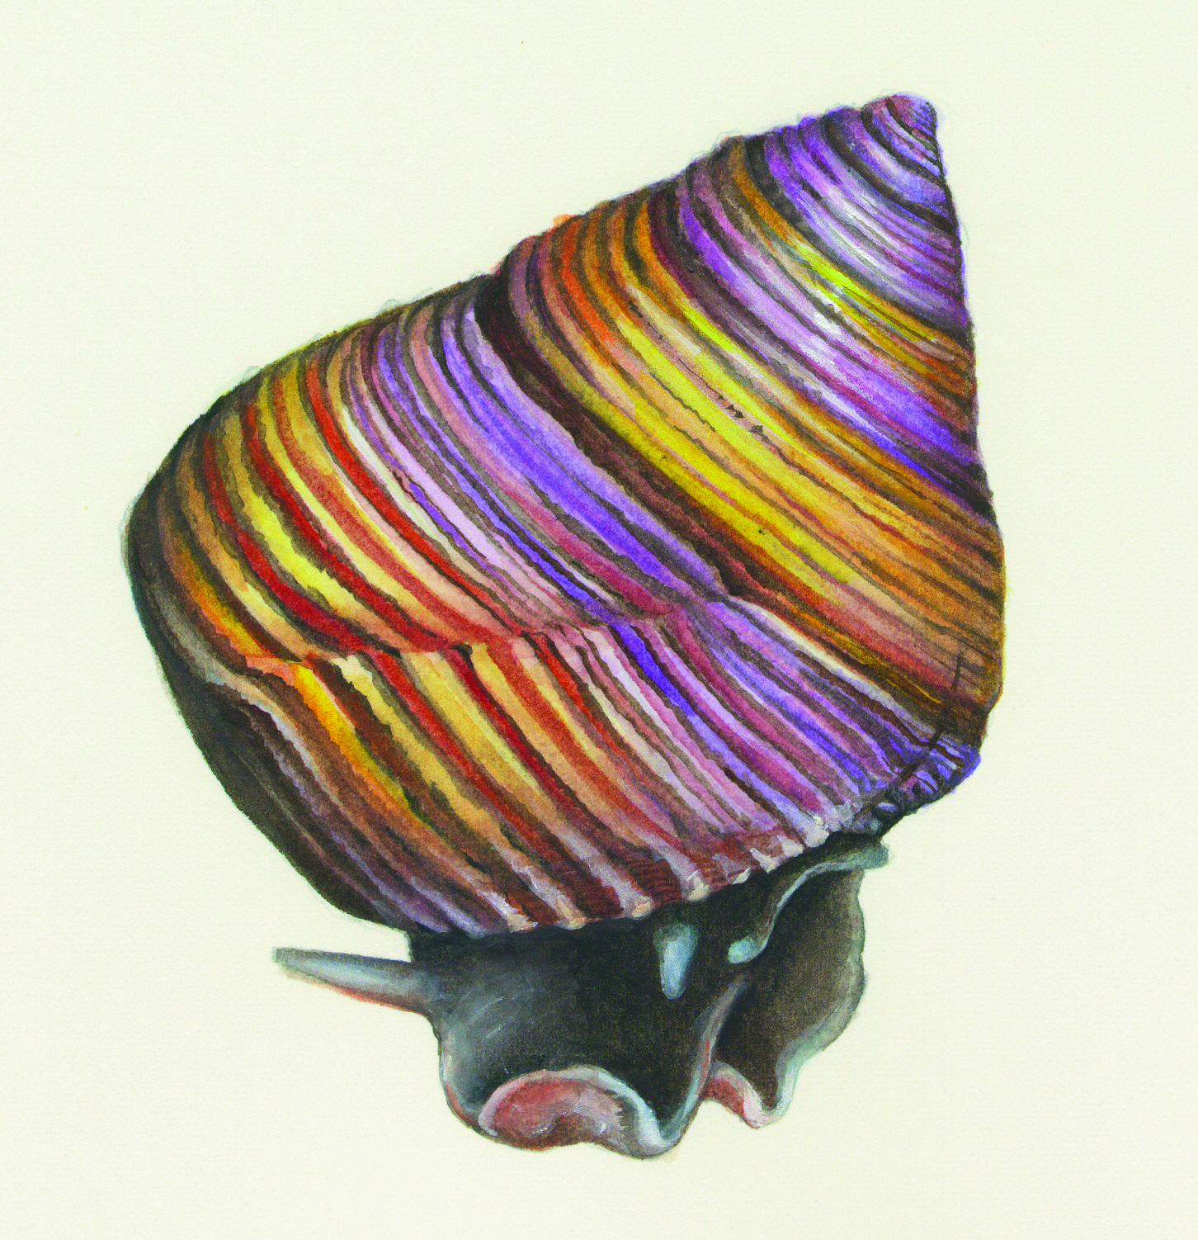
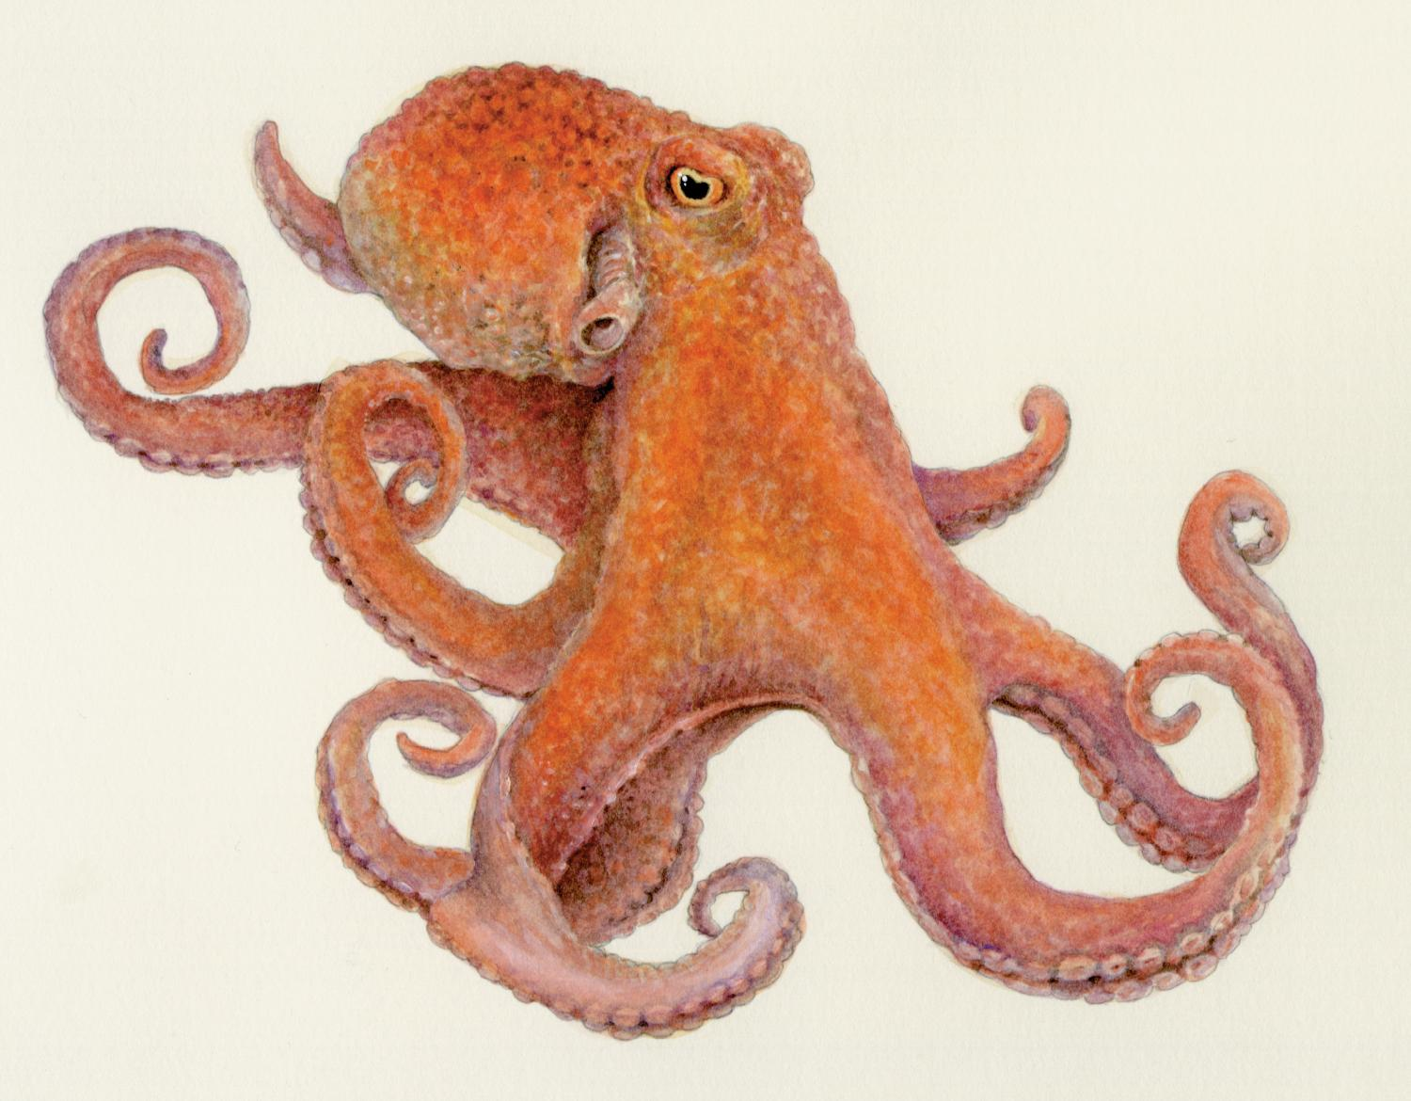
List the Four Characteristics of the Molluscan Body Plan

Slide 4
The Molluscan Shell
How does the mollusc make the shell?
How does the leafy hornmouth avoid being crushed by the crab?

Slide 5
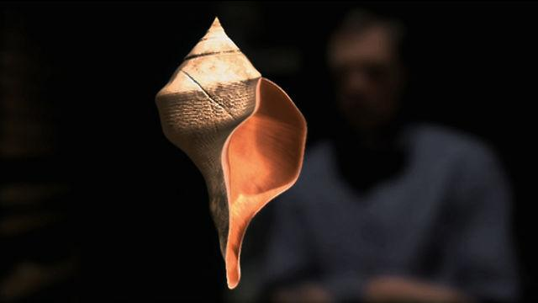
Watch Mollusc Animation: Shell Repair. Take Notes And Answer the Following Question
Click here to watch:
How is the shell built to prevent cracks?
How does the snail repair cracks?

Slide 6
The Molluscan Foot
Name some activities a mollusc can do with its foot.
What does the abalone do when the sea star catches up to it?

Slide 7
Moon Snail
How does the cockle avoid the moon snail?
What’s the moon snail’s strategy to catch the cockle?
What strategy does the moon snail use on its second approach?

Slide 8
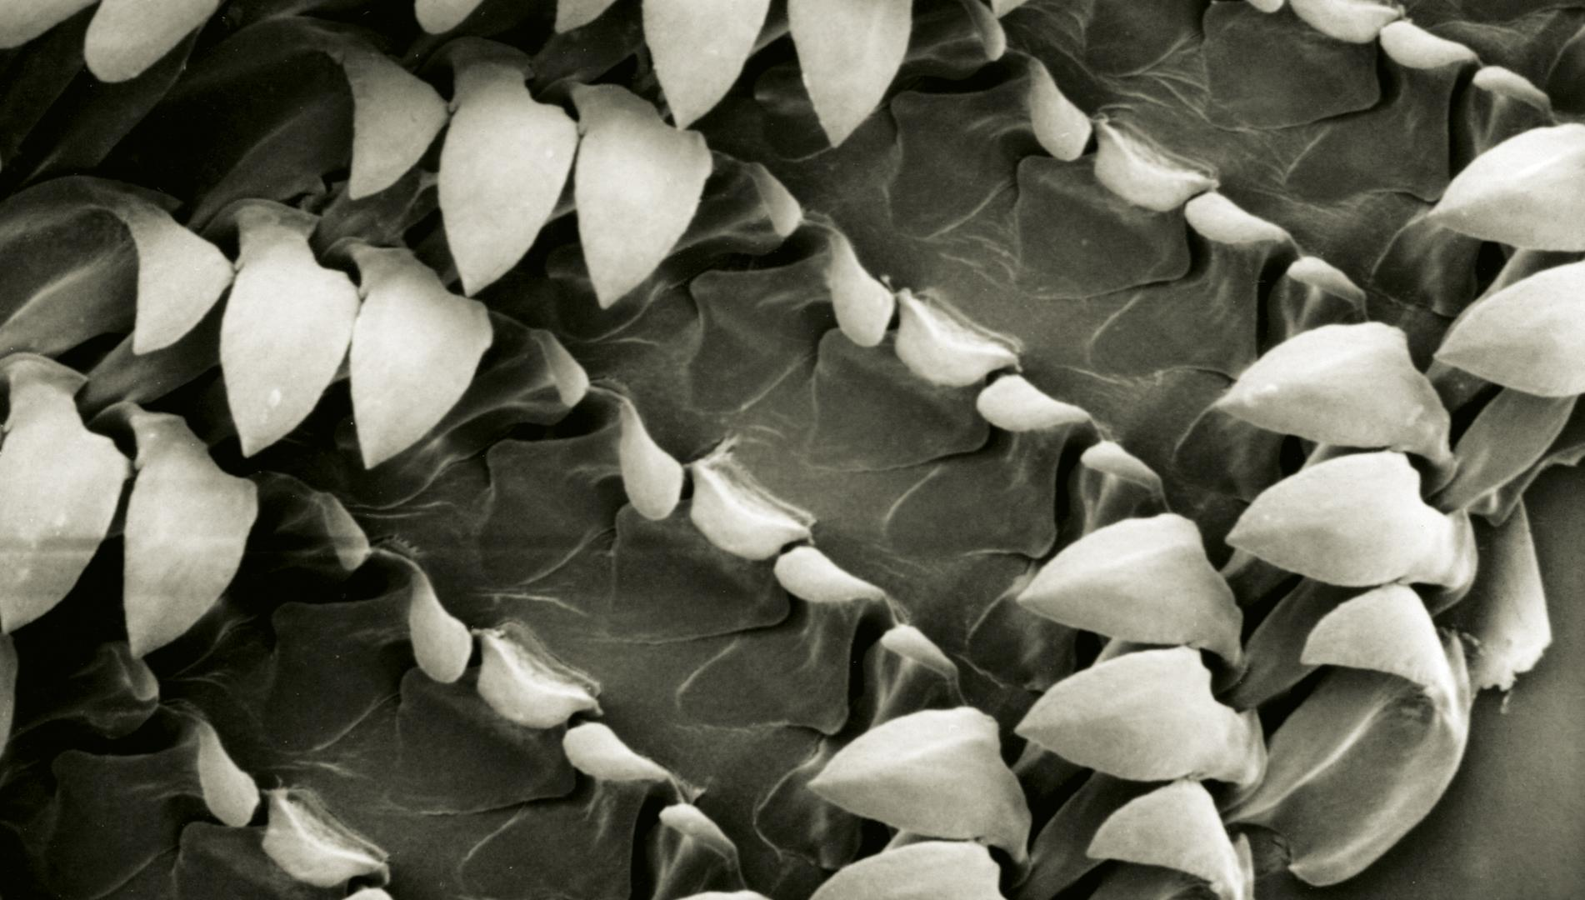
Radula
What is a radula and how does a mollusc use it?
Why don’t all radulas look alike?
How did the moon snail make the hole in the cockle??

Slide 9
Nautilus
Why did some molluscs evolve the ability to swim?
Name three adaptations Nautilus has for life off the seafloor?
From what body part did the nautilus’ funnel evolve?

Slide 10
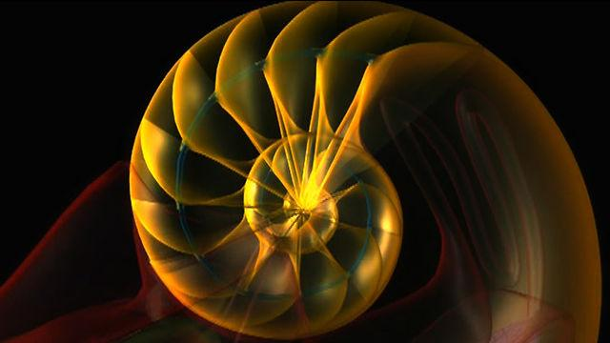
Watch Mollusc Animation: Nautilus Body Plan. Take Notes And Answer the Following Question
Watch here:
How does a chambered nautilus control its buoyancy?

Slide 11
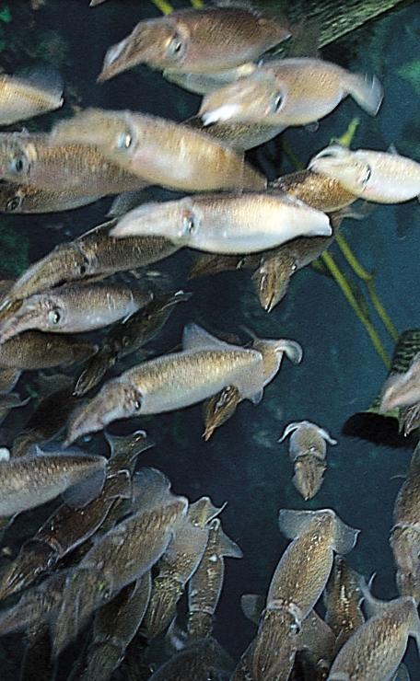
Squid
What drove the evolution of squid and octopus?
What did squid gain by not having a heavy shell?
How is the squid’s body plan adapted for speed?
How is the squid’s mantle adapted for speed?

Slide 12
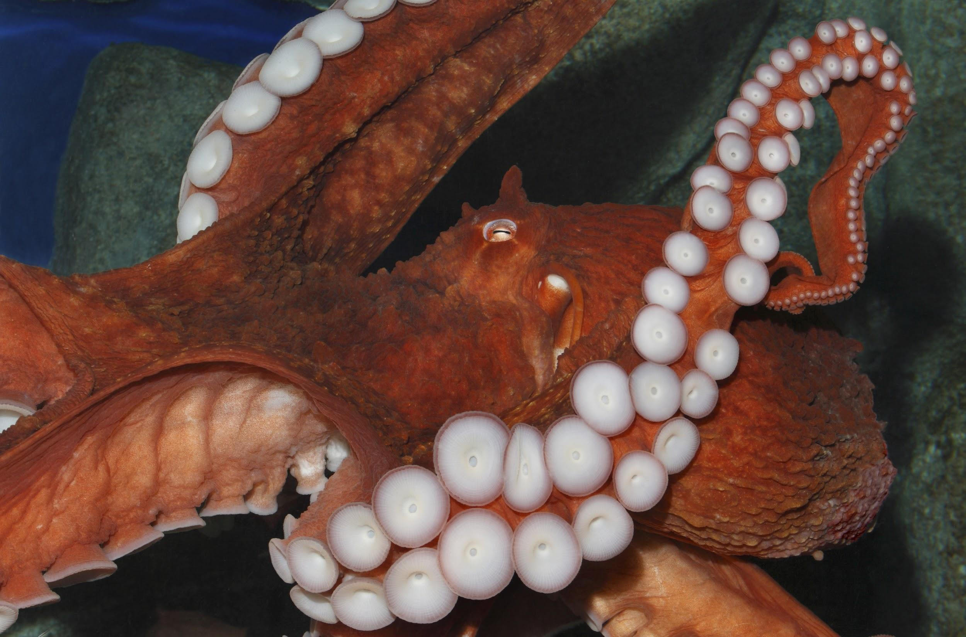
Octopus
How have octopuses without shells been so successful?
How does an octopus move?

Slide 13
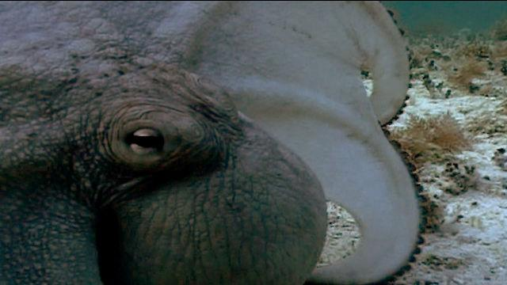
Watch Molluscs: Octopus Camouflage. Take Notes And Answer the Following Question
Watch here:
How is the octopus’ skin adapted for camouflage?

Slide 14
Make a List Of Molluscs You Have Encountered
Where did you see it?
What was it doing or what were you doing to it?
Where is its natural habitat?
What does it eat?
What eats it?

Slide 15
Vocabulary Page 1
Define in your own words these vocabulary words.
Radula:
Mantle:
Buoyancy:

Slide 16
Vocabulary Page 2
Camouflage:
Chromatophore:

