Slide 1
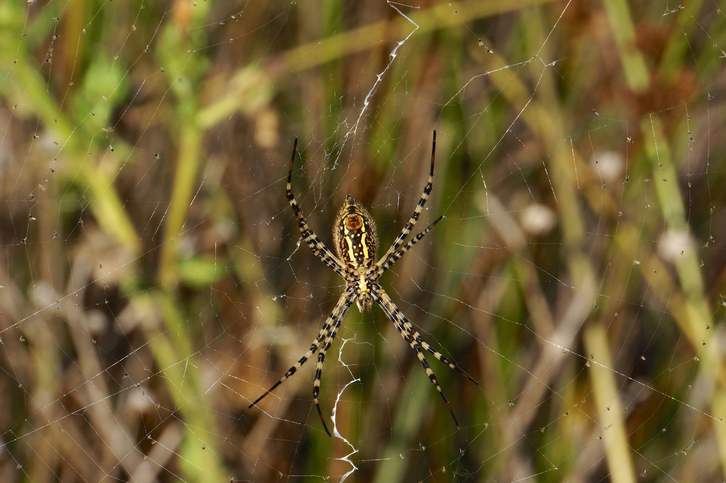
Terrestrial
Arthropods:
The Conquerors

Slide 2
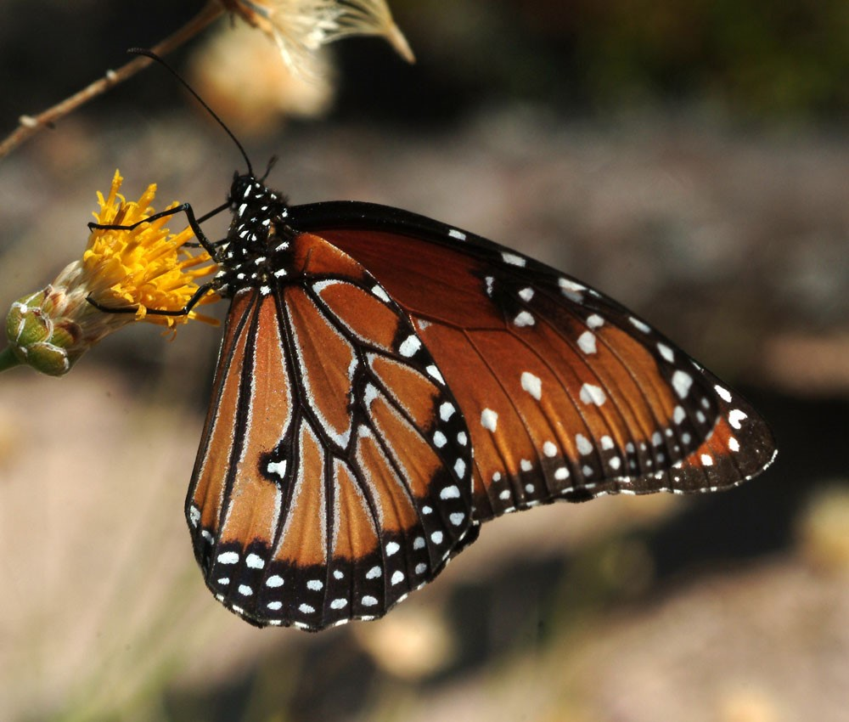
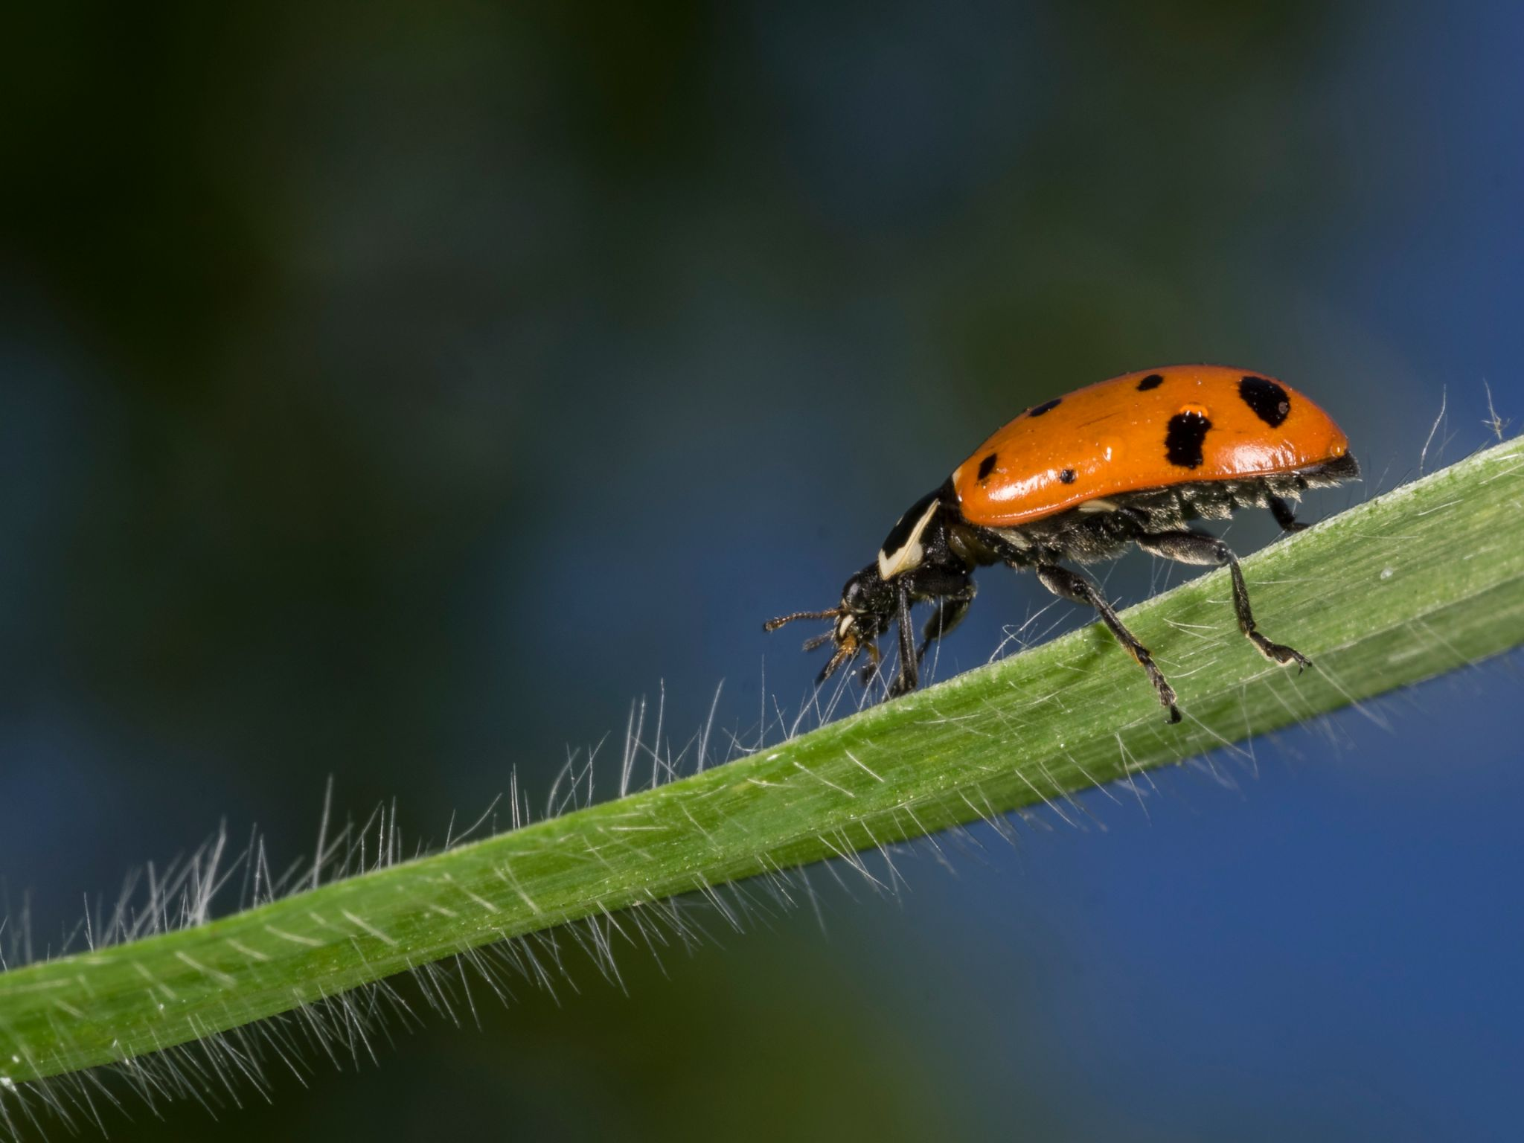
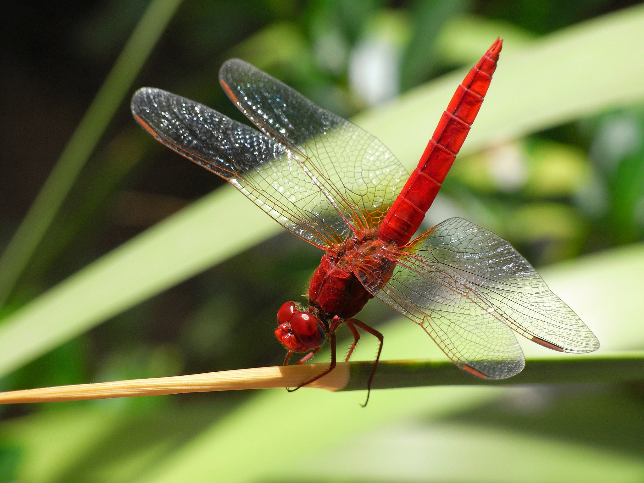
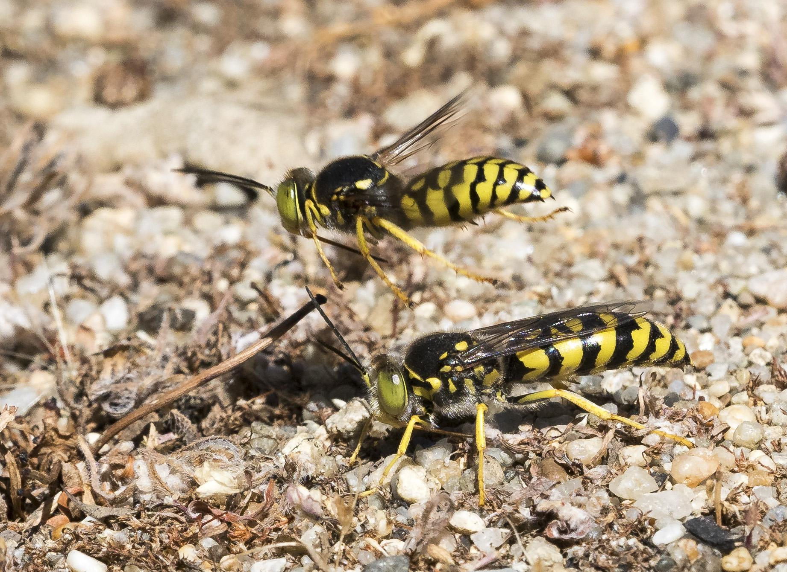
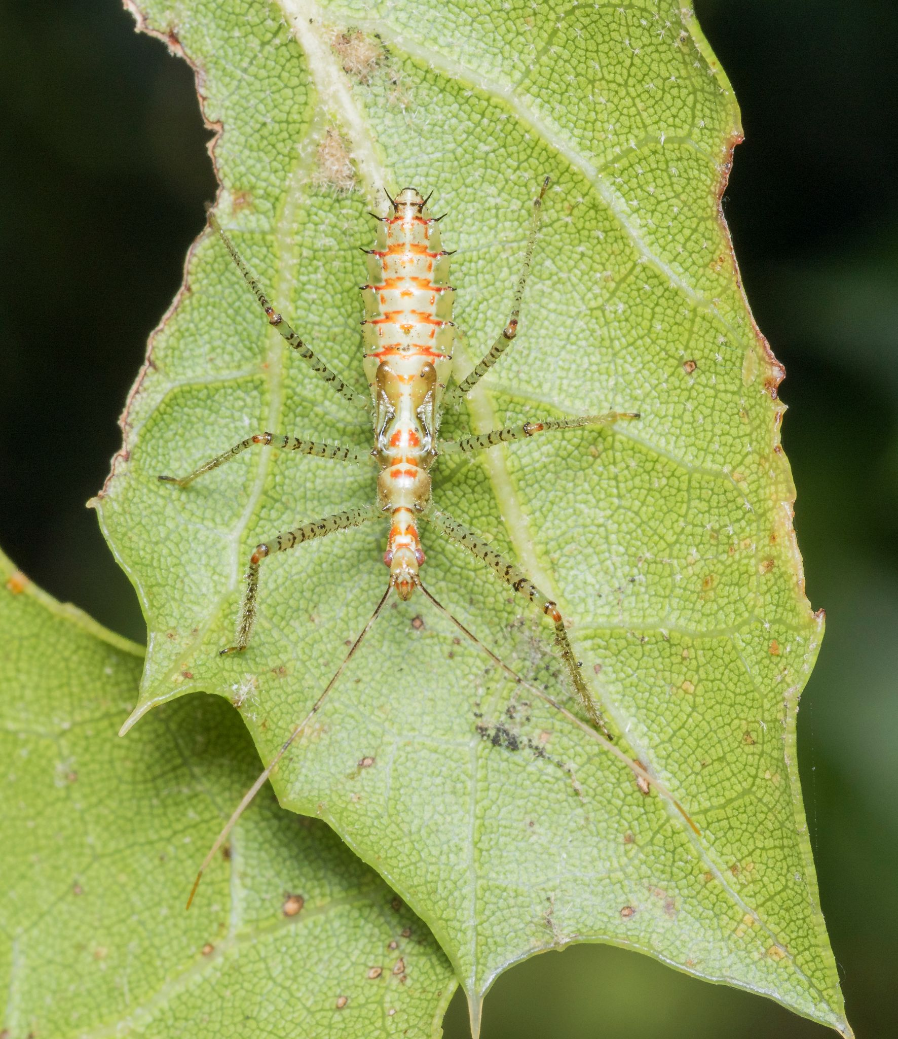
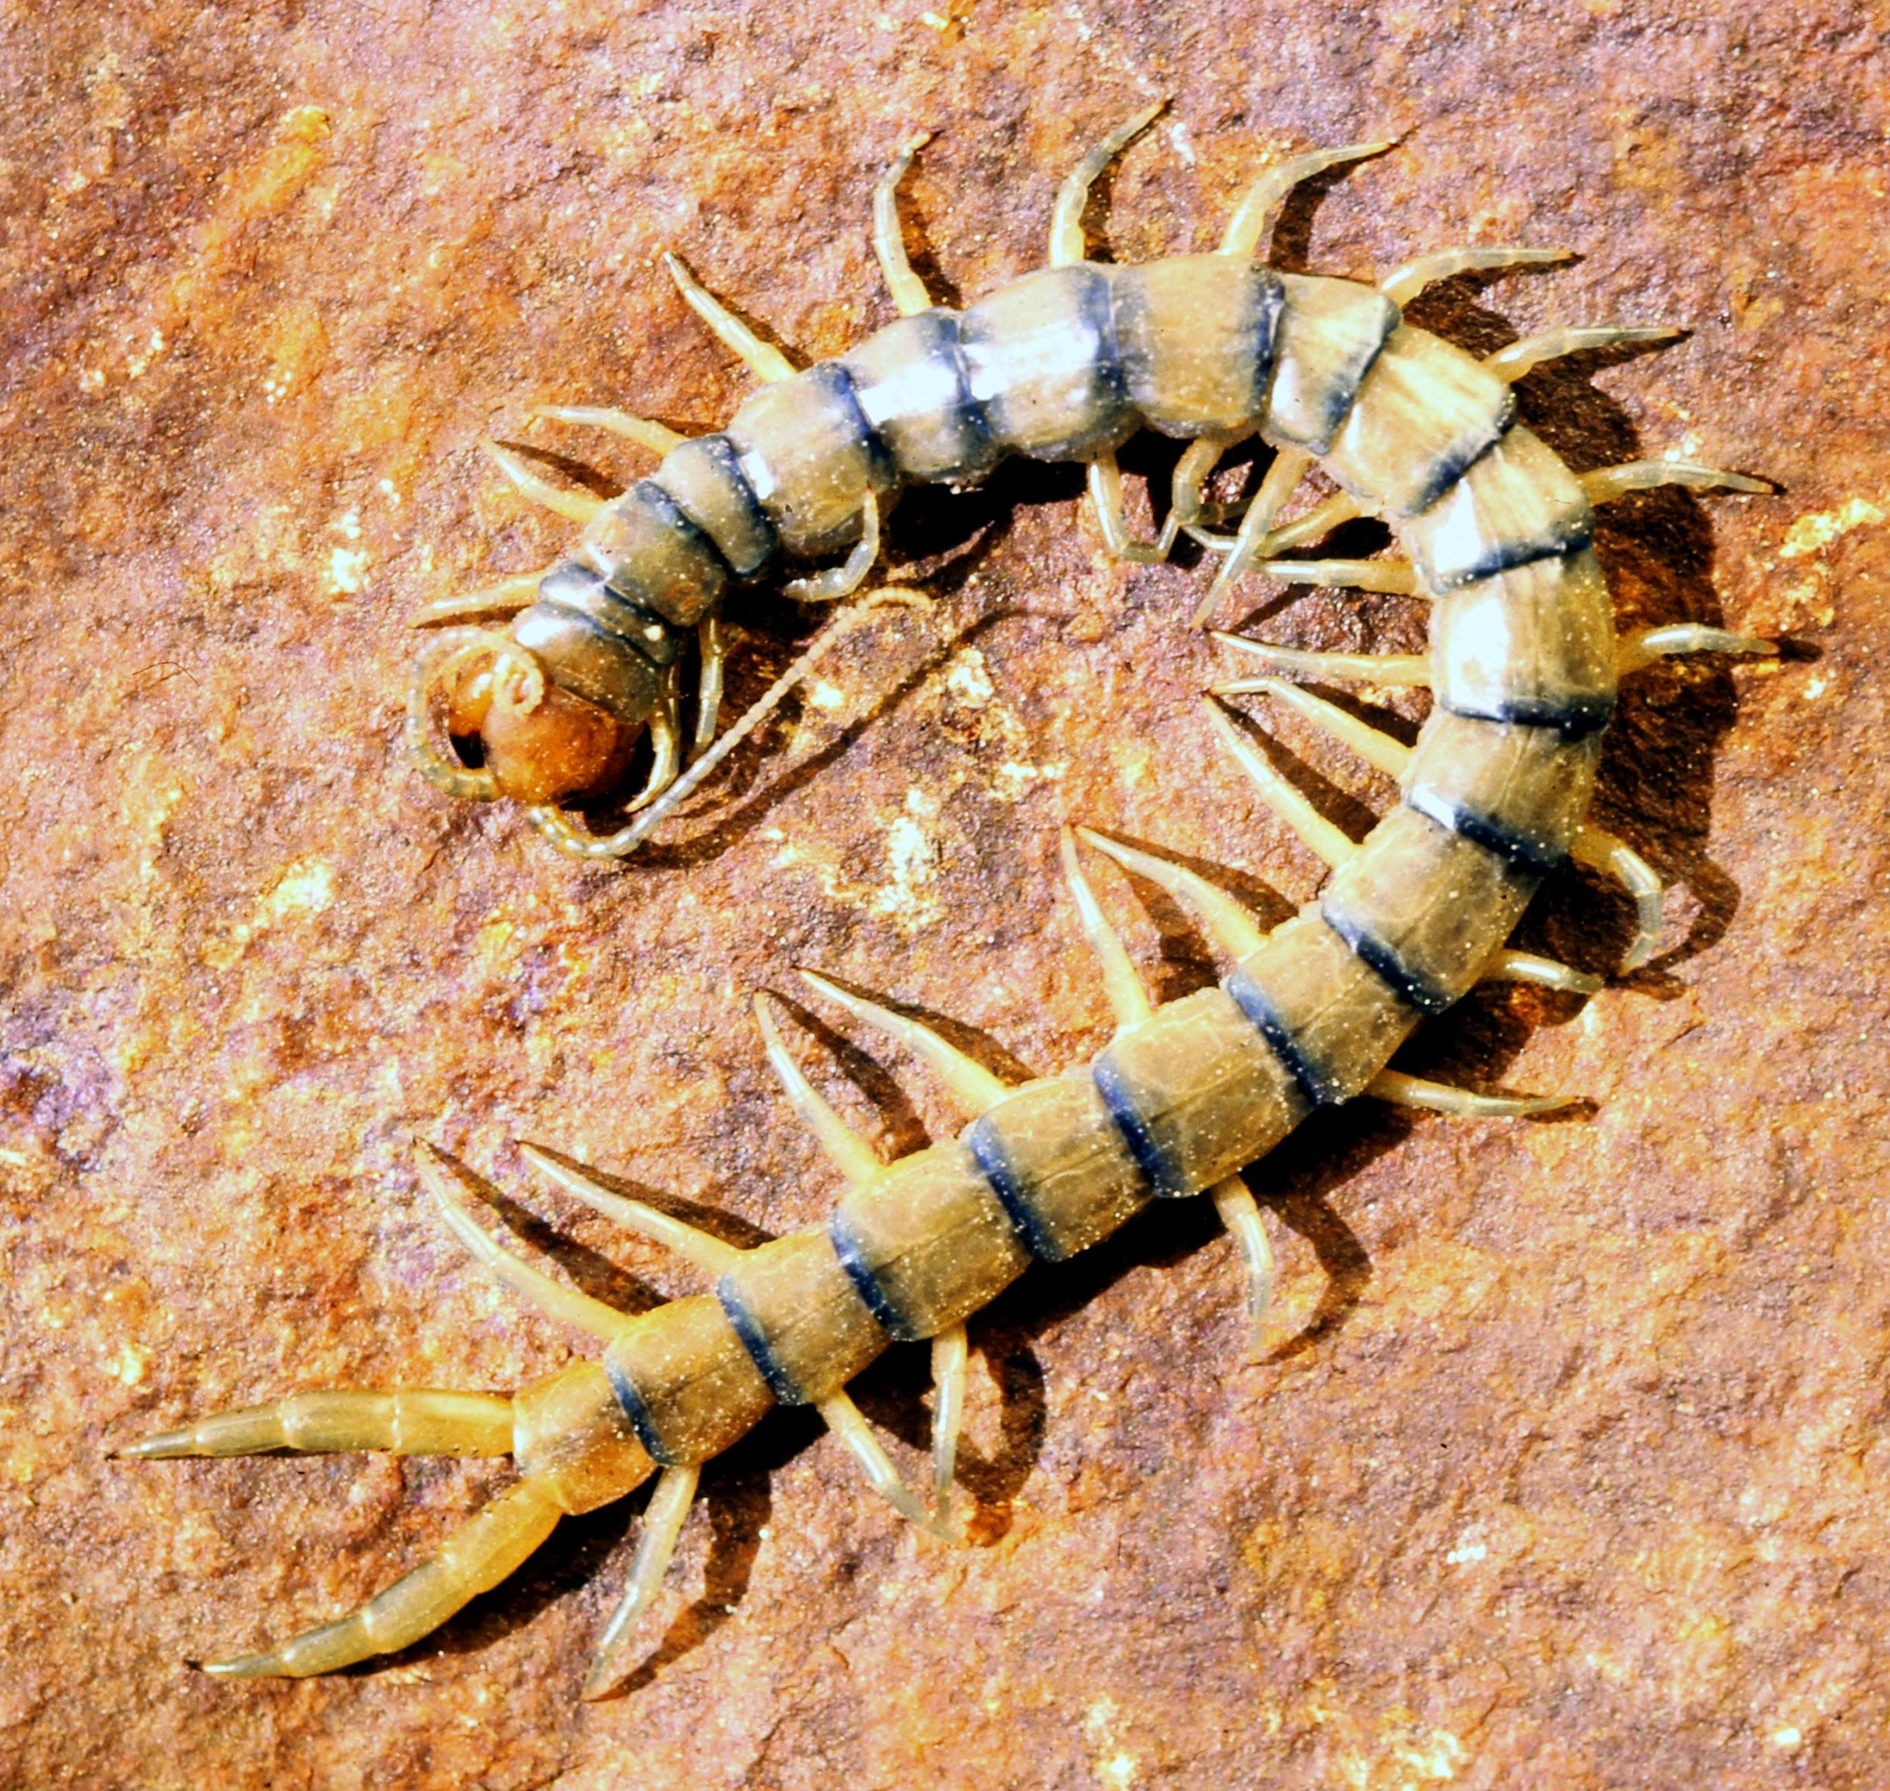
These Are Terrestrial Arthropods

Slide 3
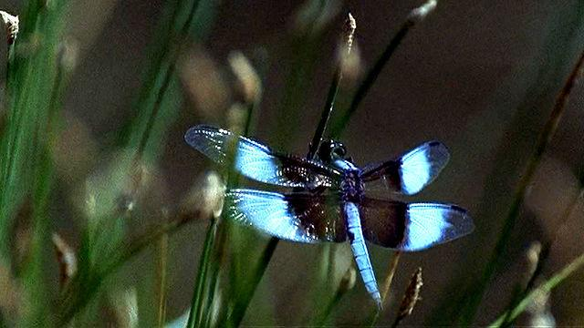
Watch Terrestrial Arthropods: The Conquerors. Take Notes And Answer the Following Questions.
Watch this video.

Slide 4
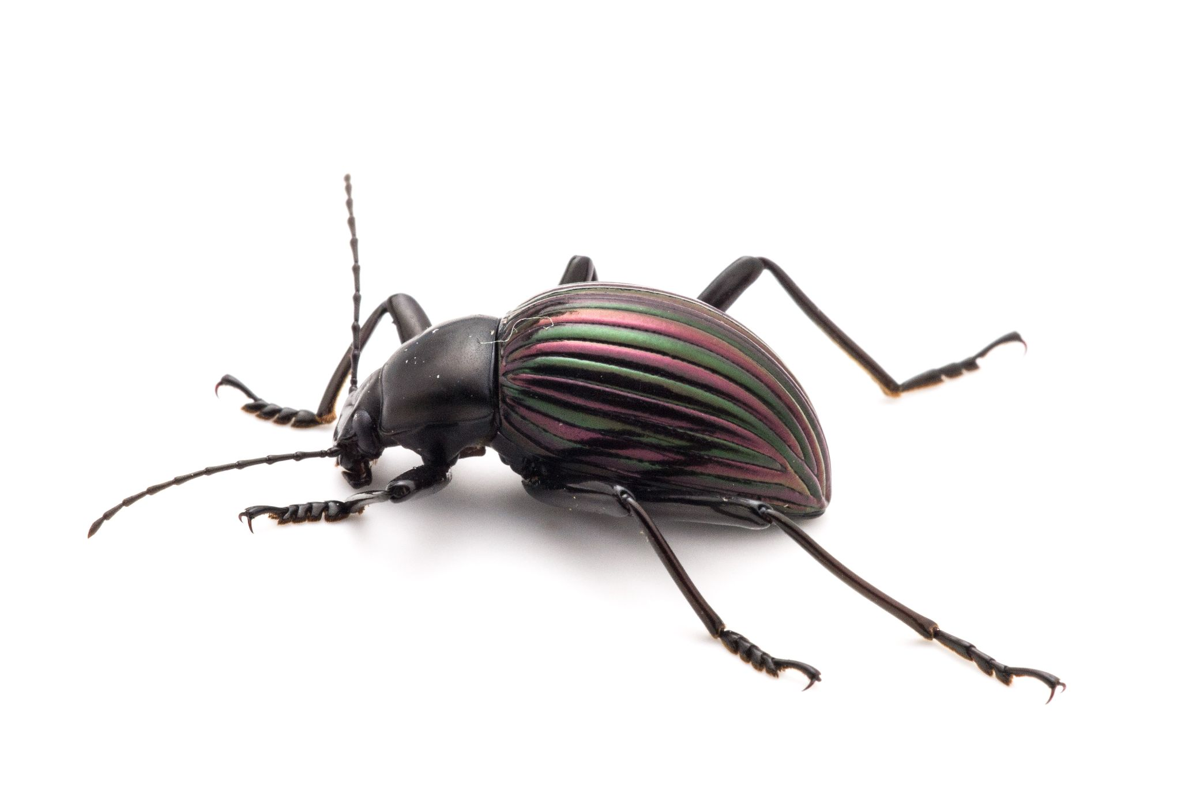
Appendages
What is special about arthropod
appendages?
What are the advantages of this
type of appendage?
List the different uses of arthropod
appendages.

Slide 5
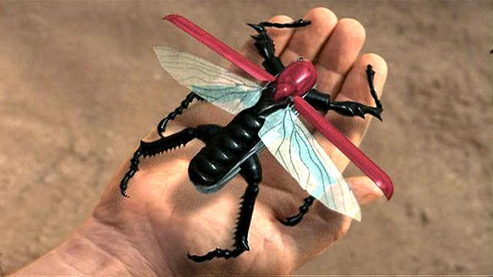
Body Plan
Watch this video.
How did arthropods succeed
In the arms race?
How is a Swiss Army knife a good metaphor for the arthropod?

Slide 6
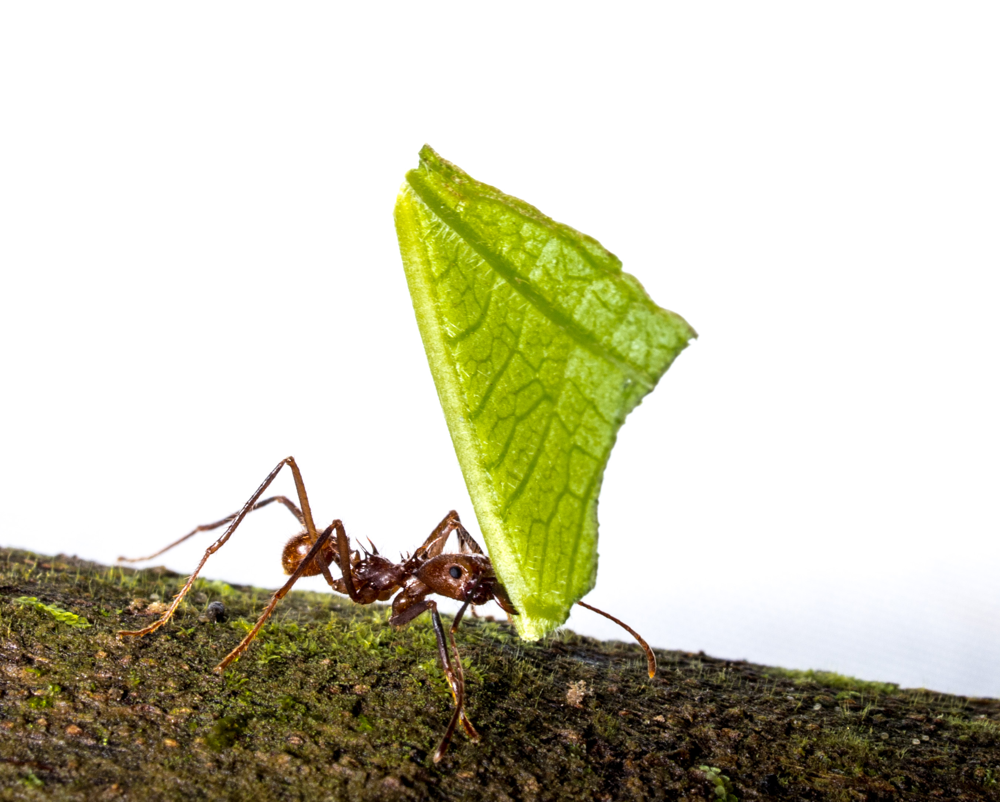
Breathing
Give two examples of different ways land arthropods breathe.
Why does the narrator use the word turbocharged to describe the tracheal system?

Slide 7
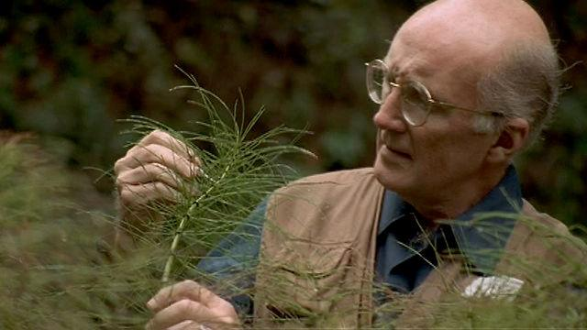
Coming onto Land
Watch How Arthropods Left the Sea
What habitat helped arthropods invade
land?
Why does Bill Shear think that arthropods invaded the land more than once?
.

Slide 8
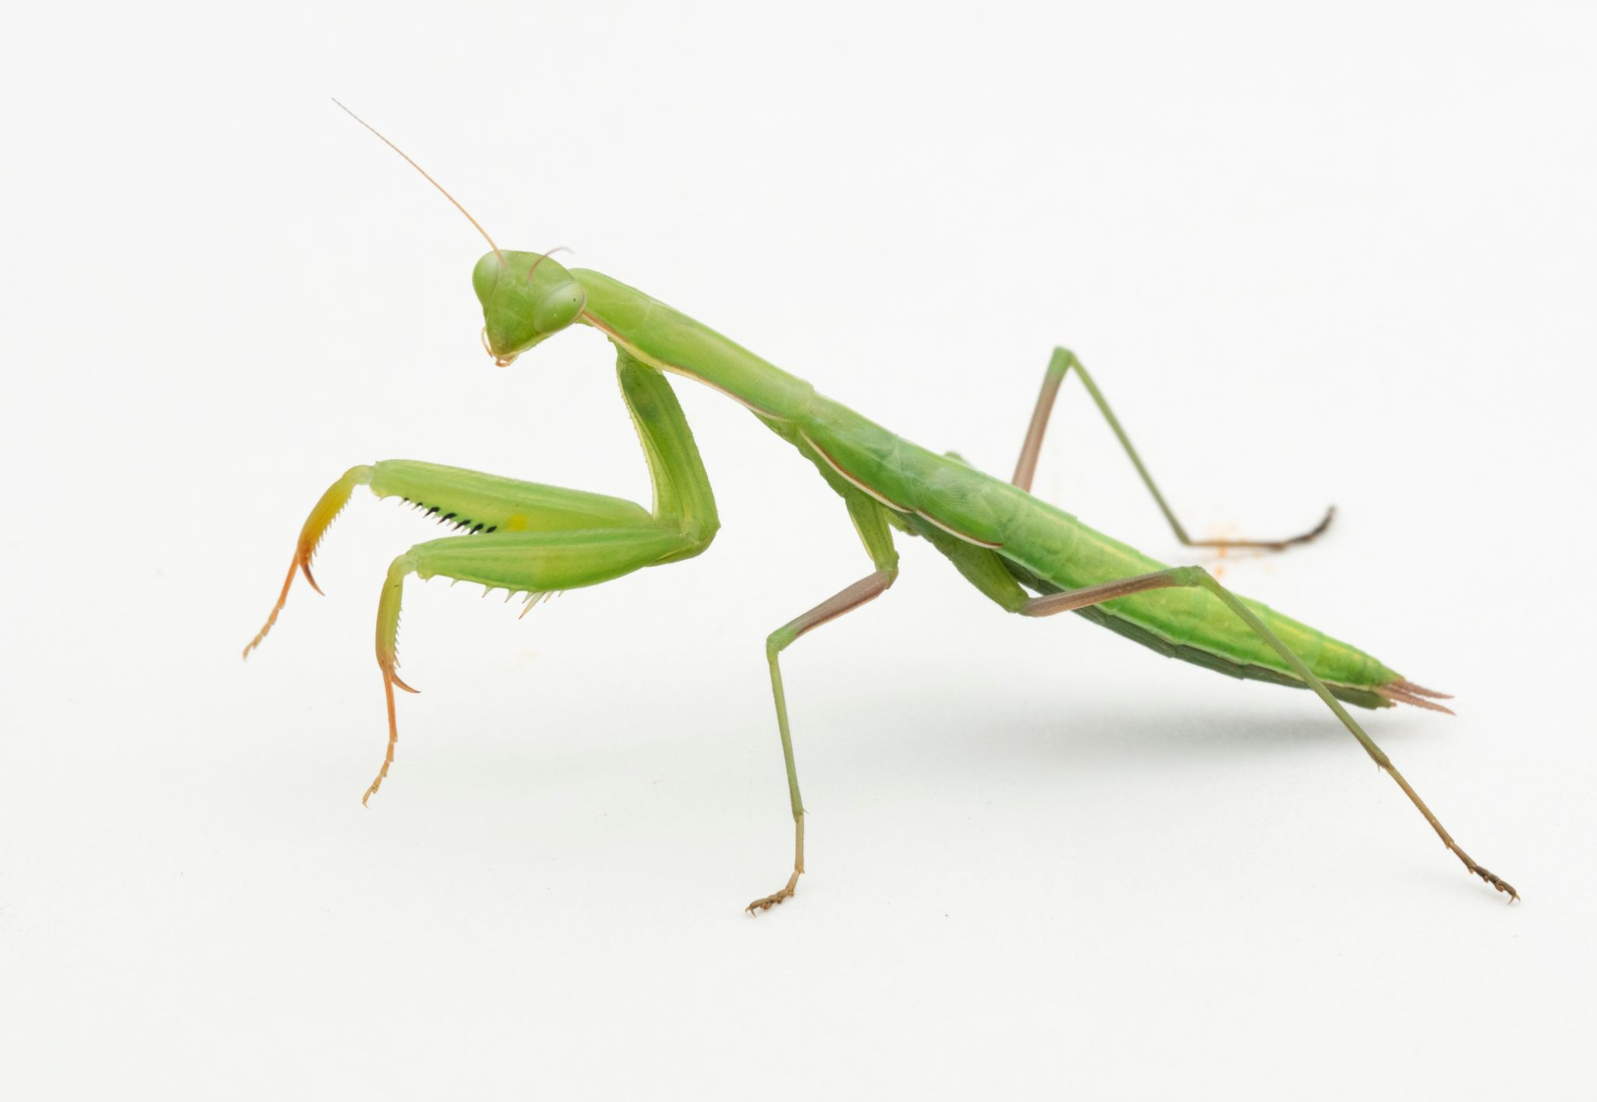
Coming Onto Land page 2
What features of the arthropod body plan allowed them to invade land?
What did the first land arthropods eat?

Slide 9
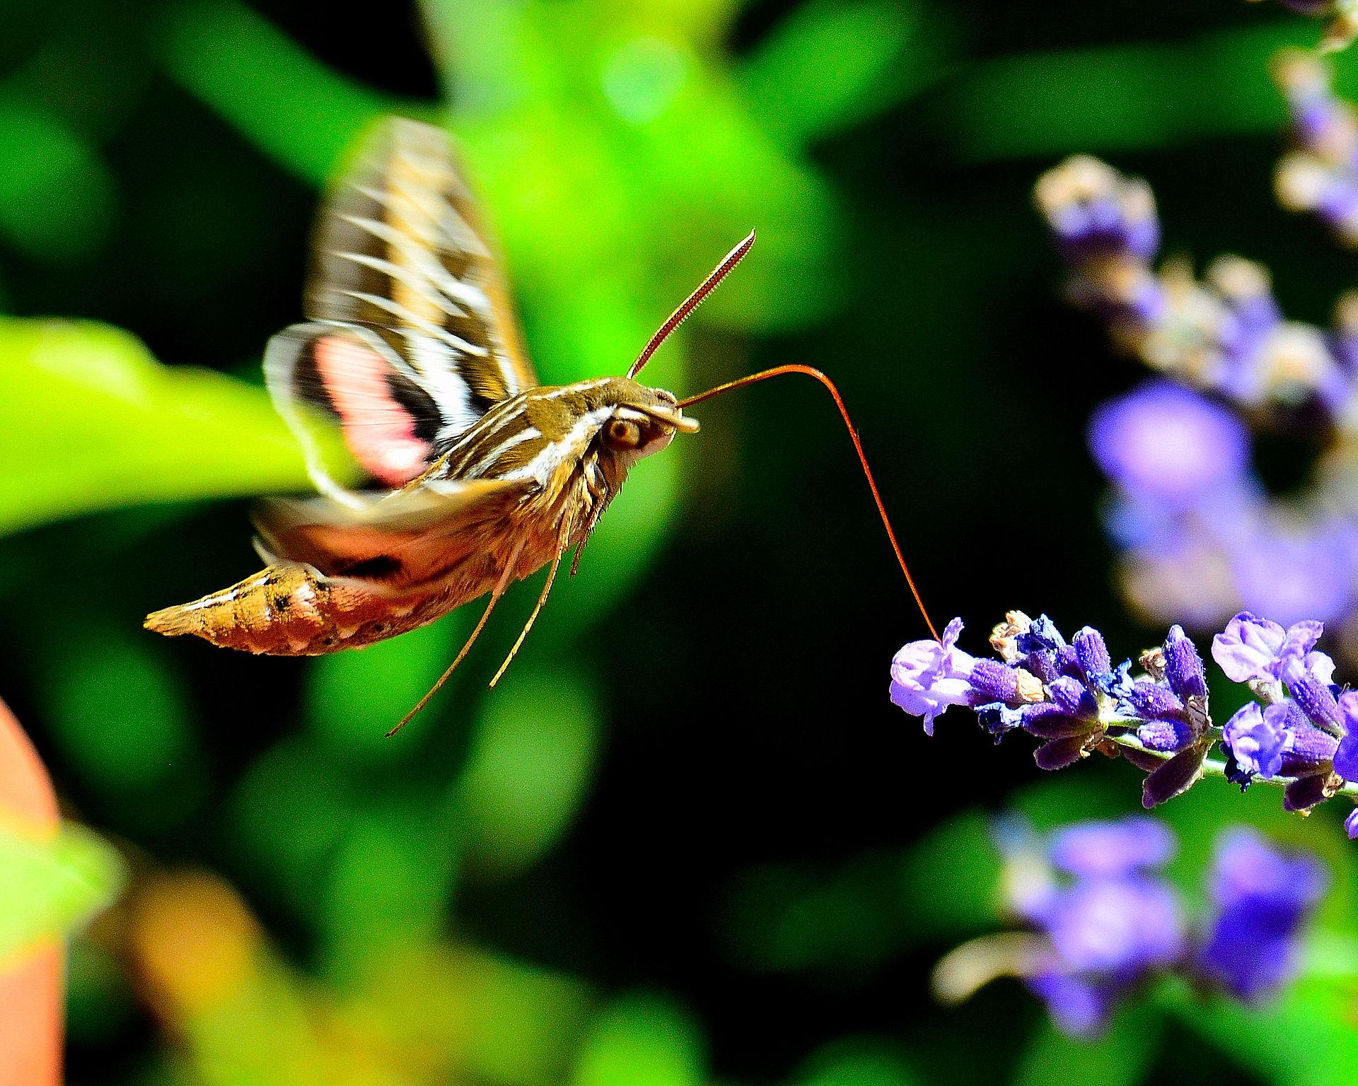
Feeding
Name three types of land arthropods and what they eat.

Slide 10
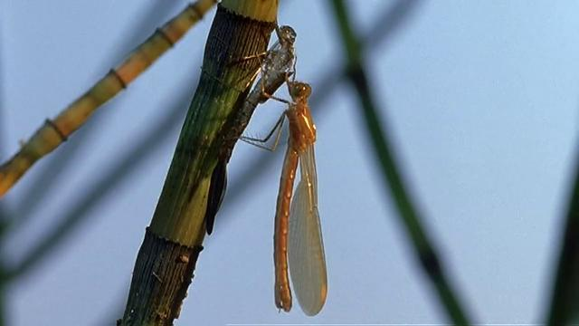
Metamorphosis
What is metamorphosis?
What are the advantages and
disadvantages of undergoing
metamorphosis?
What animals,
besides arthropods, undergo
metamorphosis?
Watch this video

Slide 11
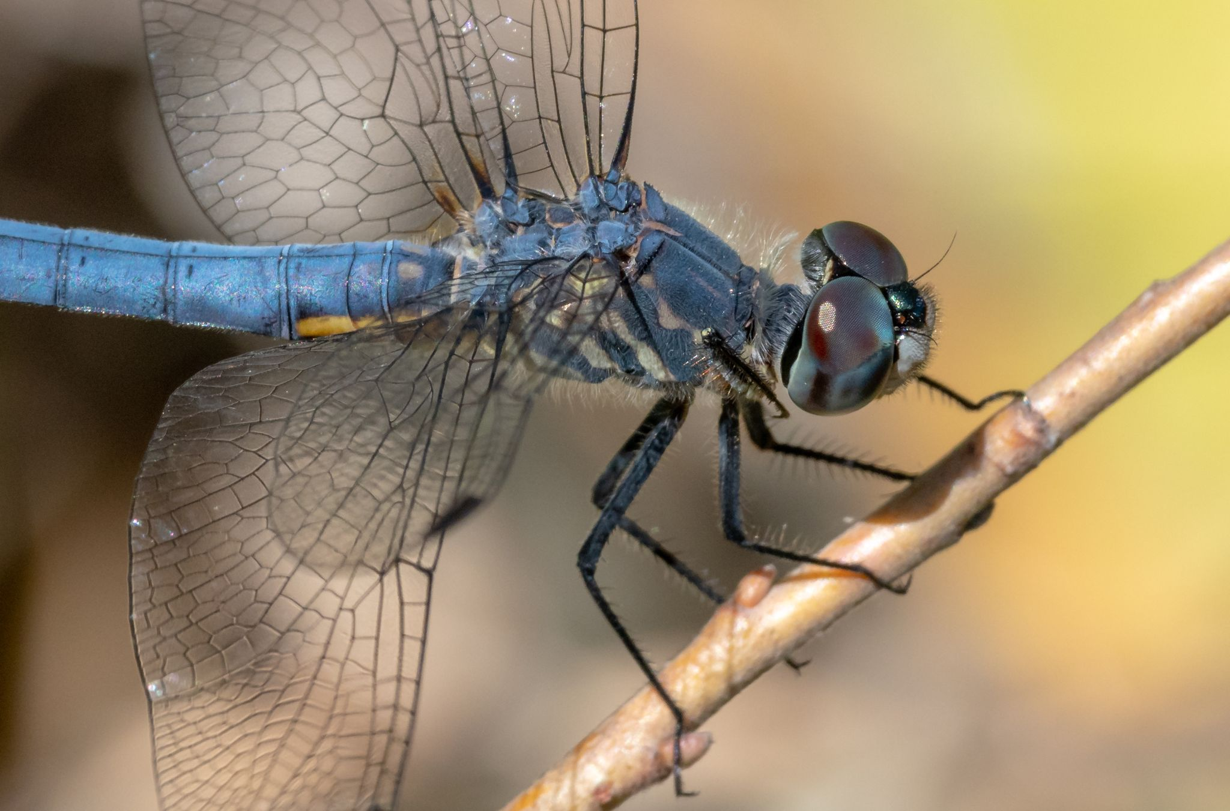
Dragonflies
Where do dragonfly larvae live?
What changes do they go through during metamorphosis?
What are the advantages to having a freshwater larva?
Why do you think dragonflies haven’t changed in millions of years?

Slide 12
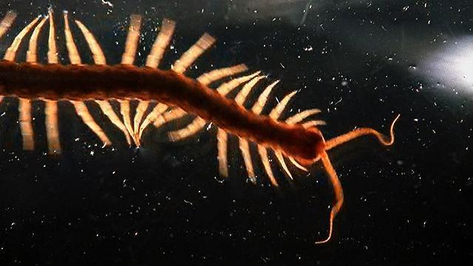
Locomotion
Watch this video
What about their body plan makes arthropods both stable and fast?
How do the skeleton and jointed appendages help control their locomotion?
Why does their design make a good robot?

Slide 13
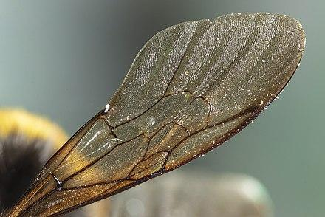
Wings
Why was the evolution of wings so important for arthropods?
Why do you think the leading edge of a
wing is thickened?

Slide 14
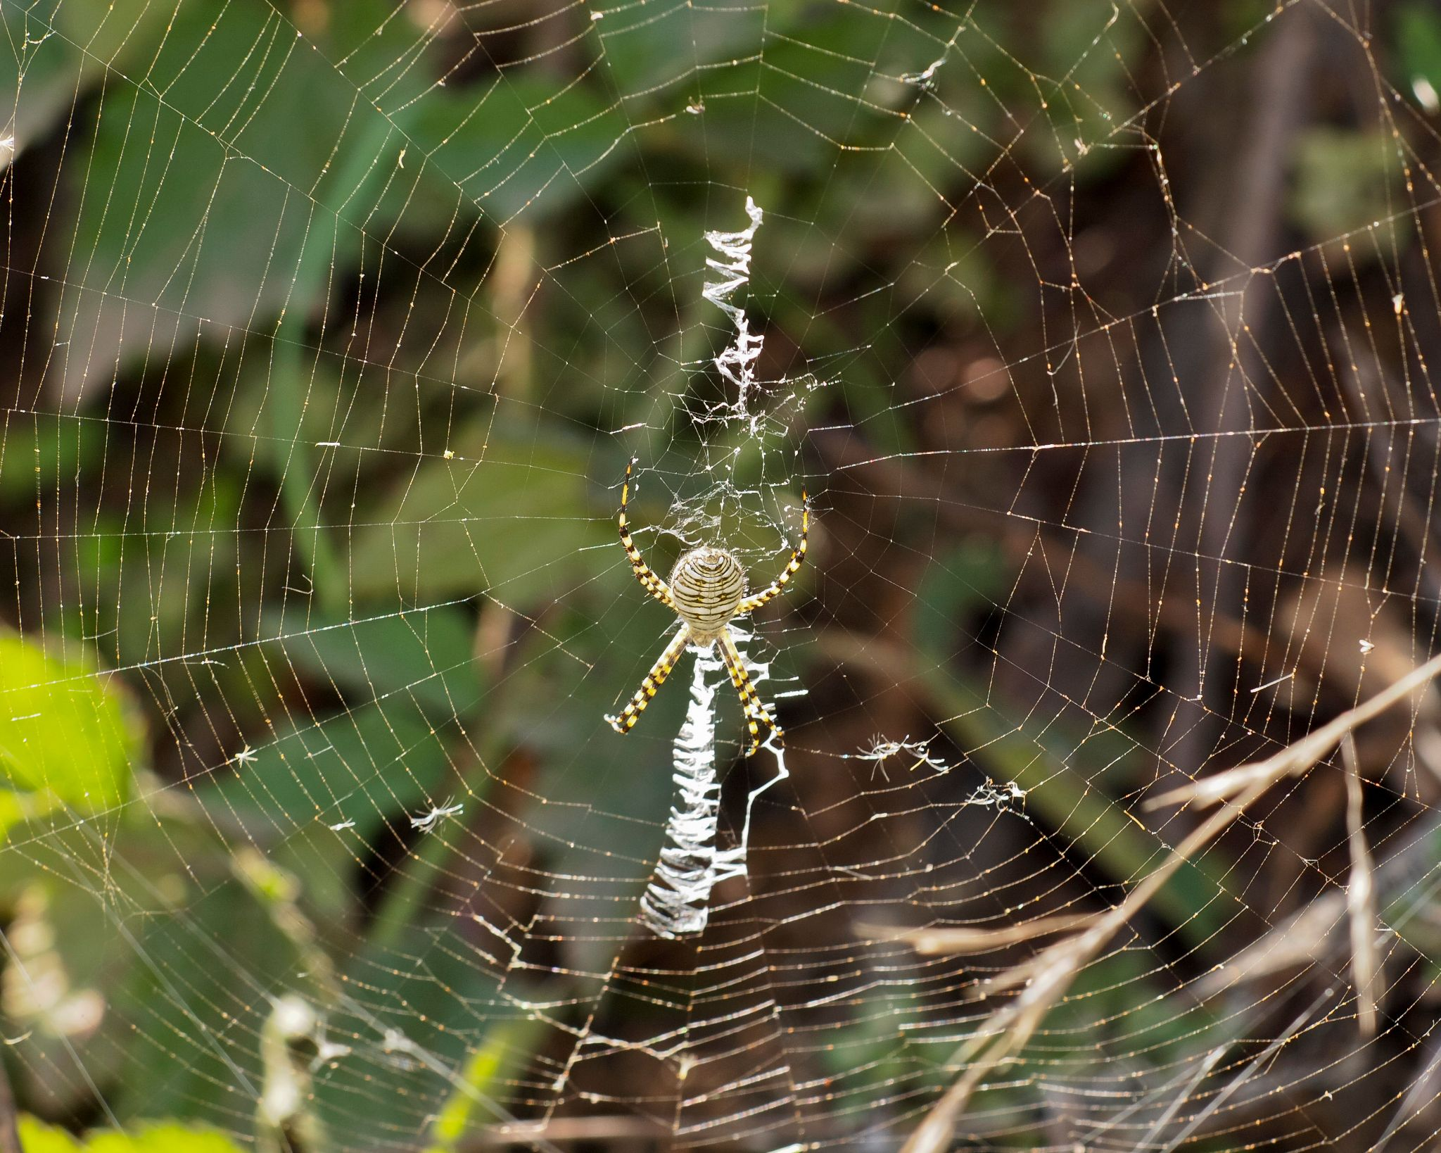
Spiders
What innovation did spiders develop?
What advantage does this give them?

Slide 15
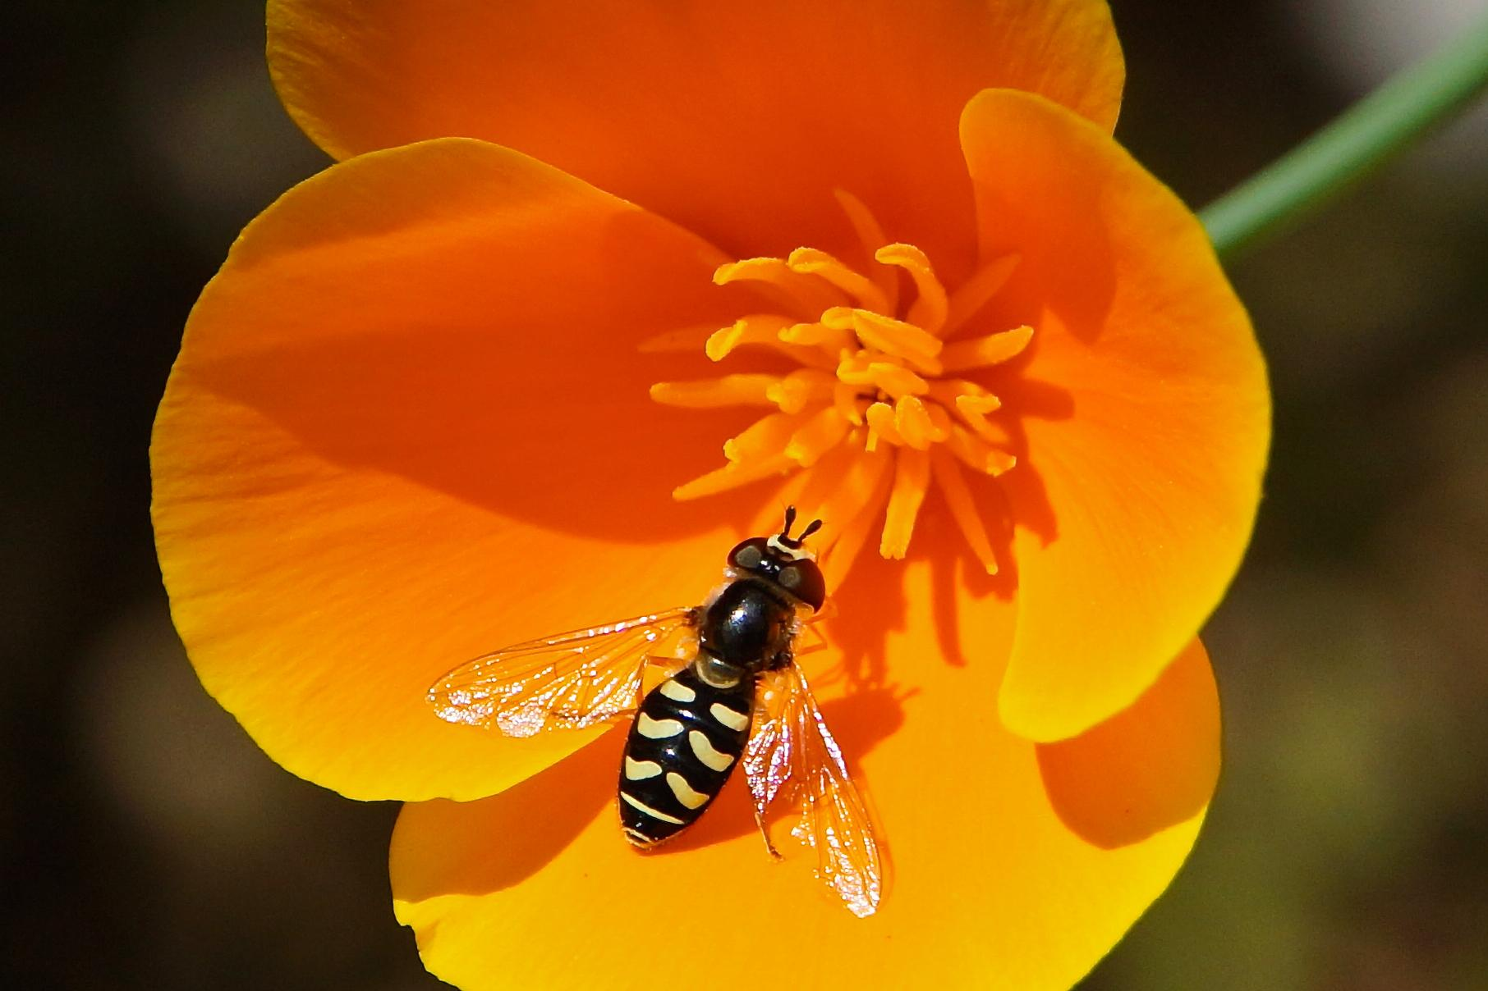
We Need Insects
What are the majority of animals on earth?
Write a few sentences describing three roles that insects play in the natural
world to help maintain ecosystem services.

Slide 16
Vocabulary
Define in your own words these vocabulary words at the end of the video.
Appendage Molting
Antenna Diversifying
Exoskeleton Gill
Segmentation Hydrothermal vent

Slide 17
Photo Credits
Thanks to Jack Nowicki for the following photos:
Sand wasp courting behavior-Slide #2
Nymph of a bug (Hemipteran)-Slide #2
Ladybird beetle in search of prey-Slide #2
Darkling beetle (a Tenebrionid)-Slide #4
Leafcutter Ant #6
Praying mantis-Slide #8
Blue dasher-Placydipthax longipennis-Slide #11
Banded spider in web-Slide #14

