Slide 1
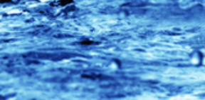
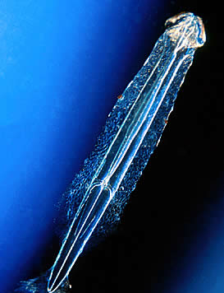
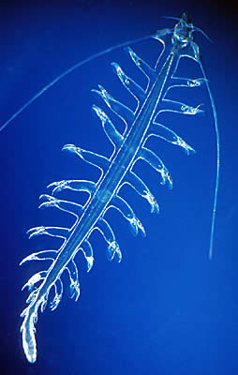
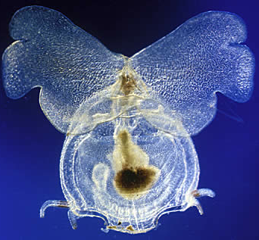
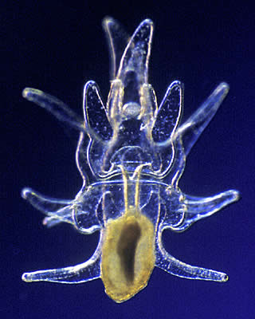
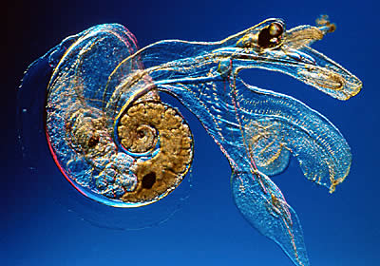
“In one drop of water are found all the secrets of the endless oceans.”
Kahil Gibran

Slide 2
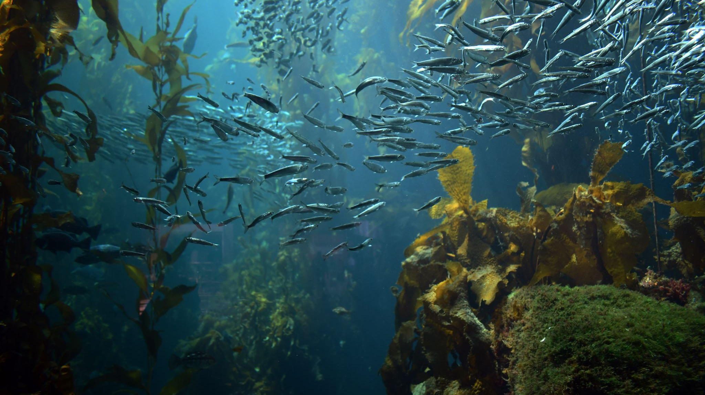
Rarely do we see what’s living beneath the water

Slide 3
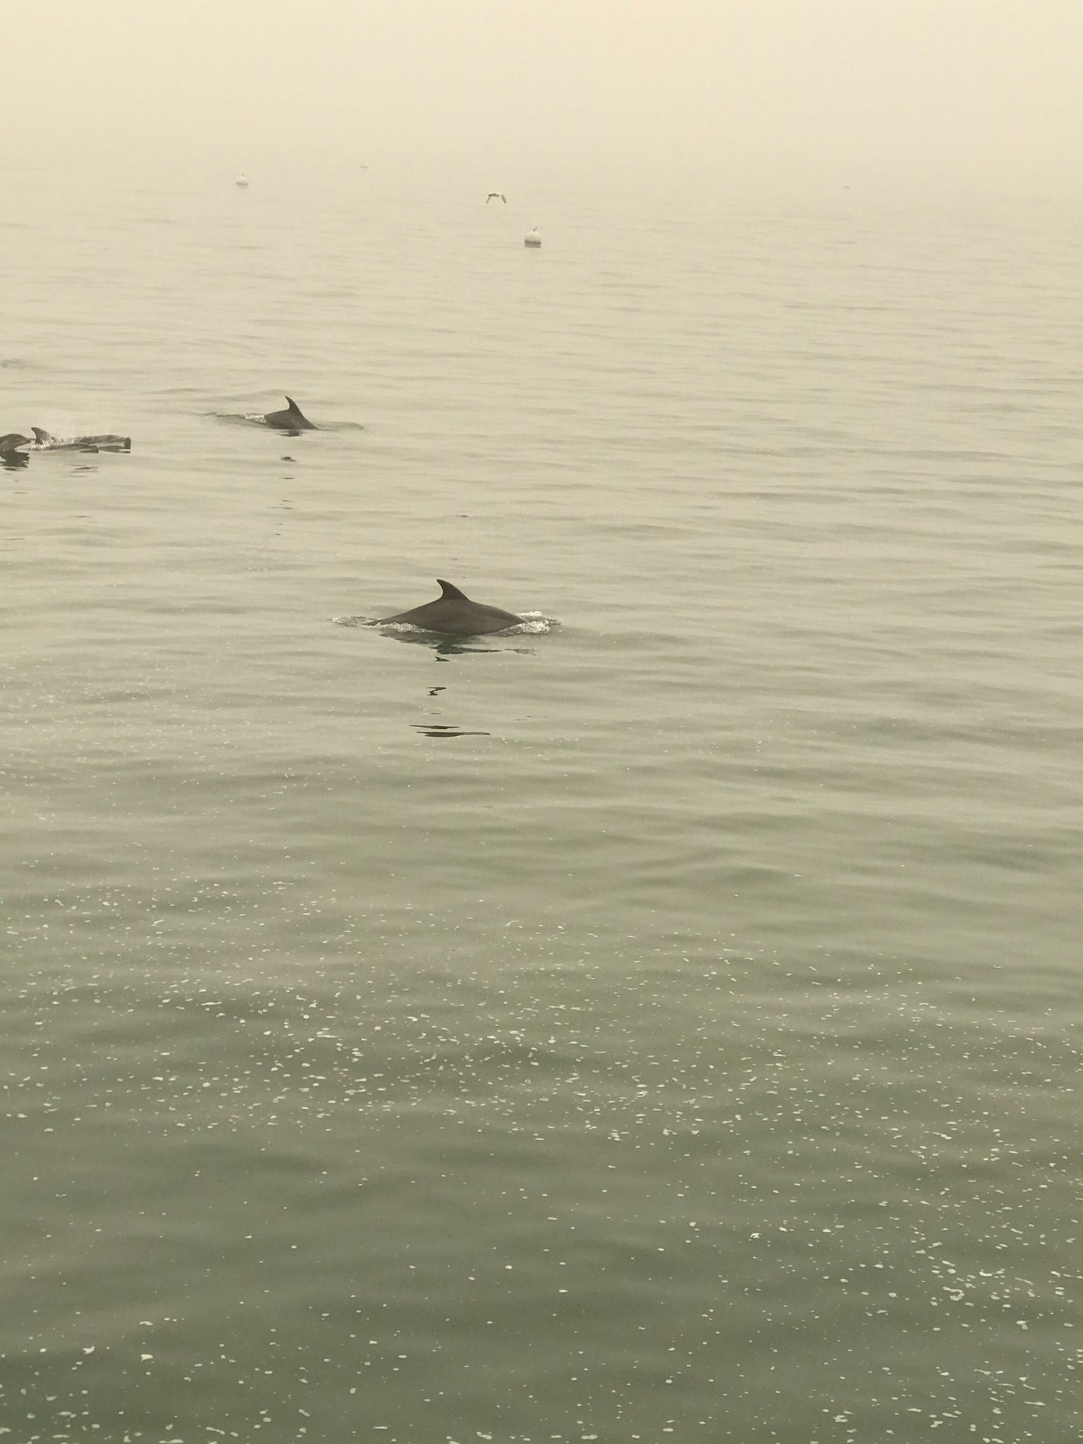
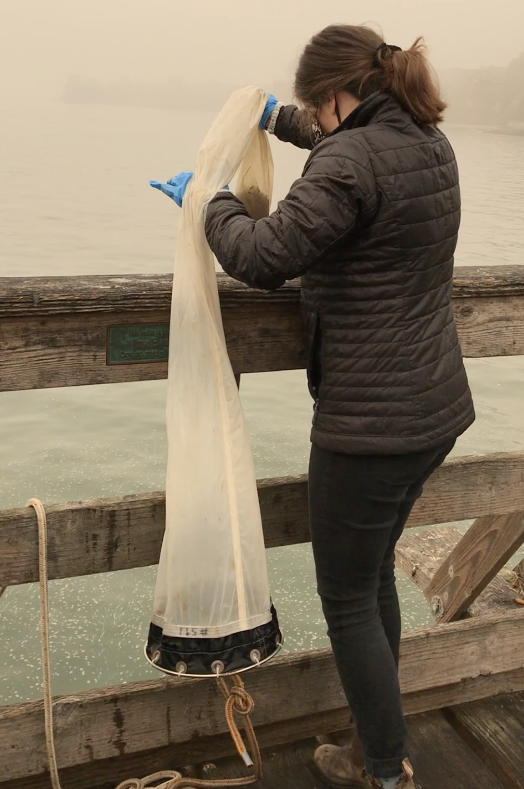
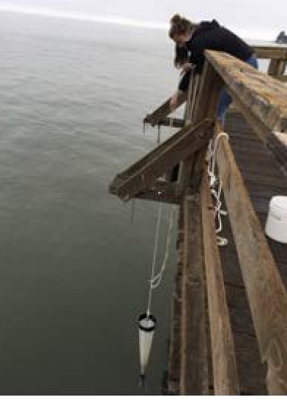
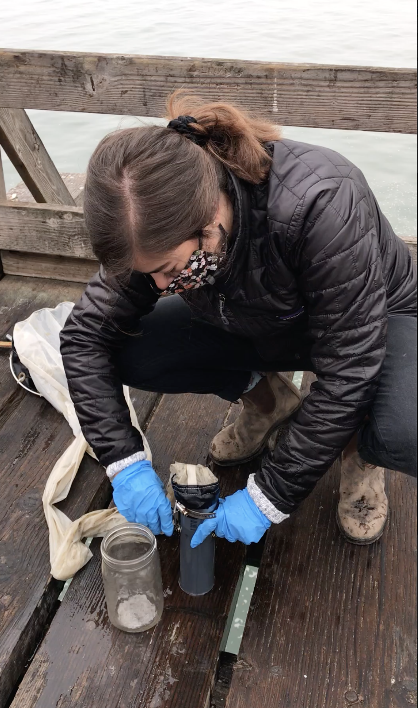
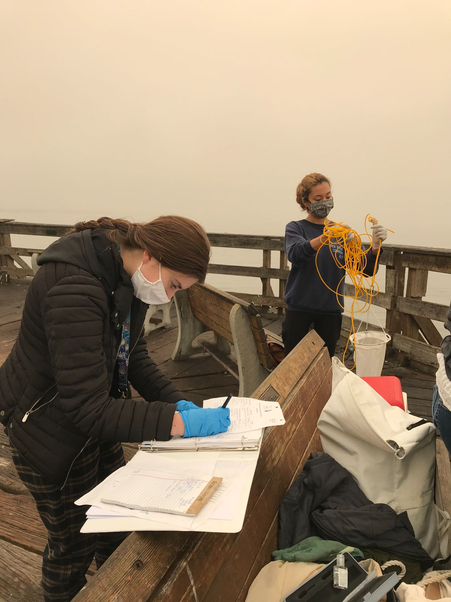
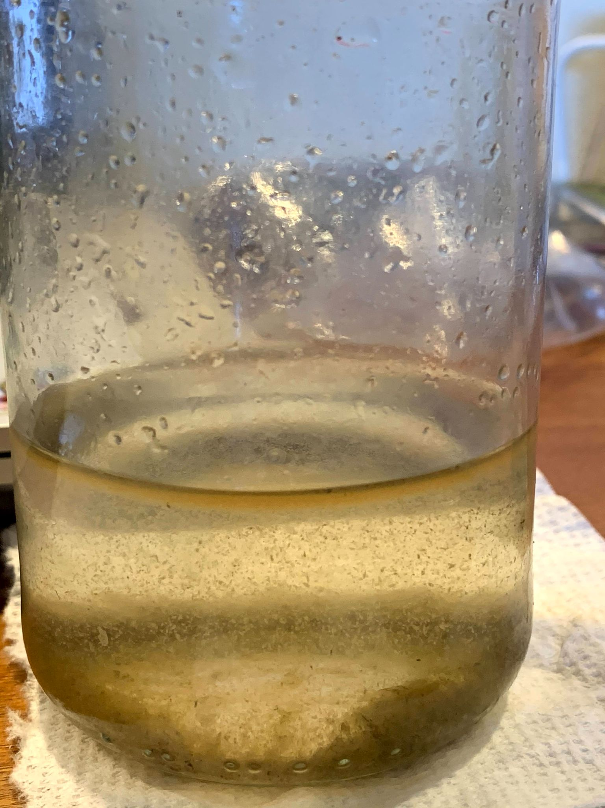
We need special tools in order to see the microscopic world that lives within each drop of water

Slide 4
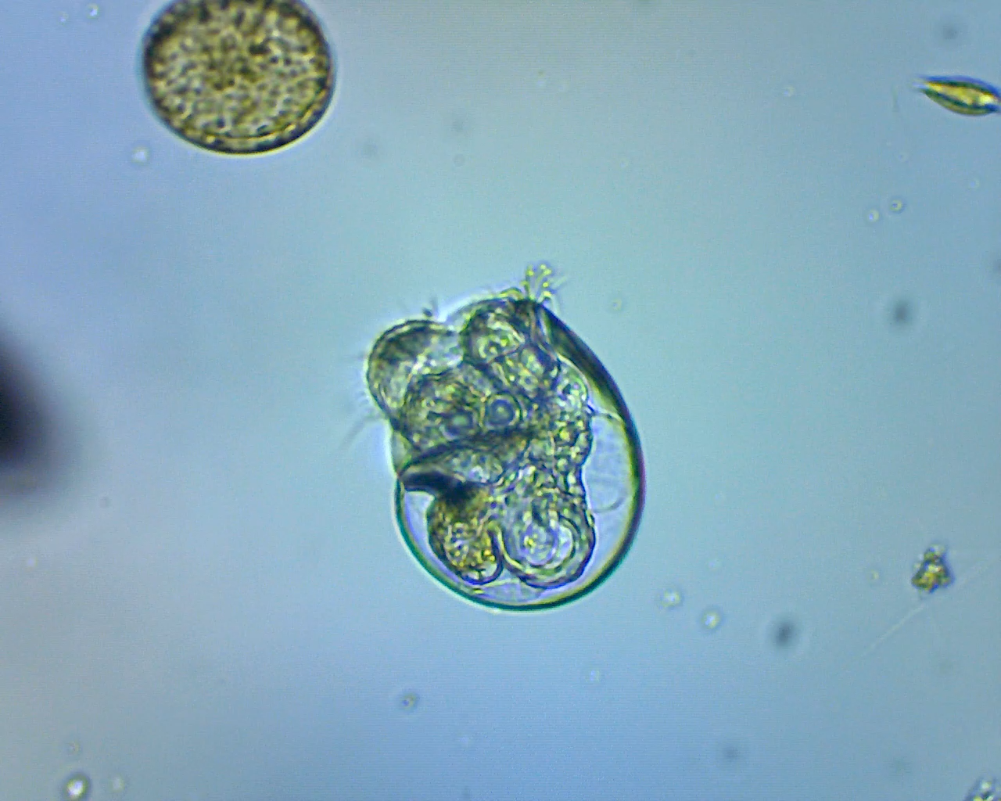
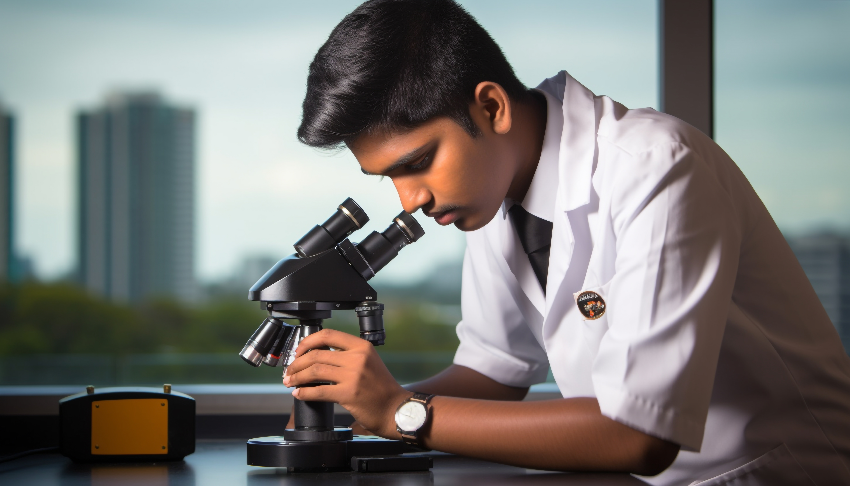
Looking at a drop of seawater
Opens up a whole new world!
Video of sample collected 4.20.23 by Clive Bagshaw Pacific Plankton Program, Santa Cruz CA

Slide 5
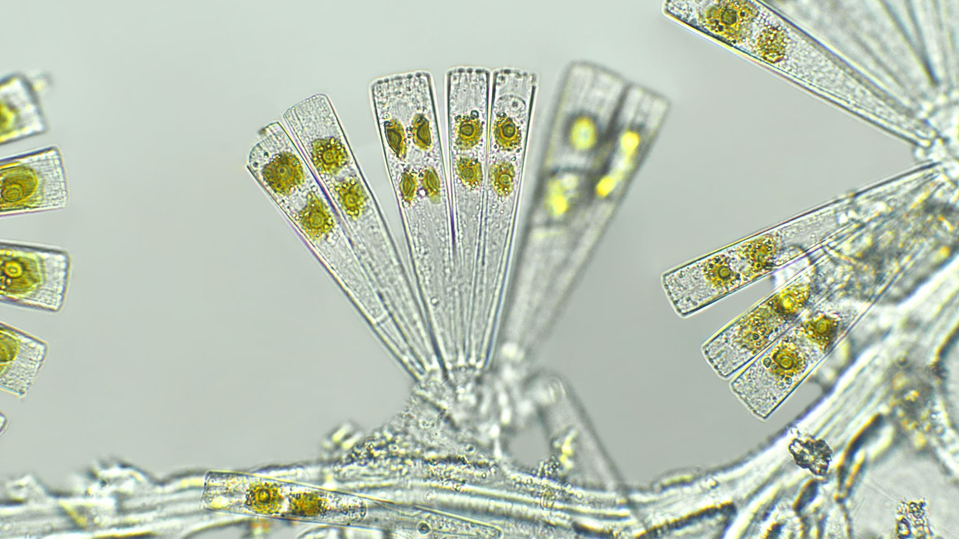
Plankton is a general term for all aquatic (fresh or salt water) organisms (both microscopic and large) that are drifting at the mercy of the major currents.
In this lesson we are focusing mostly on the microscopic zooplankton found in the ocean .
What is PLANKTON?

Slide 6
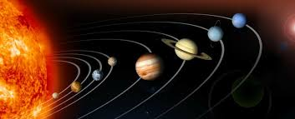
Plankton = “planktos” or Wanderer
Like the planets wandering in the solar system
plankton comes from planktos – Greek for wanderer
Plankton are at the mercy of the major ocean currents
* How many of you have been plankton?
Notes:
At this point you can ask your students if they’ve ever been in river or ocean where they’ve been pulled out by a strong current. If so, then they’ve been plankton! Author (Jane K.S.) was 16 years old when a rip tide carried her out to sea off the coast from Stinson Beach – I was definitely at the mercy of the major current!

Slide 7
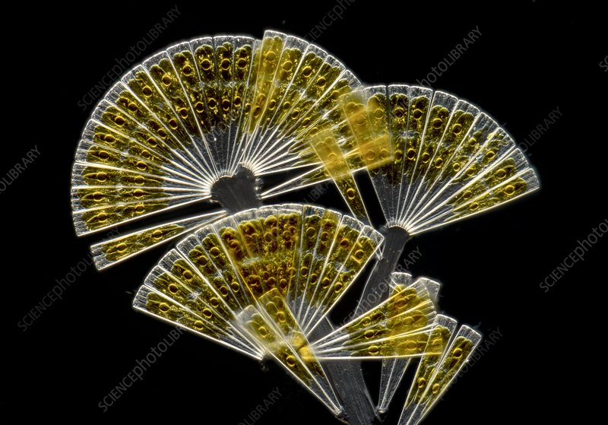
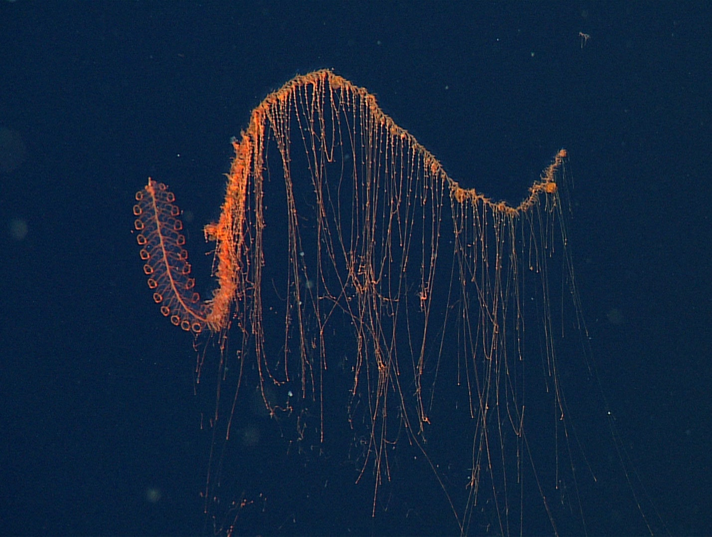
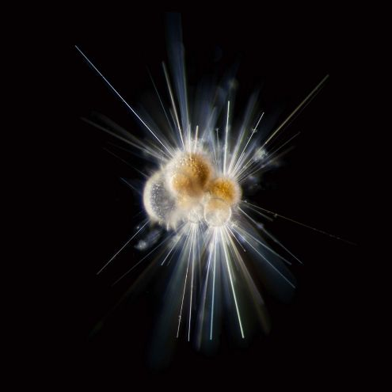
Plankton can be small or large
Fresh water or salt water
Tiny, microscopic algae or even smaller bacteria (Sardet photos)
100+ foot long siphonophores
MBARI PHOTOS
Notes:
Siphonophore photos are all from MBARI – Monterey Bay Aquarium Research Institute

Slide 8
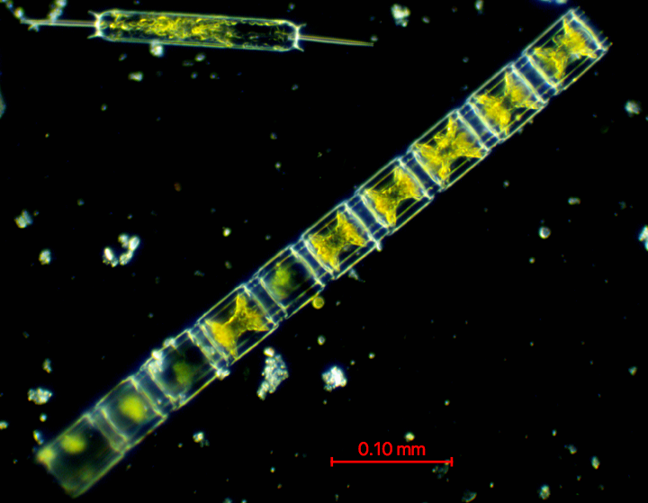
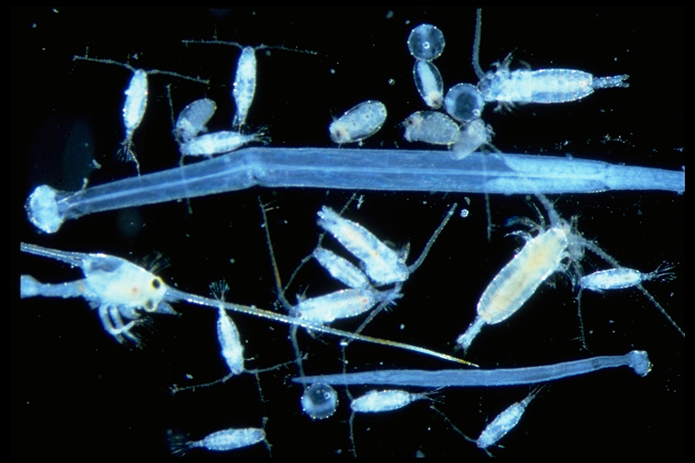
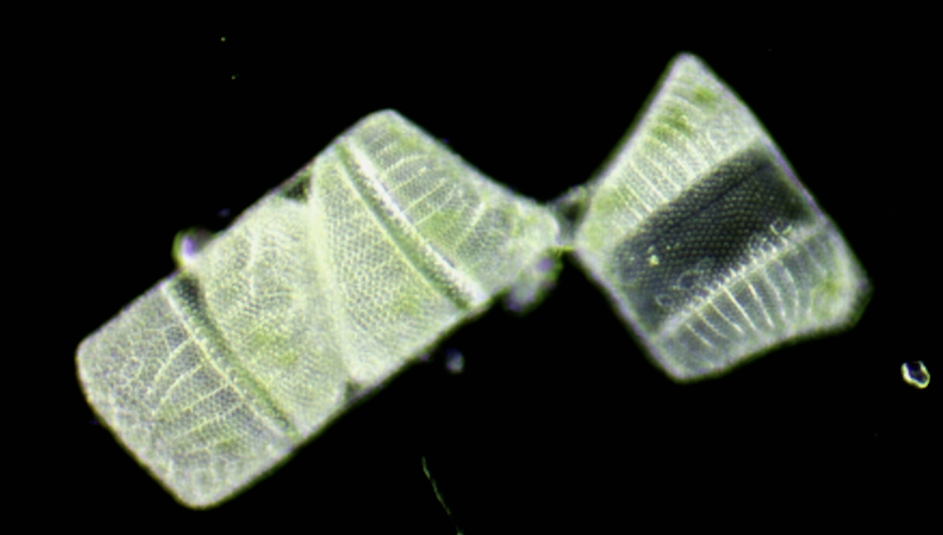
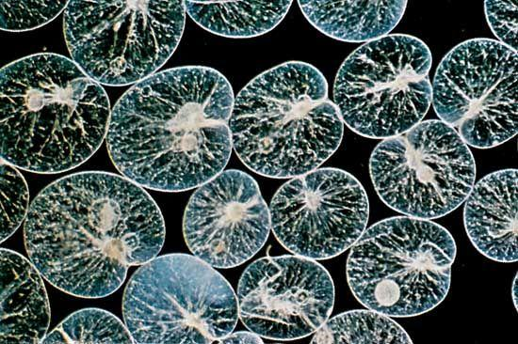
All plankton are not the same…
Phytoplankton = plant plankton
Zooplankton = animal plankton
Diatoms
Diatoms
Zooplankton community
MBA
Notes:
Phytoplankton – Ditylum and chain diatom (Lithodesmium) by Jasmin Ruiz; Isthmia by JKS; group of Noctiluca Jasmine Ruiz; Protoperidinium sp. JKS
Possible script: Some drifters or plankton make a living by converting the energy from the sun into their food or carbohydrates through photosynthesis – they need sunlight, carbon dioxide from the water/air and minerals from the water – they make their own food! In each of these images of phytoplankton you see either green, yellow/green or pink/red in the phytoplankton: these are the chloroplasts that undergo photosynthesis. The chloroplasts have various types/colors of chlorophyll (diatoms have a and c) Diatoms alone produce 20-30% of the air we breathe.
Dinoflagellates, like Noctiluca and Protoperidinium sp.
of

Slide 9
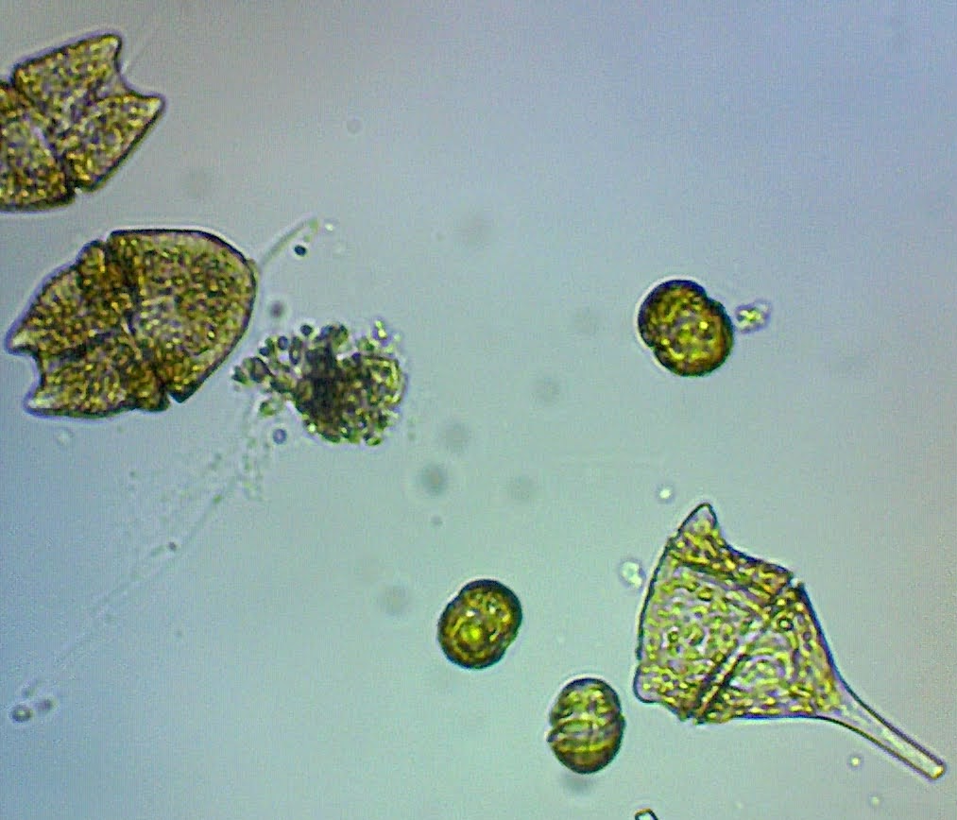
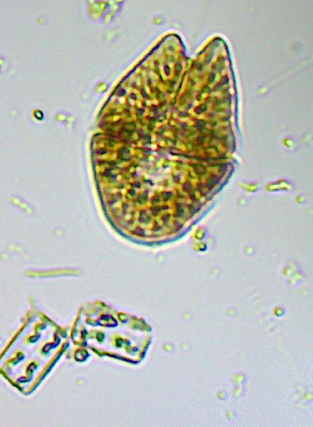
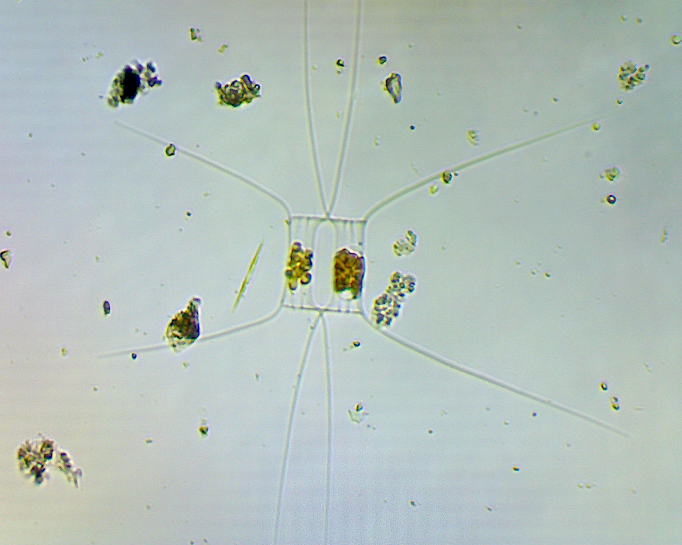
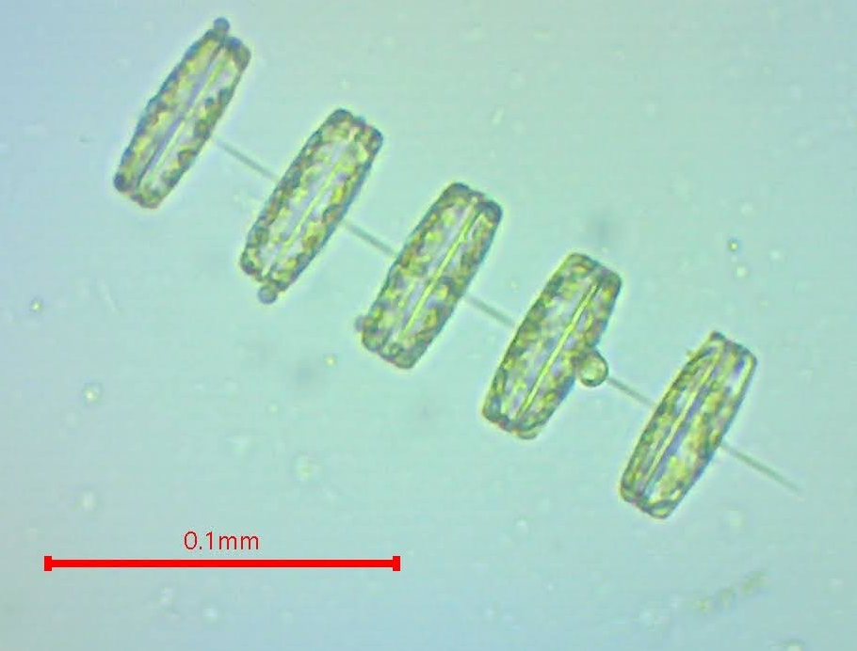
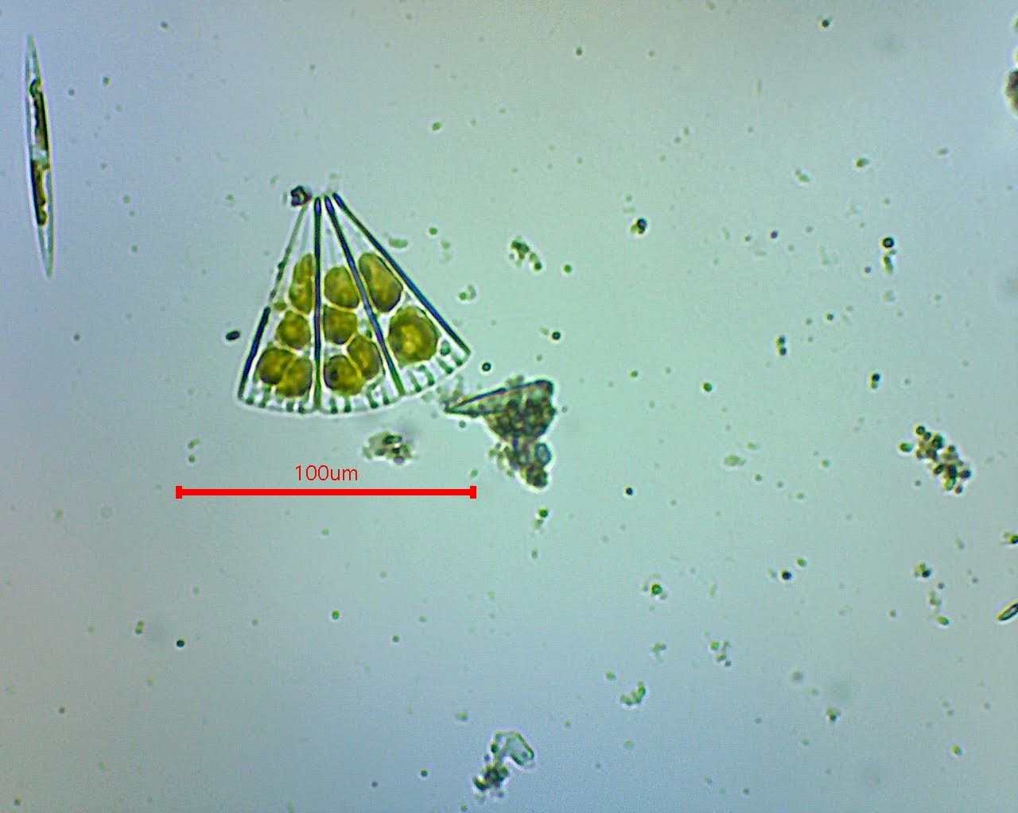
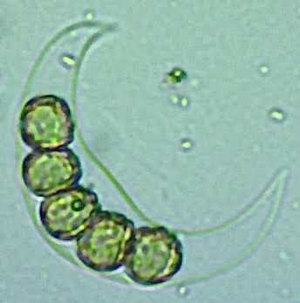
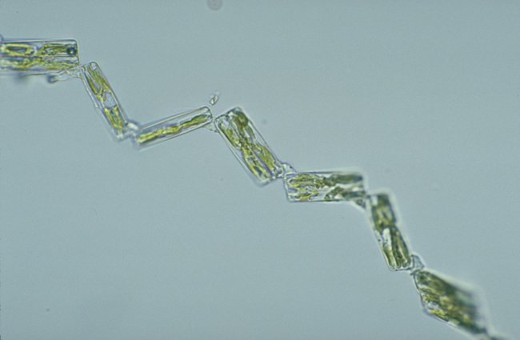
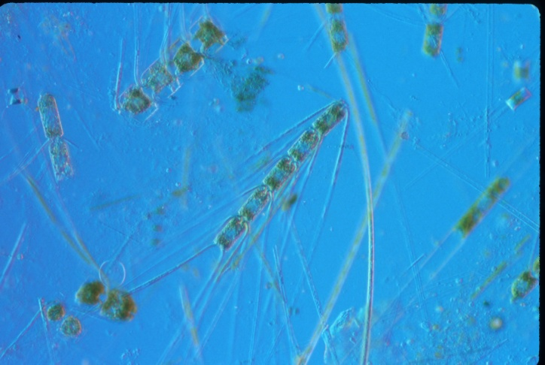
These phytoplankton are microscopic
Photos by Wendy King
Notes:
This “slide” is full of phytoplankton: diatoms, dinoflagellates and radiolarian (bottom row, second from left) Phytoplankton all photosynthesize but some can also engulf or by some means eat their pray. Most of the photos in this slide are from the bio 450 class at Cabrillo College, the beautiful fan-shaped diatom photo is from Christian Sardet. Many of the images are from Clive Bragshaw, from the Pacific Plankton Program in Santa Cruz, CA

Slide 10
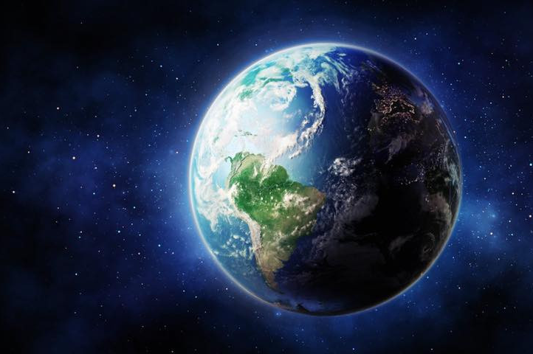
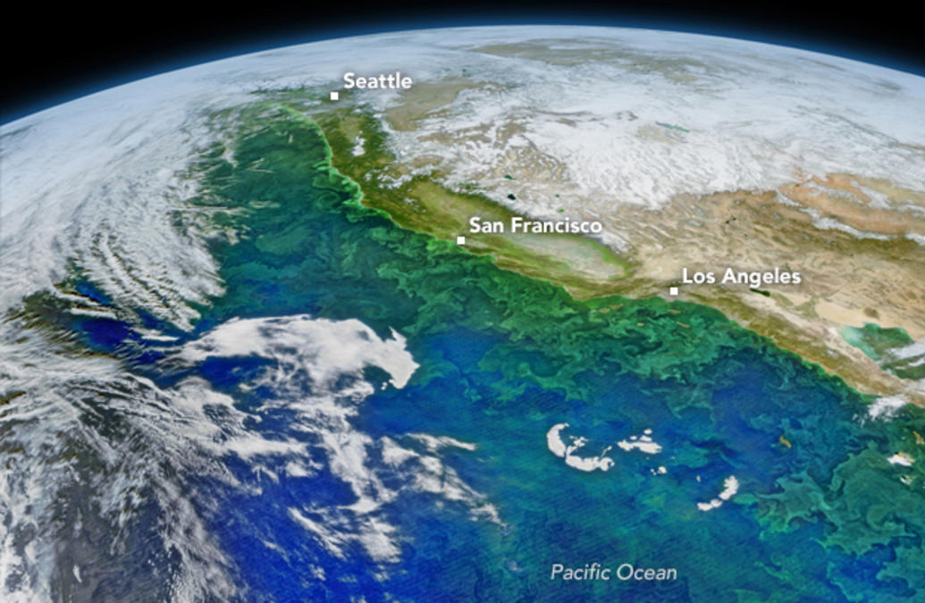
Take a deep breath
Phytoplankton are like microscopic plants that get their energy from the sun. At least 50% of the air we breathe comes from phytoplankton. You can see the green swirls in the image on the right – this is a phytoplankton bloom seen from a satellite!
Over 70 percent of the earth is covered by water (mostly ocean) A large part of the oxygen we breath (50-70%) is from phytoplankton and mostly from nearshore.

Slide 11
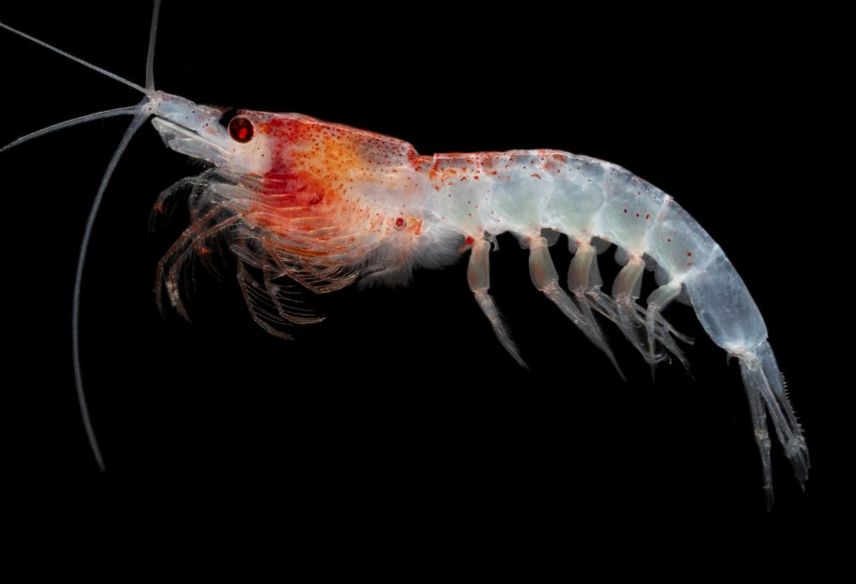
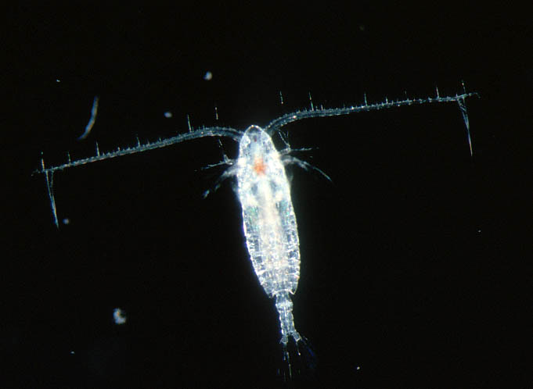
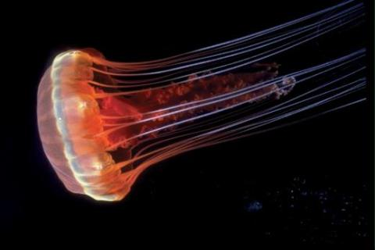
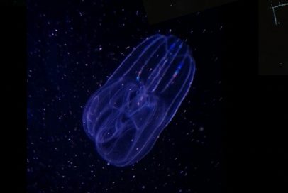
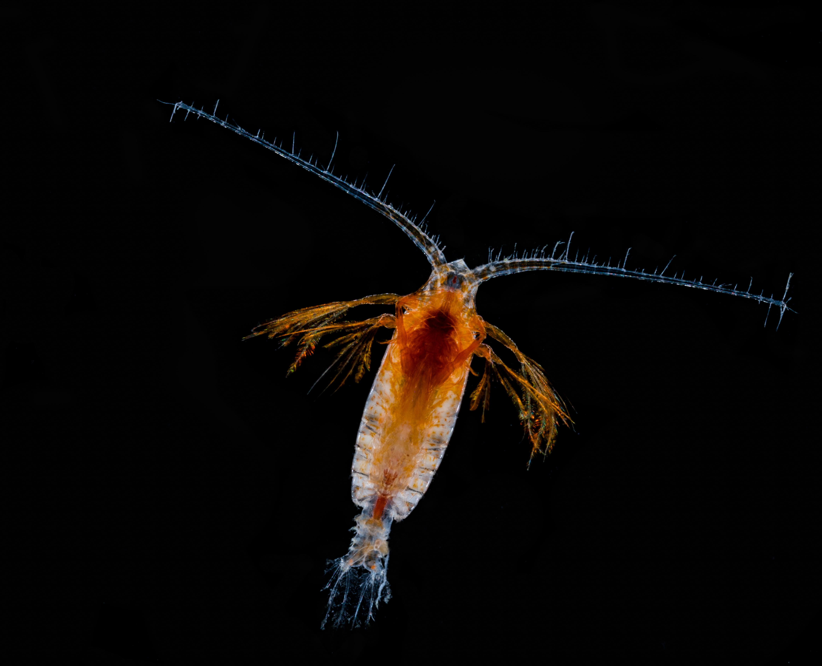
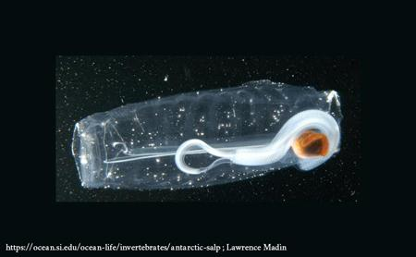
Holoplankton Zooplankton that spend their entire lives in the plankton as drifters-some become large adults
There are two types of zooplankton
Notes:
This shows a water column dwelling calanoid copepod on the top far left, then a deep water calenoid copepod (notice the red stomach and feeding apendages – in the deep most things they eat are bioluminescent and my having a red stomach lining this stops them from becoming easy prey by glowing). In the center is a krill photo from Woods Hole Oceanographic Society. On the top right is a beautiful radiolarian. Lower left are hydroid medusa that were filmed using a filter that showed the natural florescence of these jellies.

Slide 12
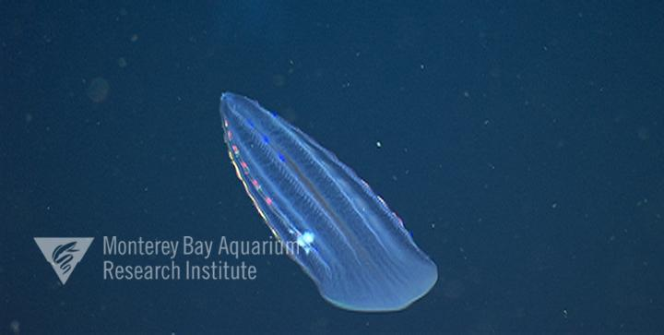
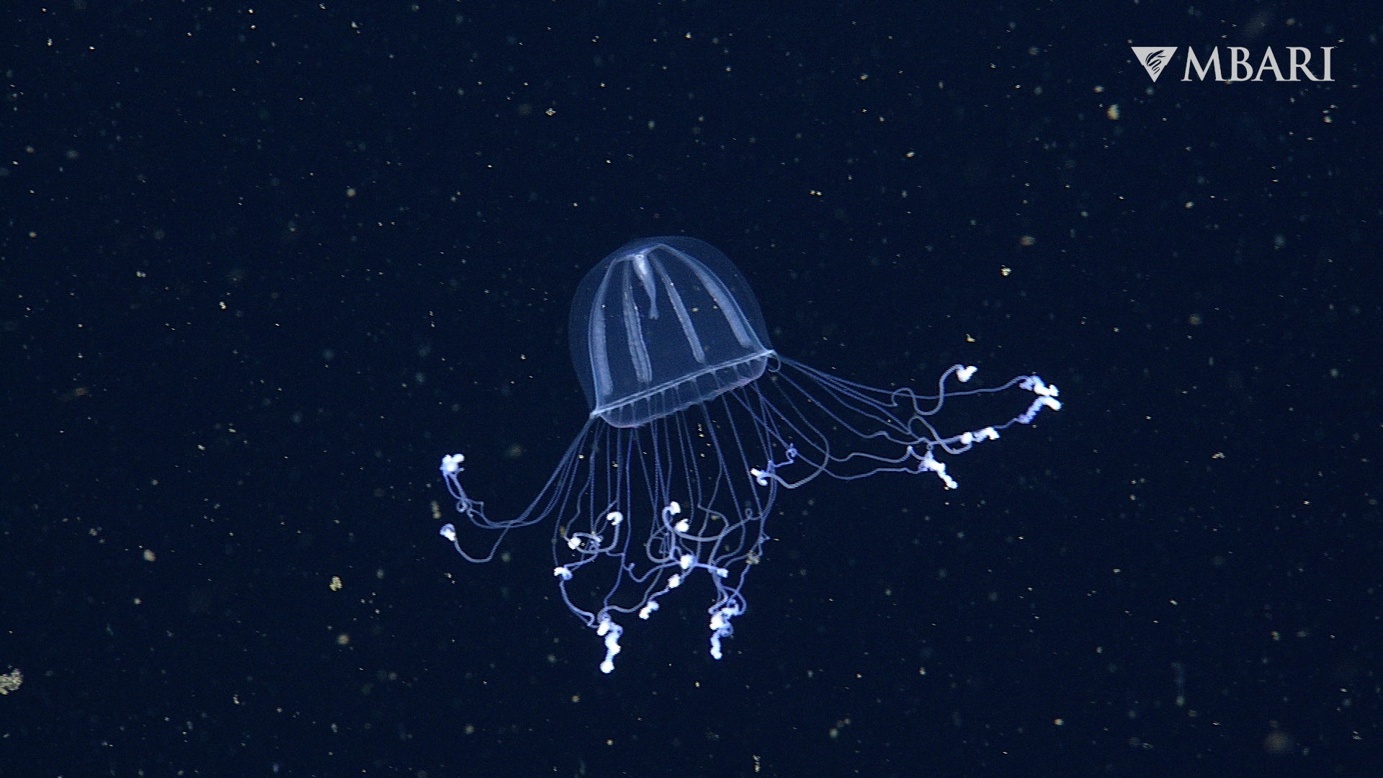
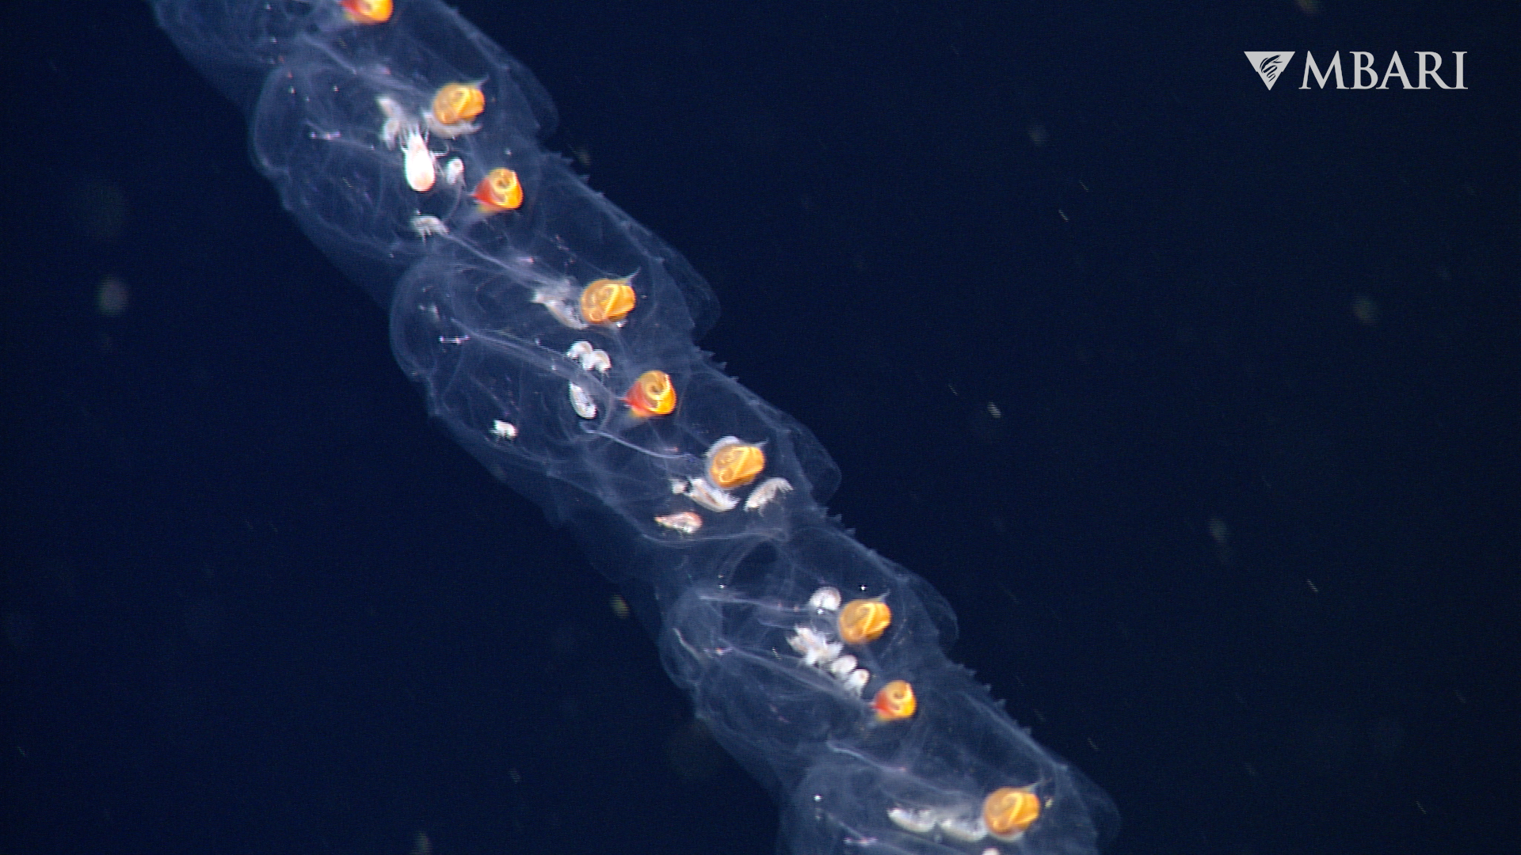
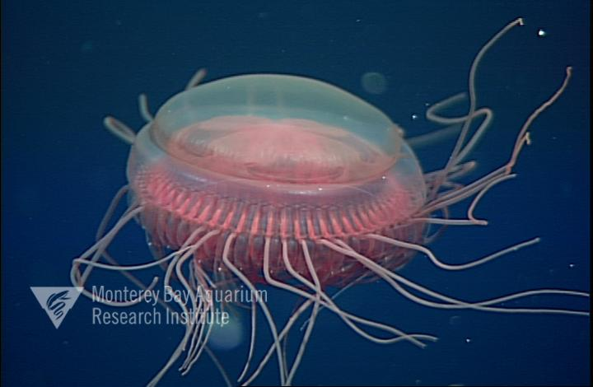
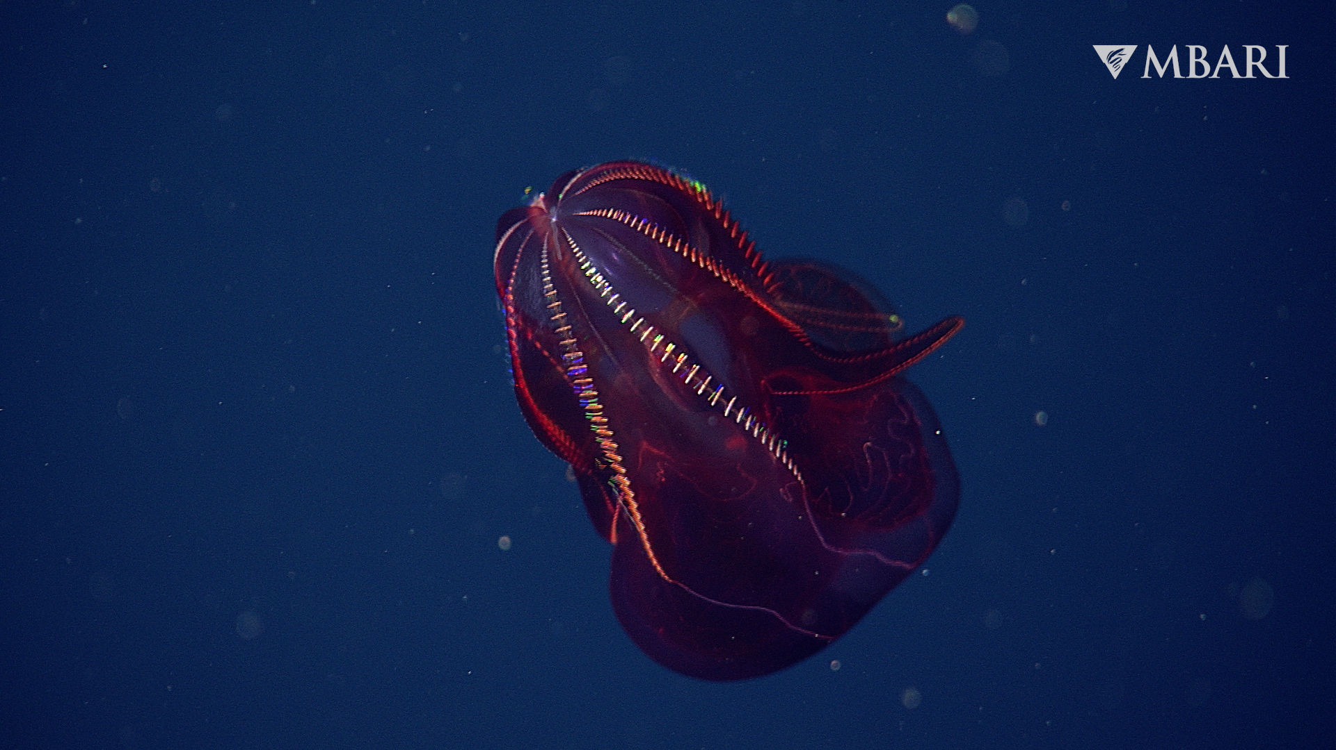
Drifters you may know …

Slide 13
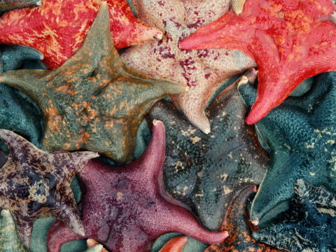
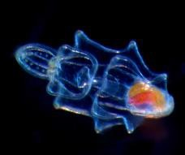


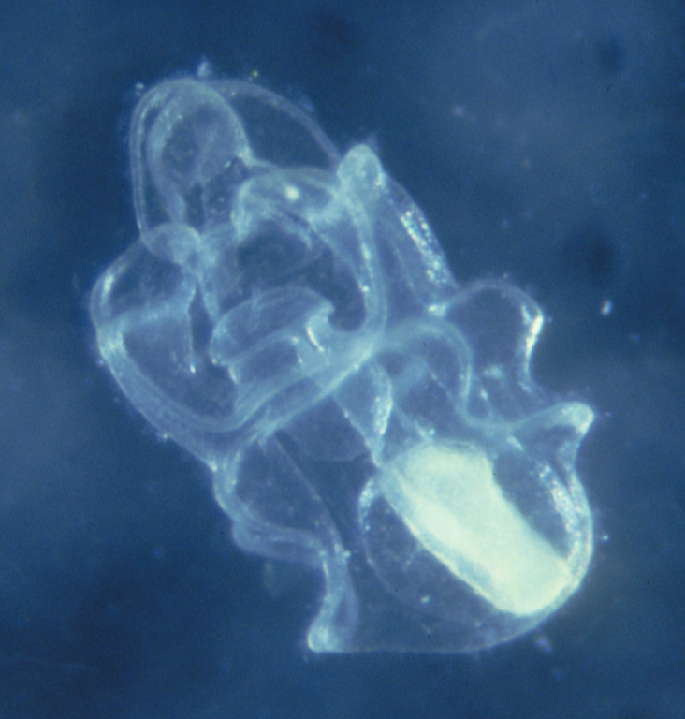
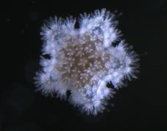
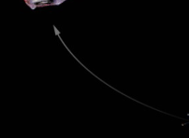




Meroplankton includes the larvae of familiar animals like sea stars, sea urchins, snails, and fish.
Didn’t start out life looking like they do now …
Notes:
Will put in photo of early stage sea star larva Photos from Shape of Life (top sea stars obv. Nancy Burnett’s photo). The drawing for the first stage in the sea star larval life cycle is mine (Jane K S) then the photo that C.Sardet took while at MBA, young sea star (MBA) sea star adult (MBA)
SEA URCHIN LARVAL DEVELOPMENT: Time spent as plankton: 6 weeks as larva before settling
Size of larva: At the eight-armed larval stage, size ranges between 0.75 and 0.80 mm
(width of 7 to 8 human hairs).

Slide 14

Life on the rocky shores along most coastlines are filled with invertebrates attached to the rocks.
There’s no more room on the Rocks!
Most animals release their larvae into the sea, to be carried away by the prevailing current and tide to find a new place to settle as adults.
This evolutionary strategy produces thousands of gametes that become developing larvae so that at least one or two survive to replace the adults.

Slide 15


Meroplankton = spends part of its’ life as plankton
They drift with the currents to find a place to settle down to call home
Cyprid stage of a barnacle The sole purpose of this stage is to find a home (on a rock or whale or ….) and settle down near others like itself.
Notes:
This was for the current plankton lab – computer screen is divided by holoplankton and meroplankton.

Slide 16




Littorina snail life cycle
Egg case
Adult snail
Veliger larva
Notes:
These snails(Littorina scutulata, up to 1.5 cm shell height) are found all along the rocky coasts from Alaska to Baja. The male and female mate and the female lays the fertilized eggs into a beautiful egg capsule that is flattened on both sides. After about a week or so the veligers hatch from the egg capsule at about 160 micrometers long. The veligers are in the plankton for about four weeks (Buckland-Nicks et al. 1972)

Slide 17


Heaviest bony fish in the sea (nearly 5,000 lbs.) starts life as 2.5 mm long and one of nearly 300 millions fellow eggs/larvae
larva
Notes:
https://wildkratts.fandom.com/wiki/Ocean_Sunfish?file=Ocean+Sunfish+Larva+Real+Life.png
Link for photo of M. mola

Slide 18



Adaptations for life as a drifter
Transparent body to hide in the open ocean
Long, thin appendages to slow the descent downward (buoyancy)
Excess food stored as oil droplets to help stay afloat

Slide 19




Holoplankton (like copepods, krill & shrimps) and meroplankton are amazingly adapted for their floating lifestyle.
1. Transparent bodies that hide them in the open water
2. To keep afloat many have spines (increase surface area) oil droplets and light materials to make shells and body parts
3. Many, like us have a daily commute (avoid visual predators & food resources)
4. Body shape is long and thin, sometimes flat (floatation) or jelly-like

Slide 20

All plankton are a critical part of the ocean food web
Notes:
Let’s look deeper into why plankton are so important in our ocean. This image is from the Monterey Bay Aquarium Research Institute as they have been studying the role phytoplankton plays in the global carbon dioxide removal process and the food web in general.

Slide 21


We first recorded the largest migration on planet earth when sonar was invented and saw this (below)
copepods
The yellow, red and green shows a massive amount of life moving up towards the surface at night!
Notes:
NOAA website and Klevjer et al. 2016

Slide 22

Copepod/krill rise to the surface to feed at night and return to depth during the day
Notes:
Image from: Monterey Bay Aquarium Tiny Drifters exhibit

Slide 23

Why should we care about plankton?
Plankton supports the entire marine food web.
The fisheries that provide jobs and food for people worldwide would collapse without plankton.
The fossilized phytoplankton are responsible for producing the oil reserves that we currently use to fuel our lives.
Plankton brings excess carbon dioxide from surface waters to the deep (where it stays locked up a long time).

