Slide 1

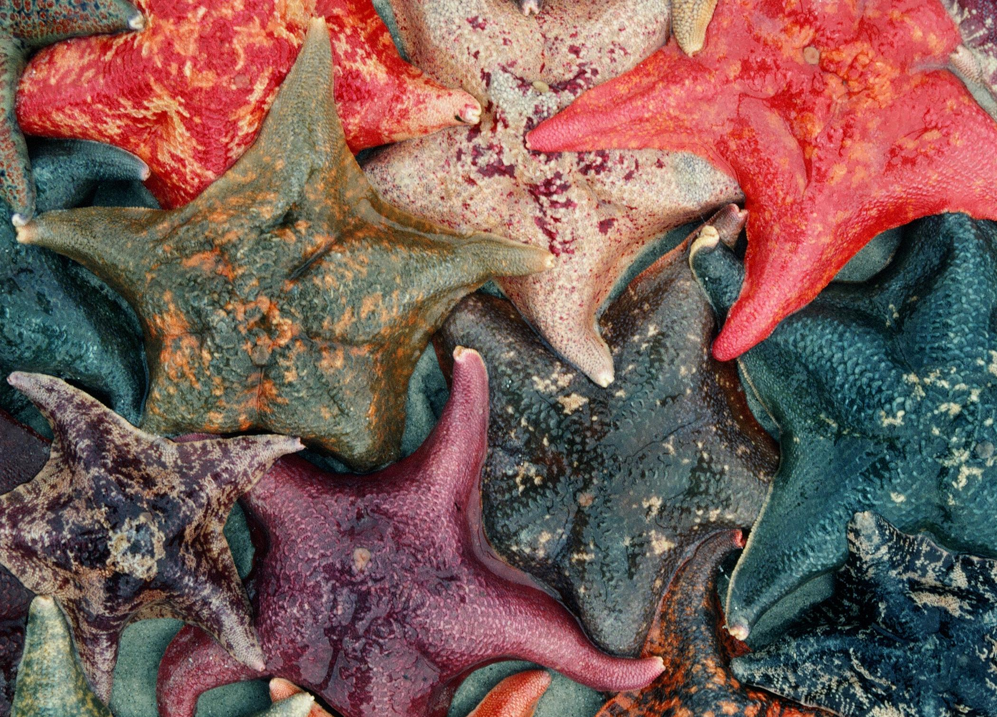
Echinoderms: the Ultimate Animal

Slide 2
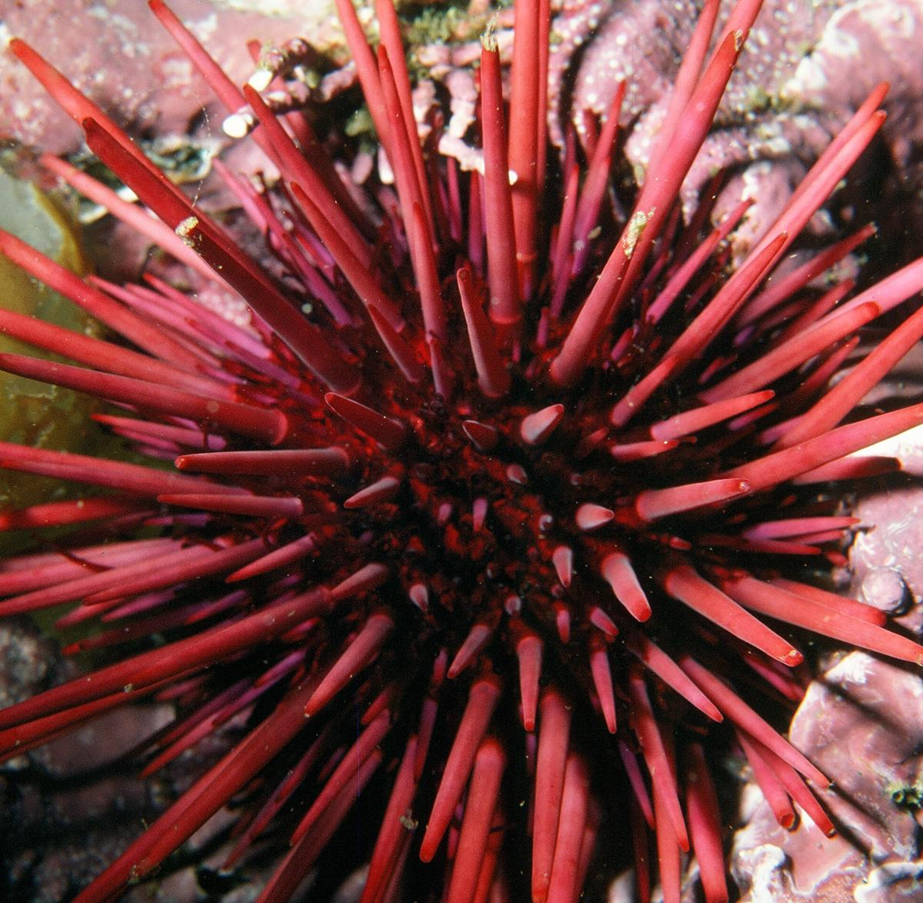
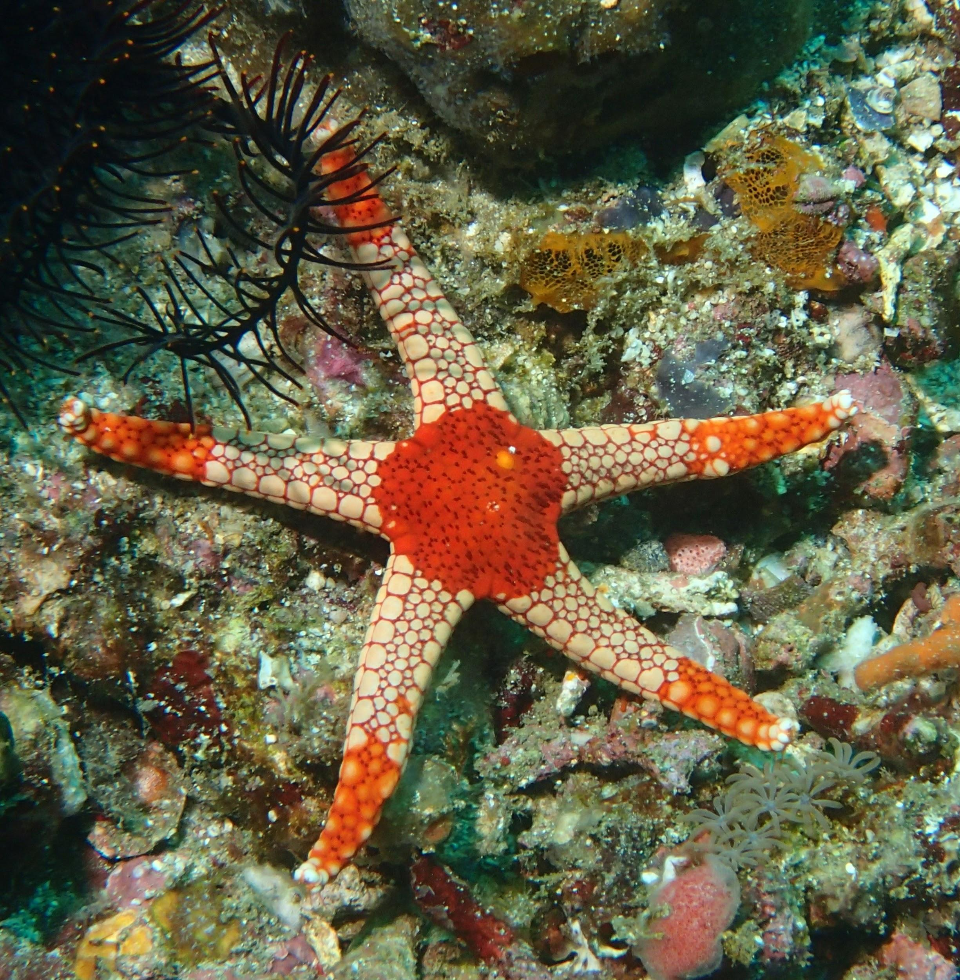
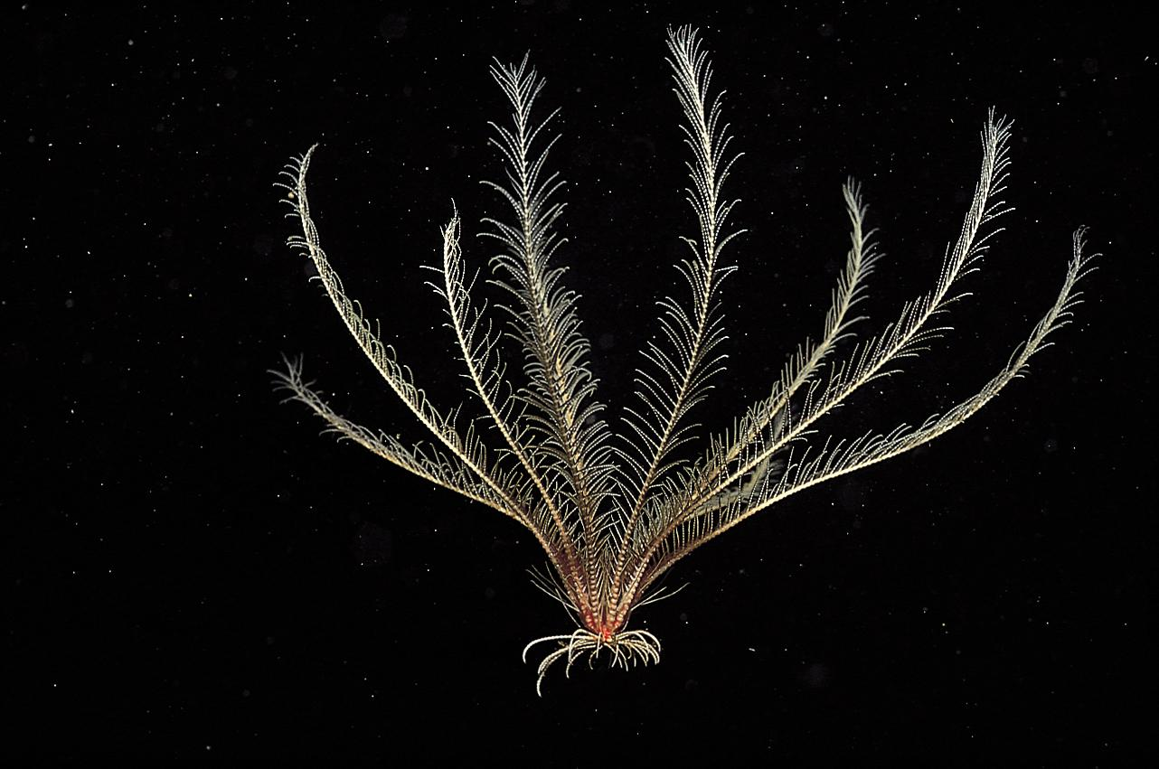
These Are All Echinoderms

Slide 3
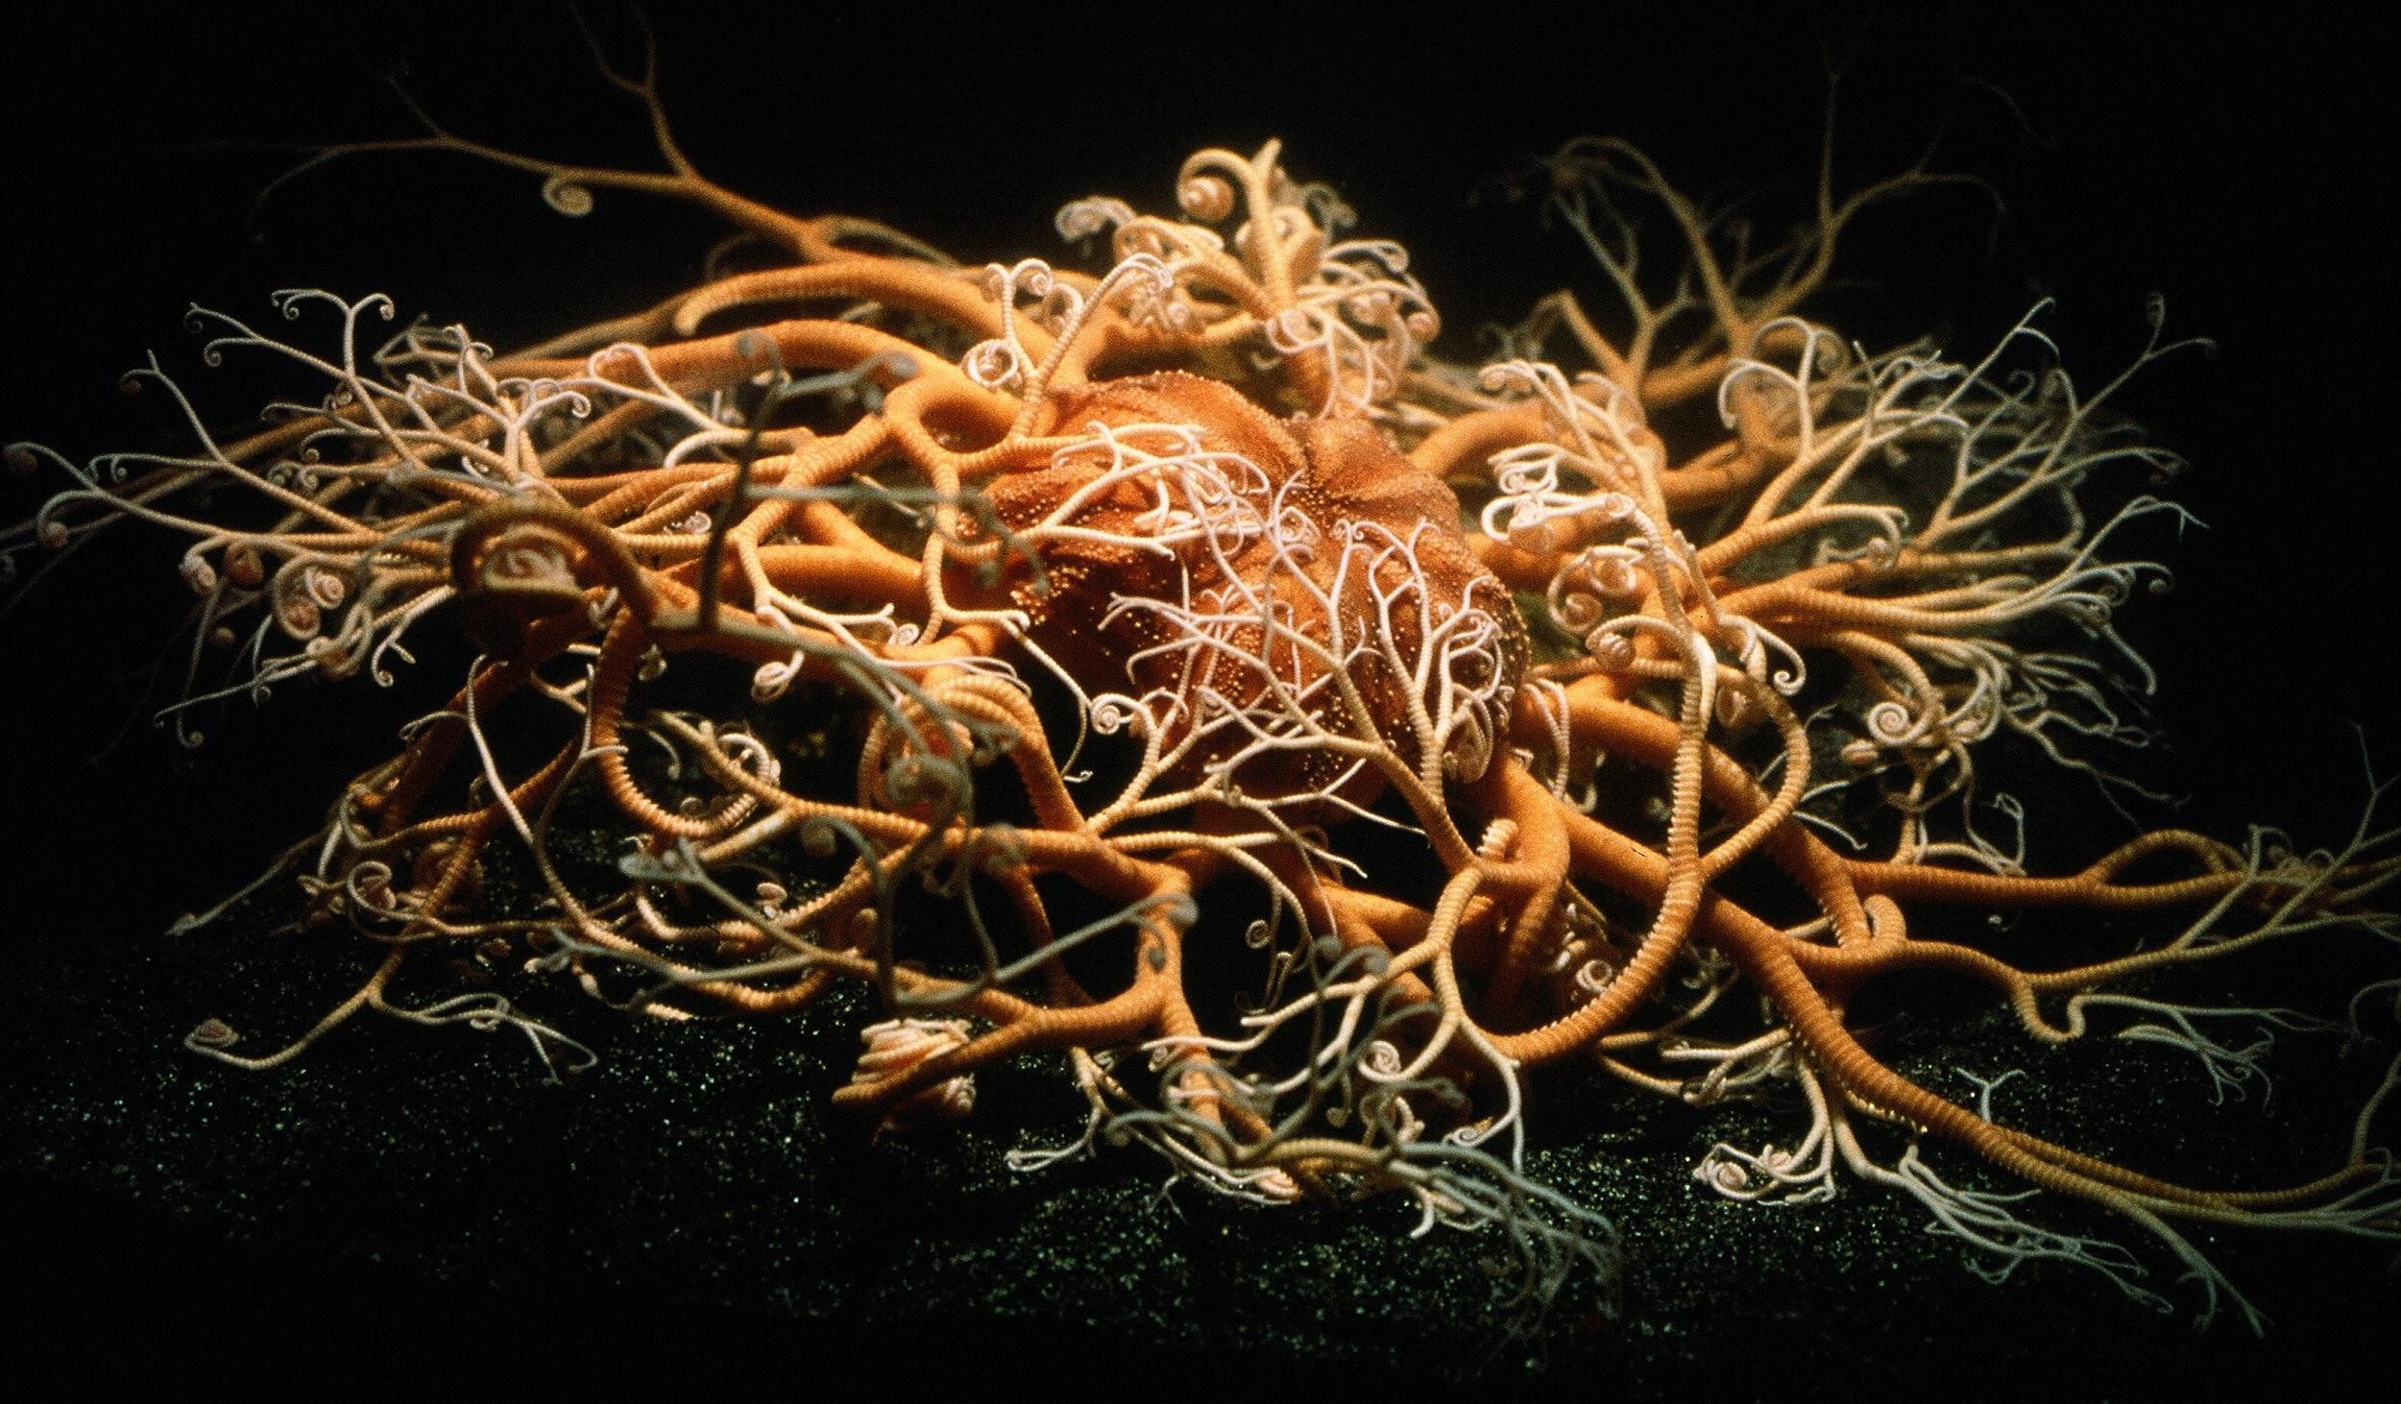
Watch Echinoderms: the Ultimate Animal. Take Notes And Answer the Following Questions.
Watch this video

Slide 4
Echinoderm Groups
Give the common name for the four major kinds of echinoderms.

Slide 5
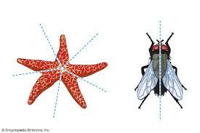
Five-part Symmetry
Watch this video
Most animals you are familiar with including us have bilateral symmetry.
Compare the five-part radial symmetry of echinoderms to bilateral symmetry.
What might be the advantages of five-part symmetry?

Slide 6
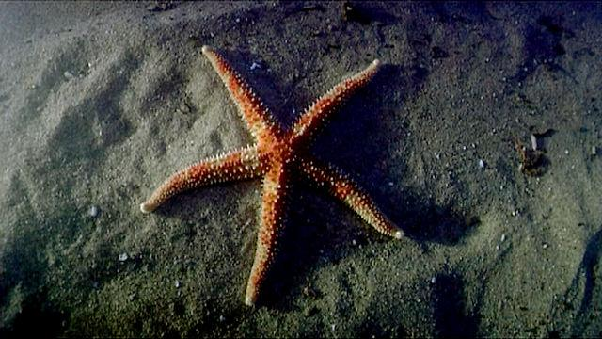
Sea Star Body Plan
Watch this video

Slide 7
Muscles and Nerves
How can a sea star be so flexible and then suddenly become rigid?
What is the advantage of holding the body rigid?
What does a sea star have instead of a brain?

Slide 8
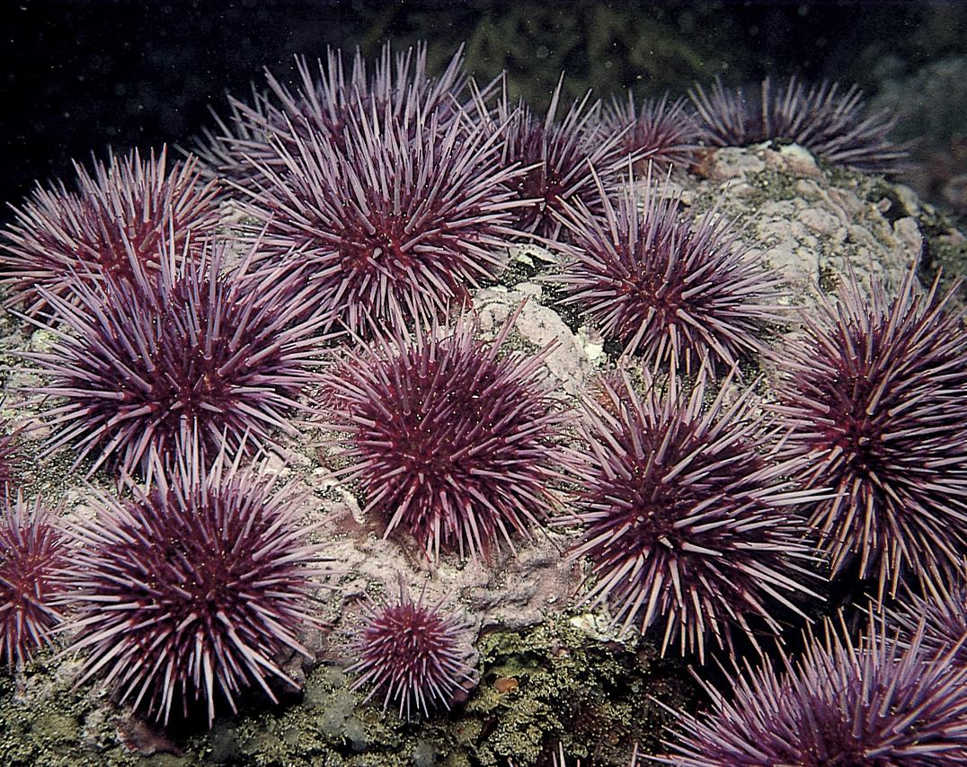
Sea Urchins
What do sea urchins eat?
How do sea urchins move?

Slide 9
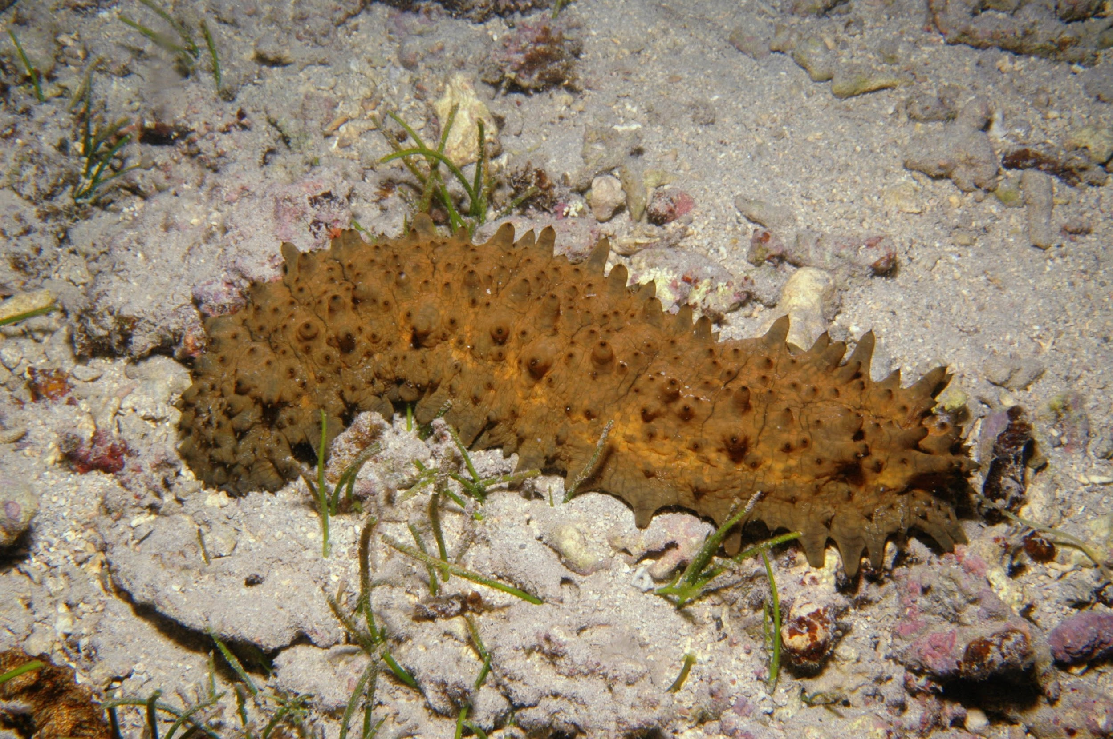
Sea Cucumbers
How do sea cucumbers feed?
What is their role
in the ecosystem?

Slide 10
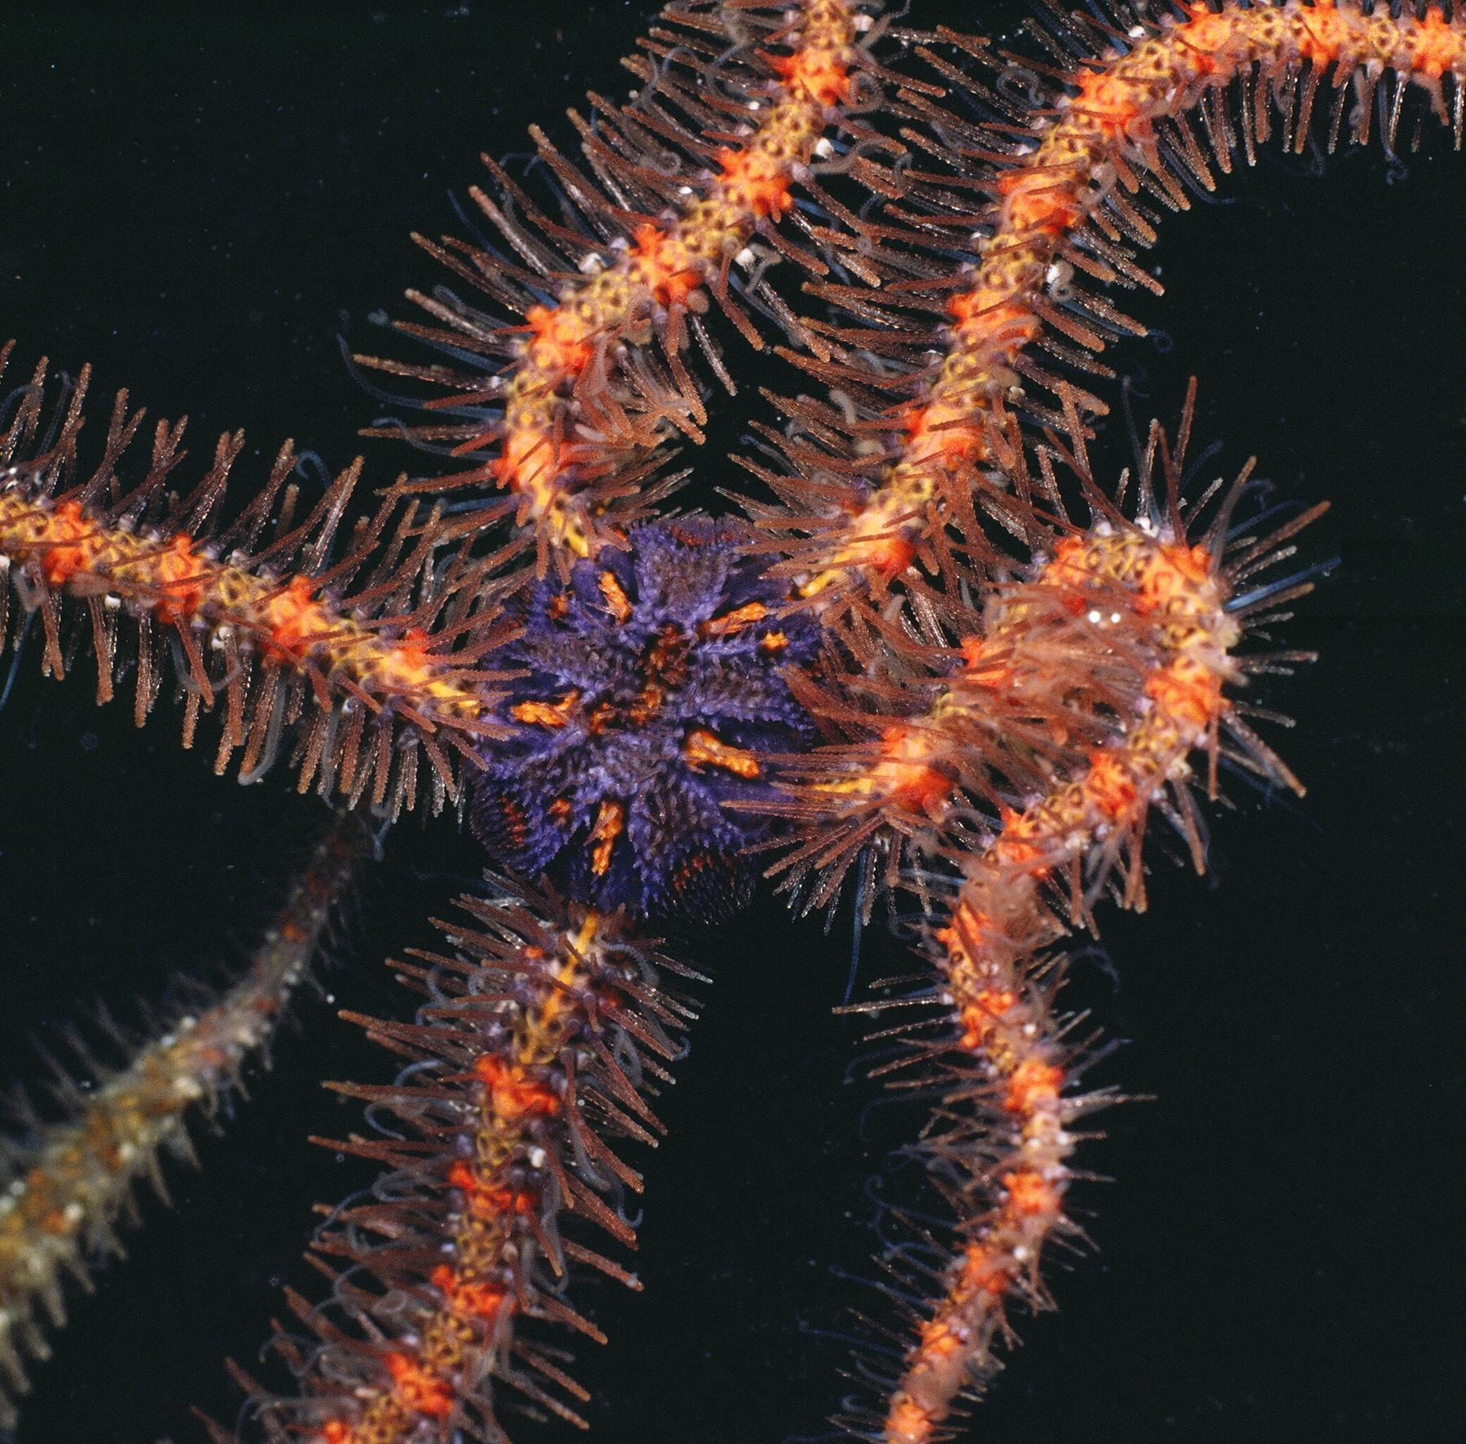
Brittle Stars
How do brittle stars feed?

Slide 11
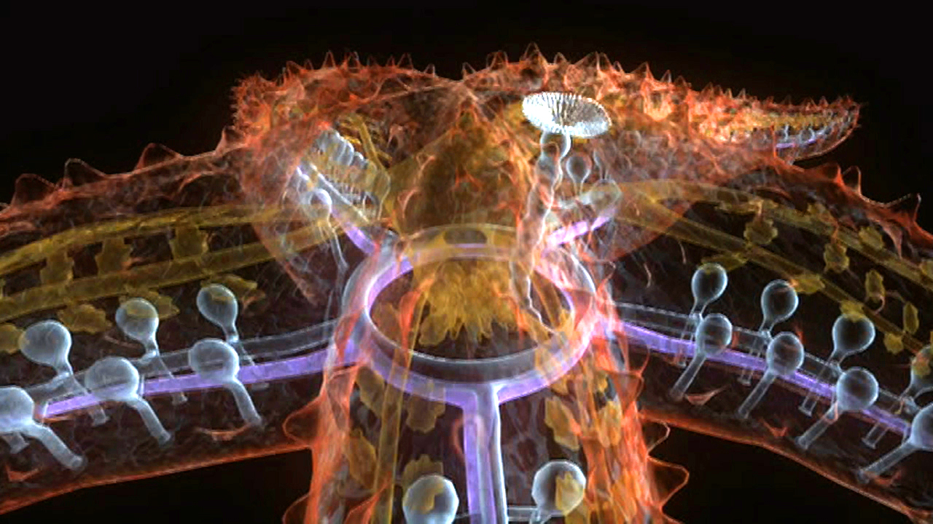
Tube Feet
How do the tube feet and the water-vascular system work?
What do echinoderms use their tube feet for?

Slide 12
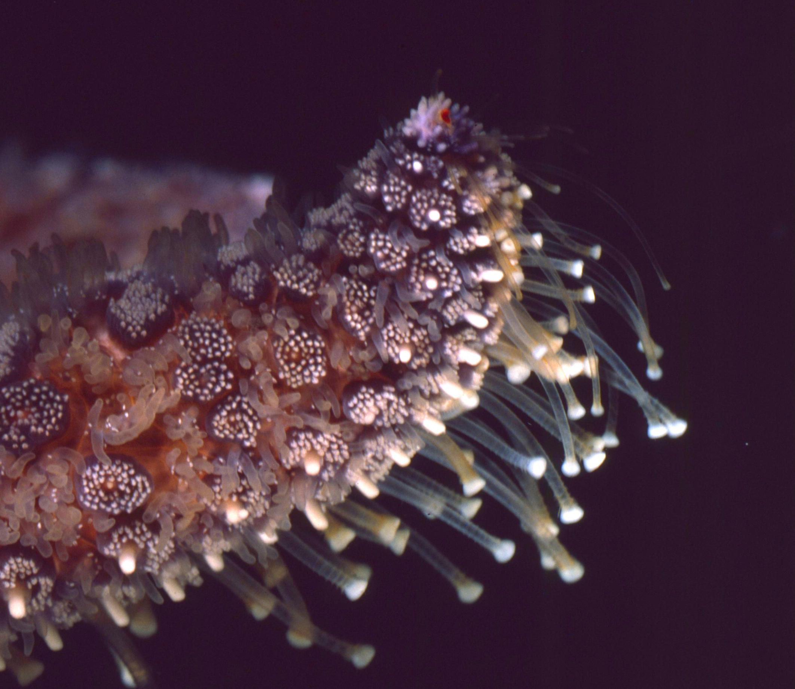
Sensing the World
What senses do sea stars have?

Slide 13
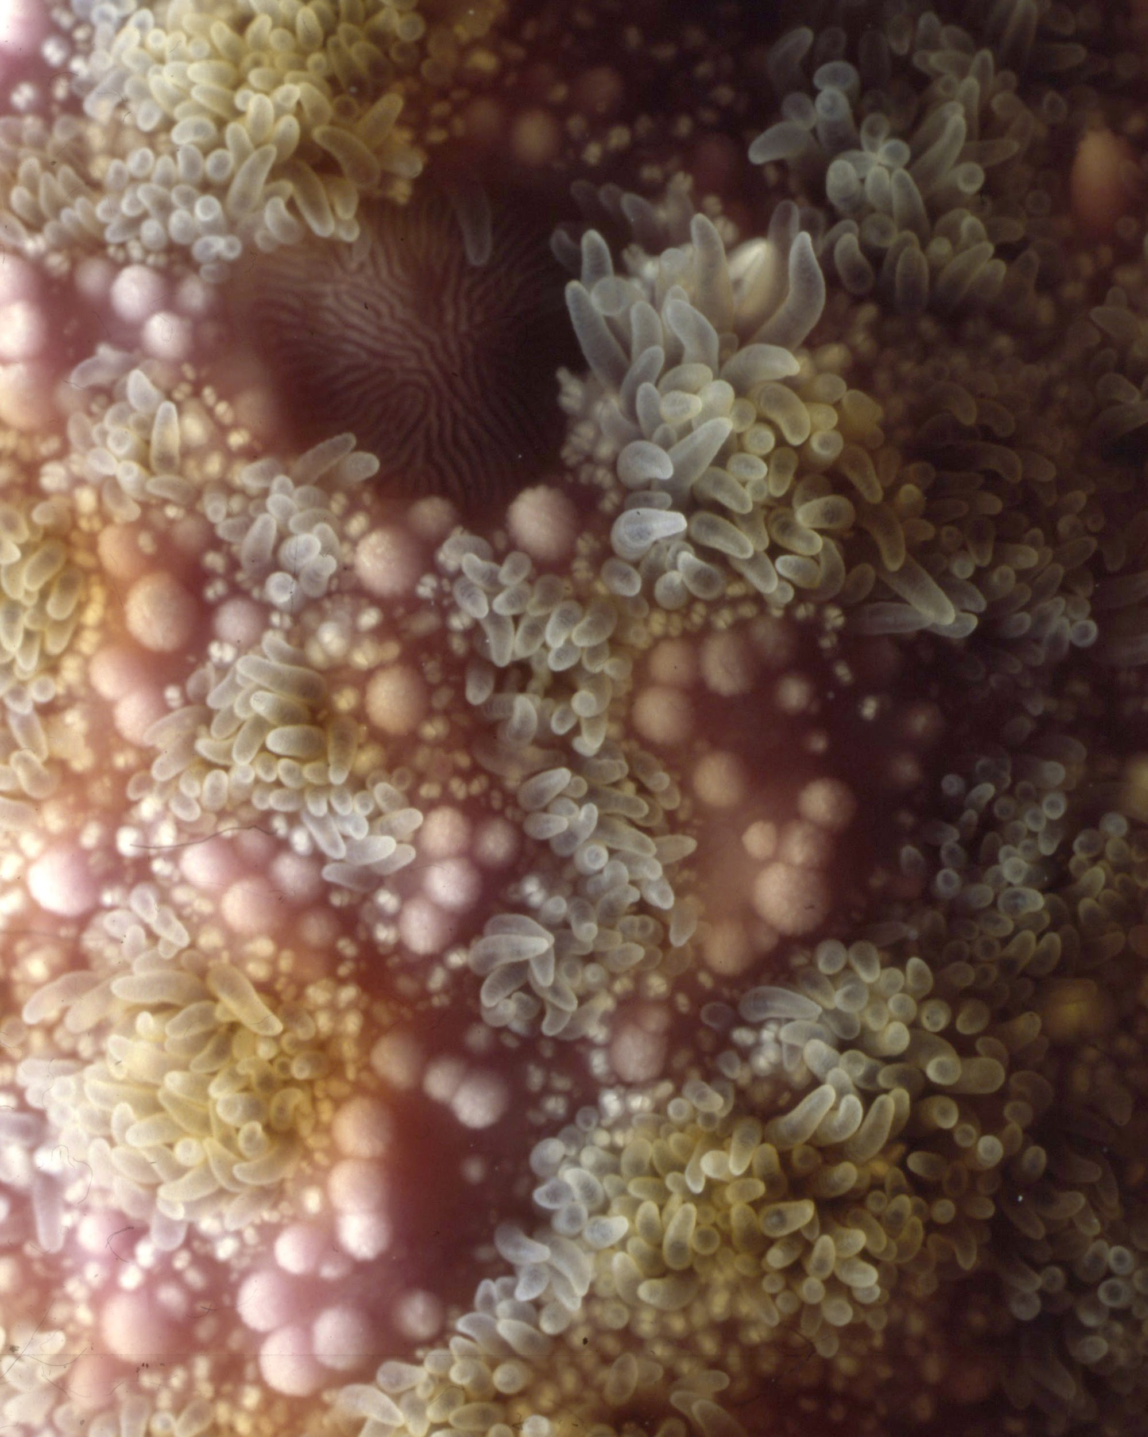
Sensing the World
Page 2
Echinoderms are covered with a skin with sensory papillae that absorb oxygen and taste the environment.

Slide 14
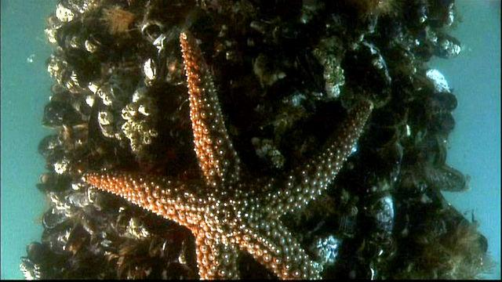
Sea Star Feeding
Watch this video
Describe how sea stars feed on mussels.
What are the advantages and disadvantages of eating with an extrusible stomach?

Slide 15
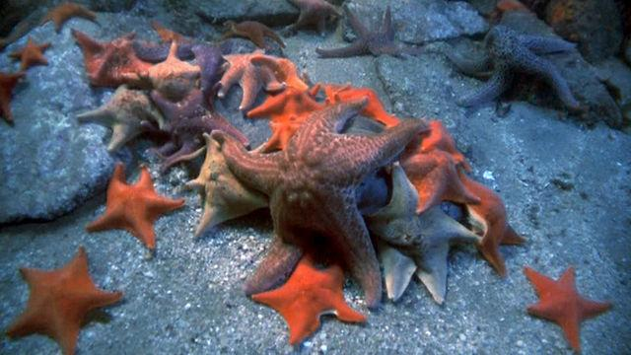
Life In Slow Motion
What does time-lapse motion tell you about the lives of echinoderms?
Watch this video

Slide 16
The Ultimate Animal
What are the benefits of being headless, brainless and not bilaterally symmetrical?
Echinoderms seem so different from most animals, and they are very successful. What does this say about evolution?

Slide 17
Vocabulary
Define in your own words these vocabulary words at the end of the video.
Five-part symmetry Sieve plate
Bony platelet Radial canal
Nerve ring Assimilate
Tube feet

