Slide 1
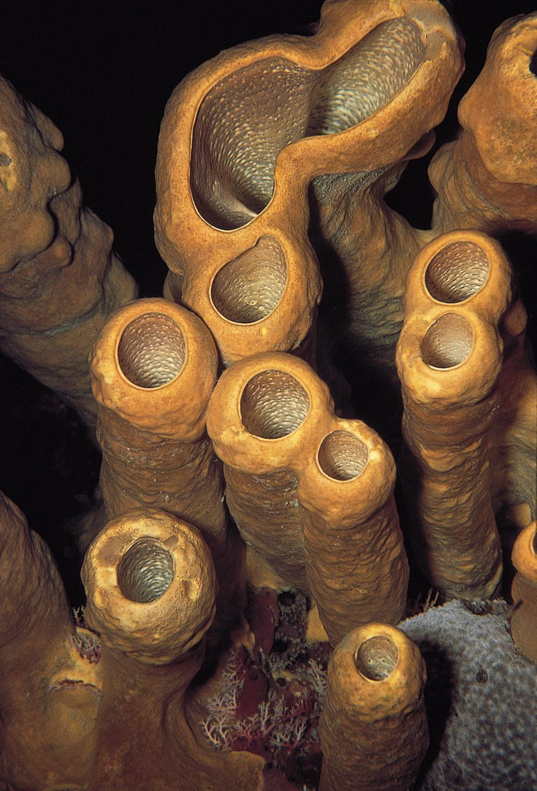
Sponges:
Origins
The First Animal

Slide 2
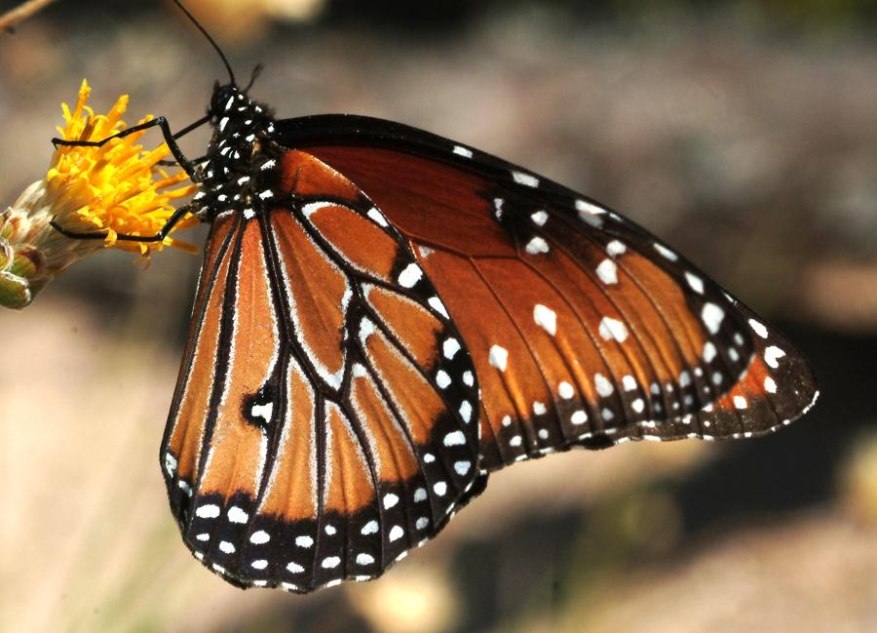
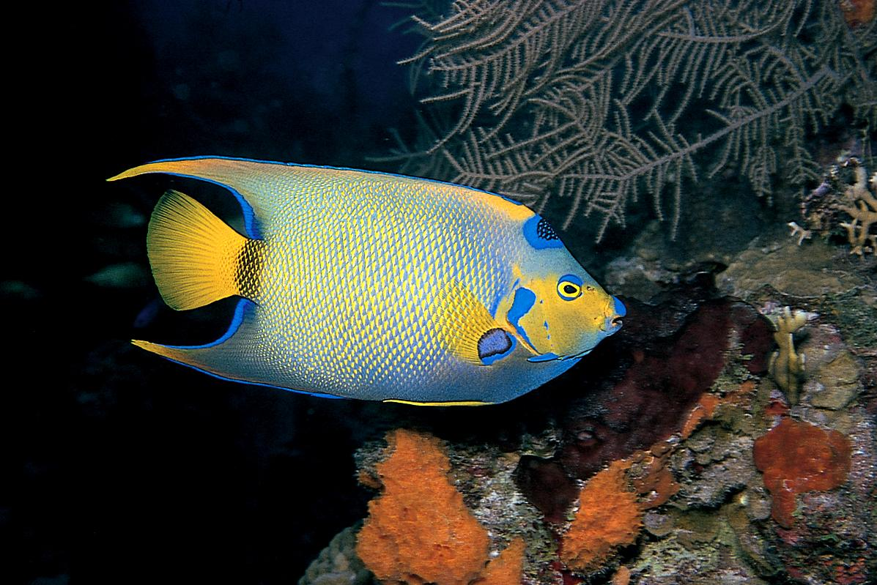
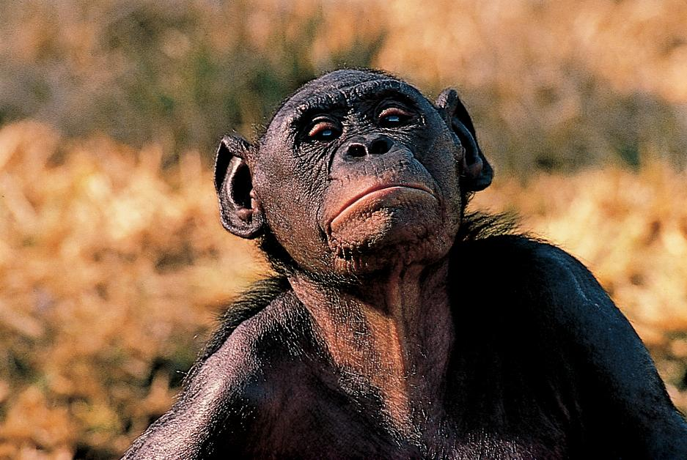
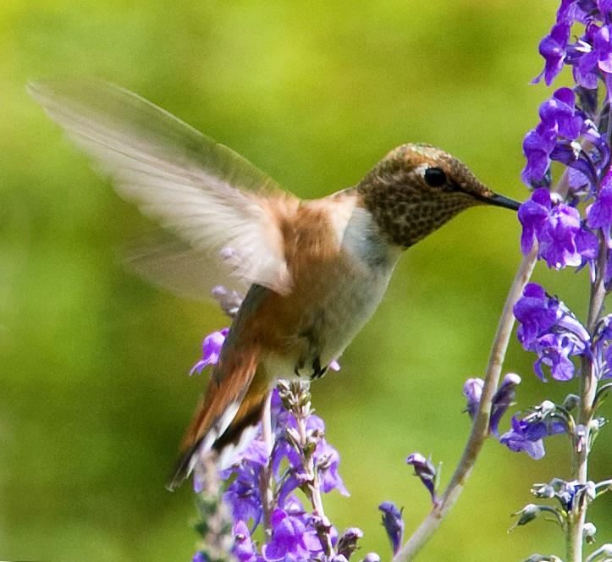
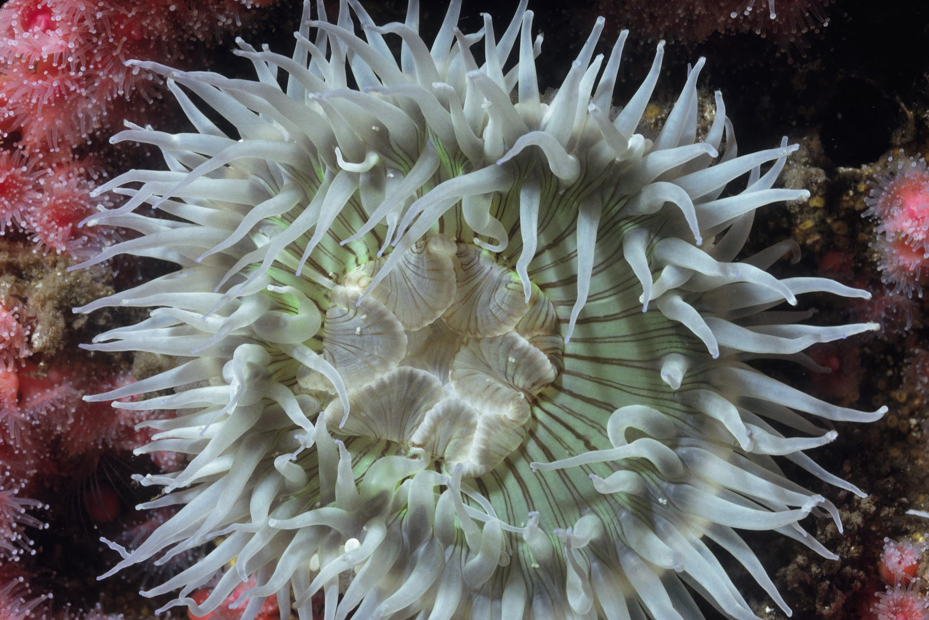
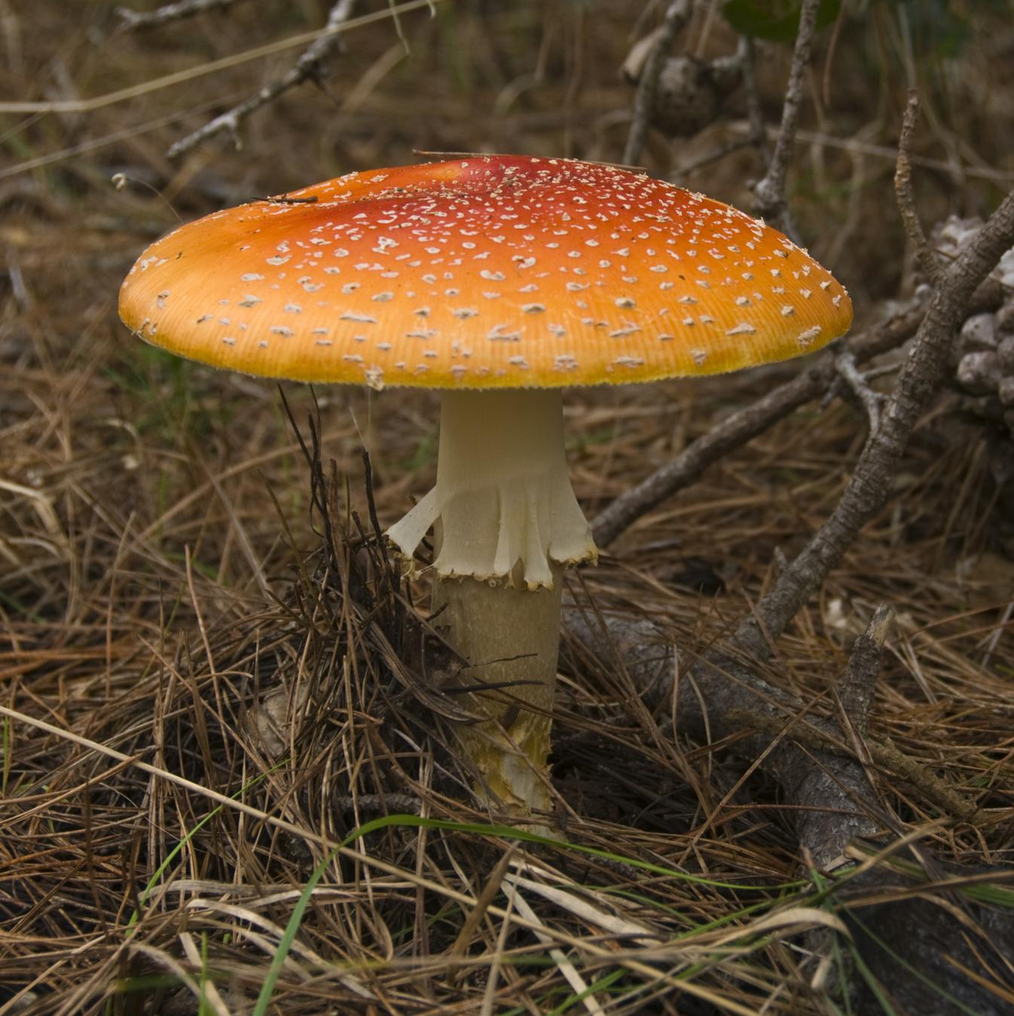

Slide 3
Think About the Animal Kingdom
How would you define an animal?
What do you think are the basic characteristics of an animal?
Are sponges animals?

Slide 4
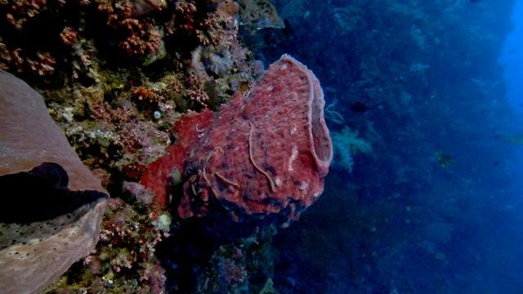
Watch Sponge Video, Take Notes And Answer the Following Questions
Watch here:

Slide 5
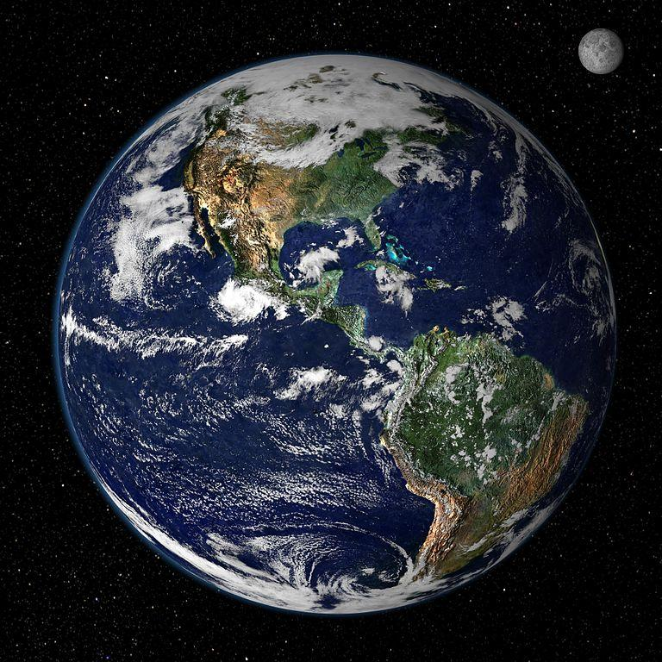
When did life appear on planet earth?

Slide 6
Single-celled Organisms
For how long did single-celled organisms dominate the Earth?
Why is a single-celled organism not classified as an animal?

Slide 7
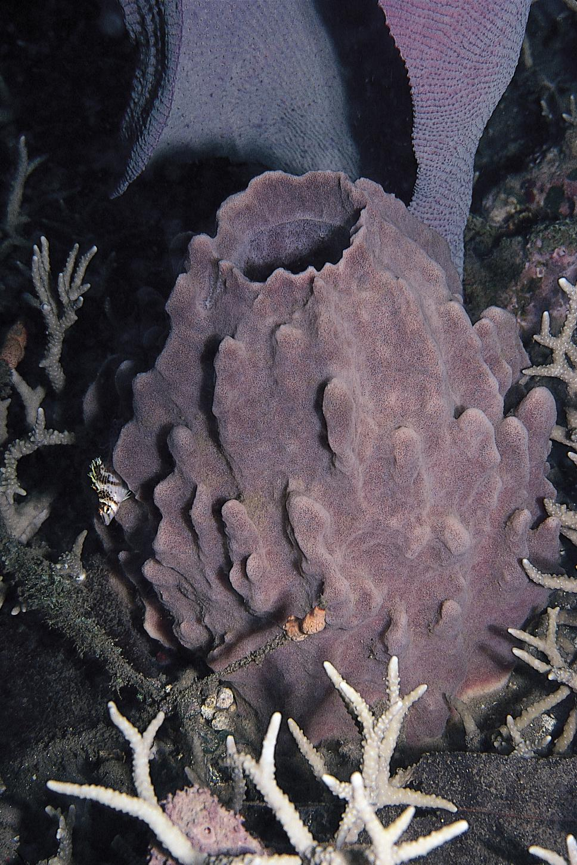
The First Animals
How long ago did the first animal appear?
Why are sponges considered animals?
Are the scientists hurting the sponge when they cut off pieces for study?

Slide 8
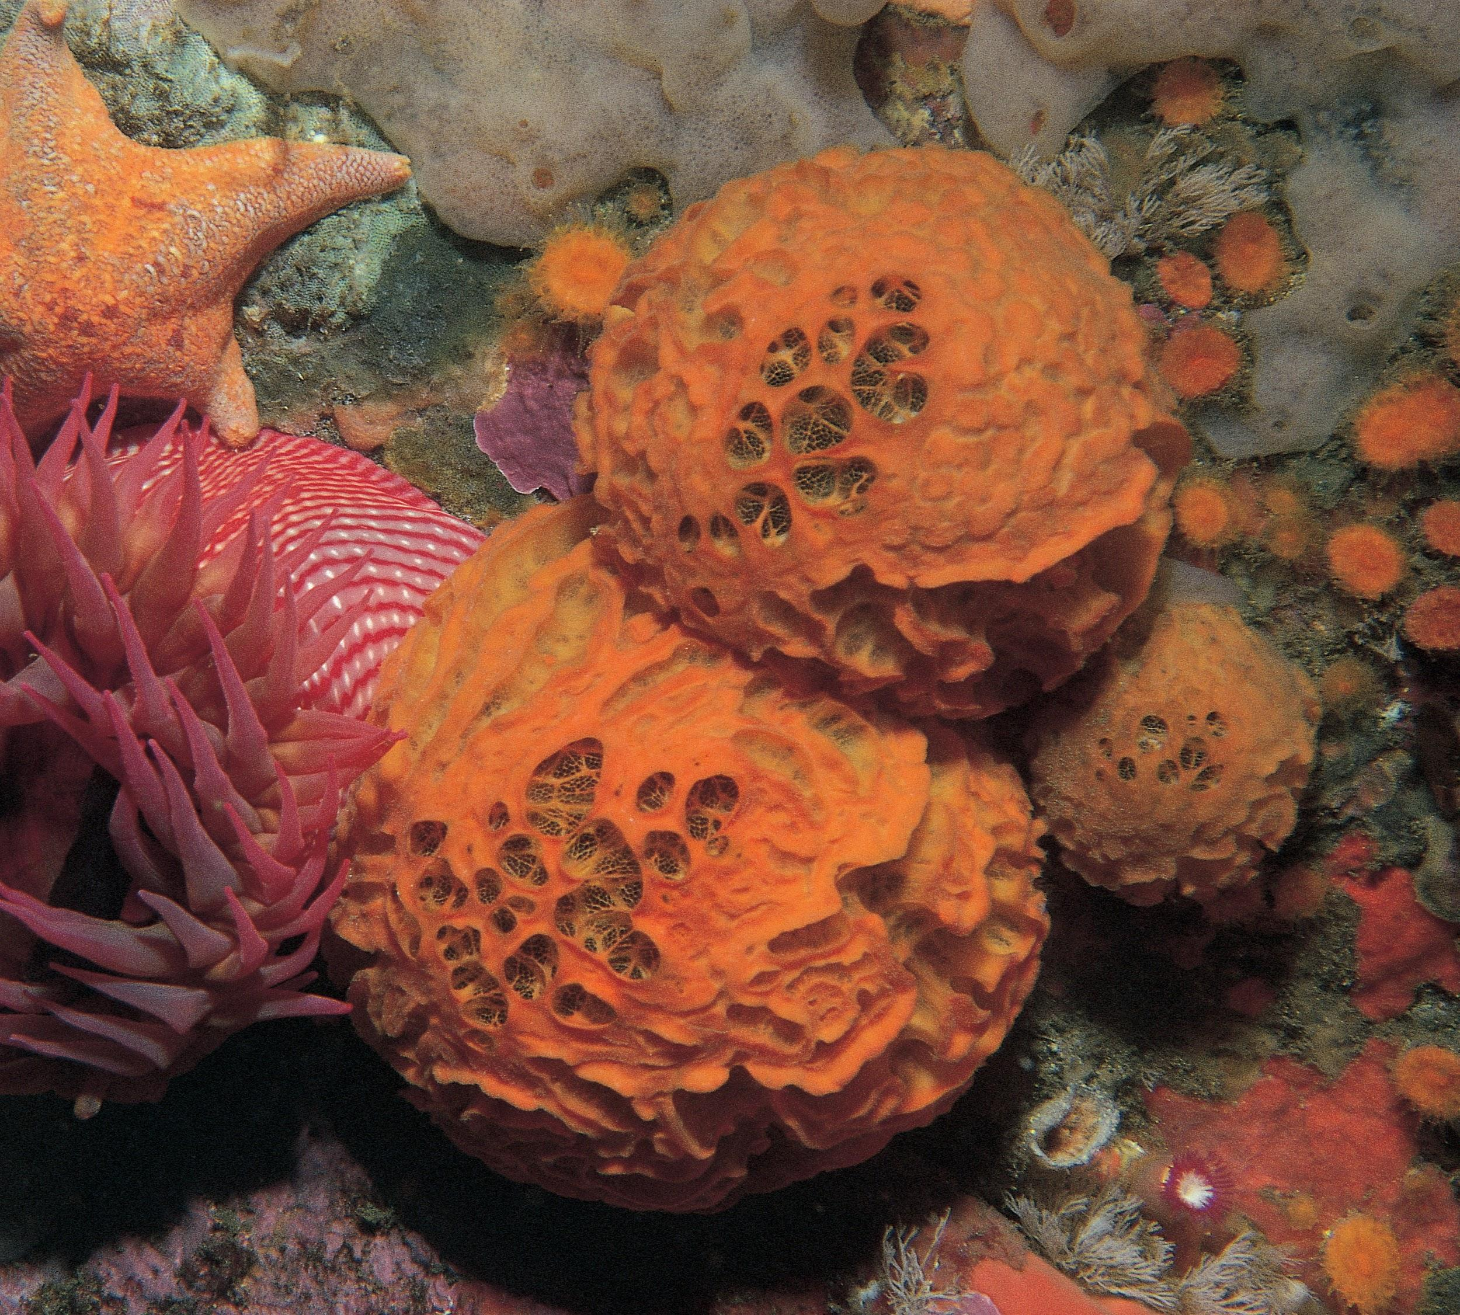
Sponge Cells Are Unique
How are sponge cells different from all other animal cells?
What does collagen do for sponges?

Slide 9
Sponge Spicules
Watch Sponge Spicules animation here
What do the spicules do for the sponge?

Slide 10
Sketch any two sponge spicules

Slide 11
Sponge Feeding
How does a sponge eat without a mouth?
How much water does a sponge need to pump to filter out one ounce of food?
How does Dr. Diaz demonstrate the pumping action of the sponge?

Slide 12
Watch This Wild Ride Through A Sponge
Watch here
How is the sponge’s pump powered?

Slide 13
The Inside of A Sponge
Describe the inside of the sponge.
How is the sponge’s pump powered?
How does the sponge actually take up particles of food?

Slide 14
Sponges: Simple or Complex?
Do you agree with the narrator when he says that the sponge is more complex than we imagined?
Explain your answer.

Slide 15
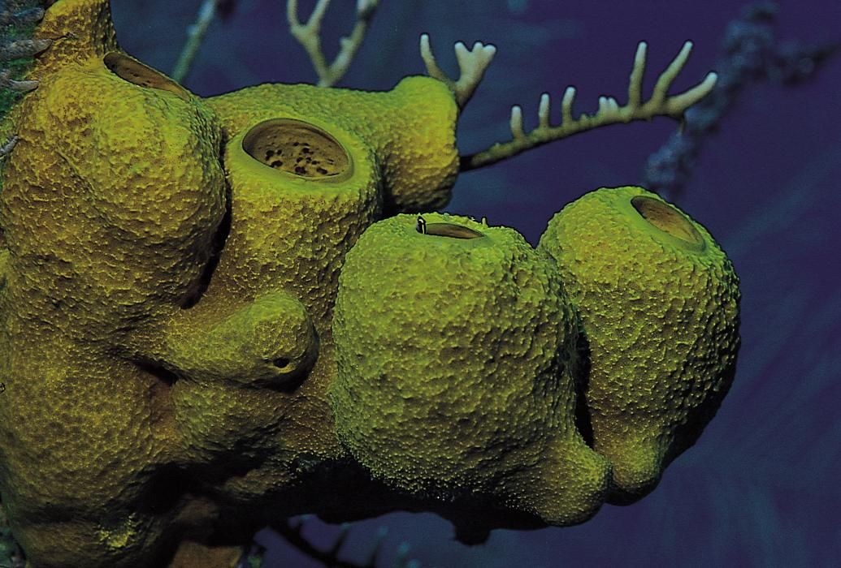
Sponges Are Animals!
List three “firsts” that the sponge can claim that define all animals.

Slide 16
Vocabulary Page 1
Define in your own words these vocabulary words at the end of the video.
Collagen:
Spicule:
Filter feeding:

Slide 17
Vocabulary Page 2
Choanocyte:
Flagellum:
Plankton:

