Slide 1
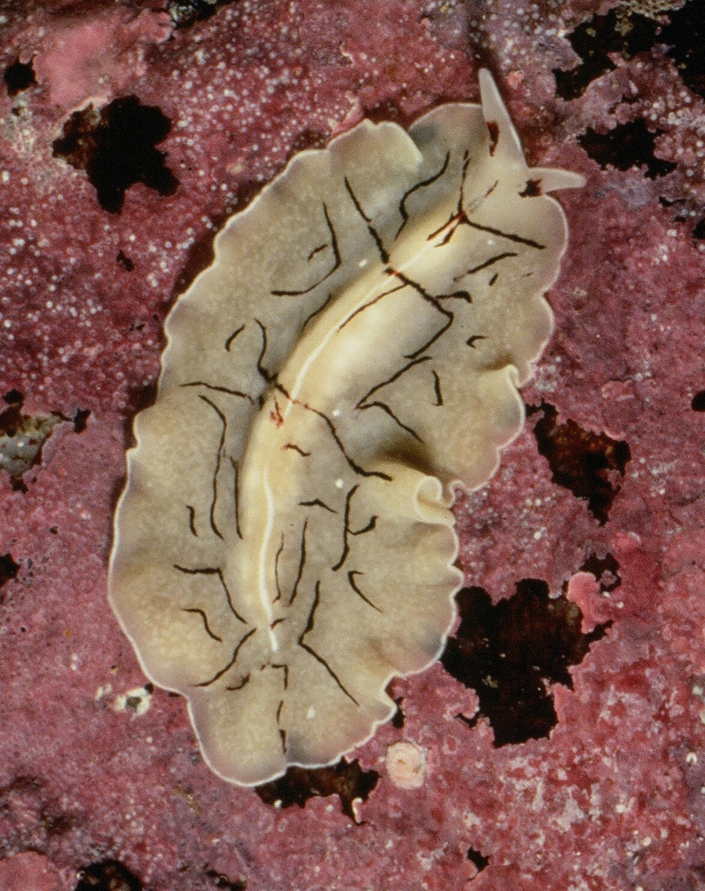
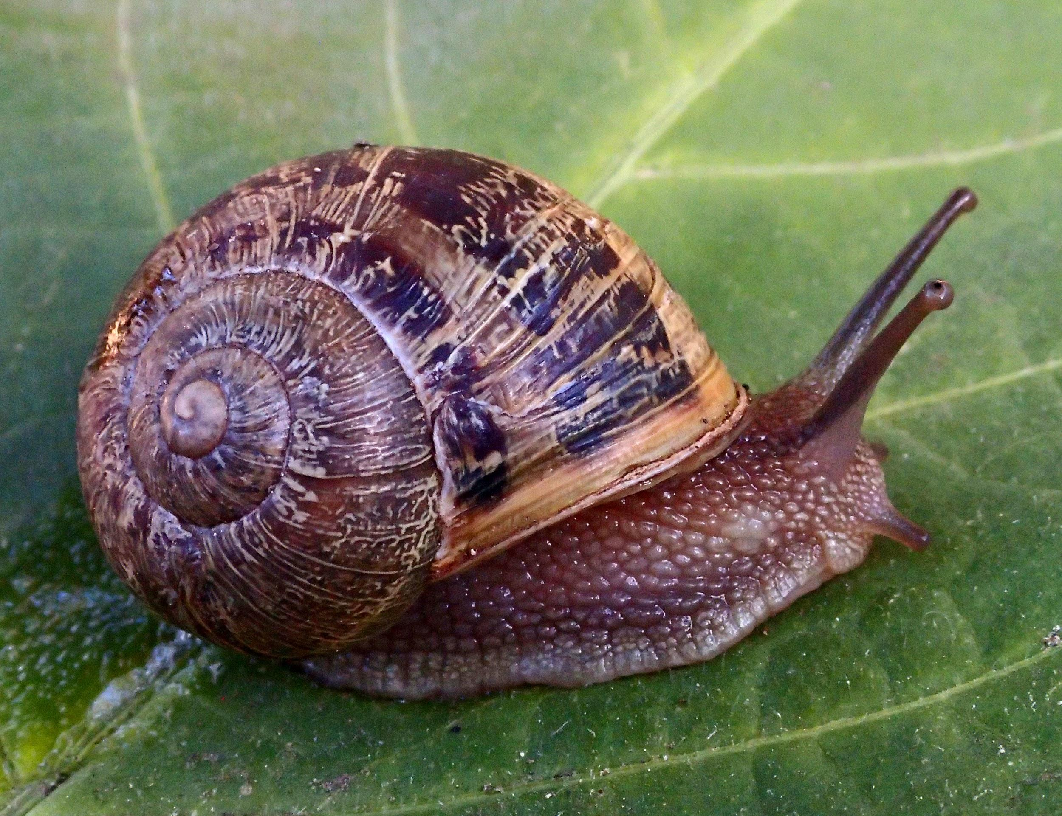
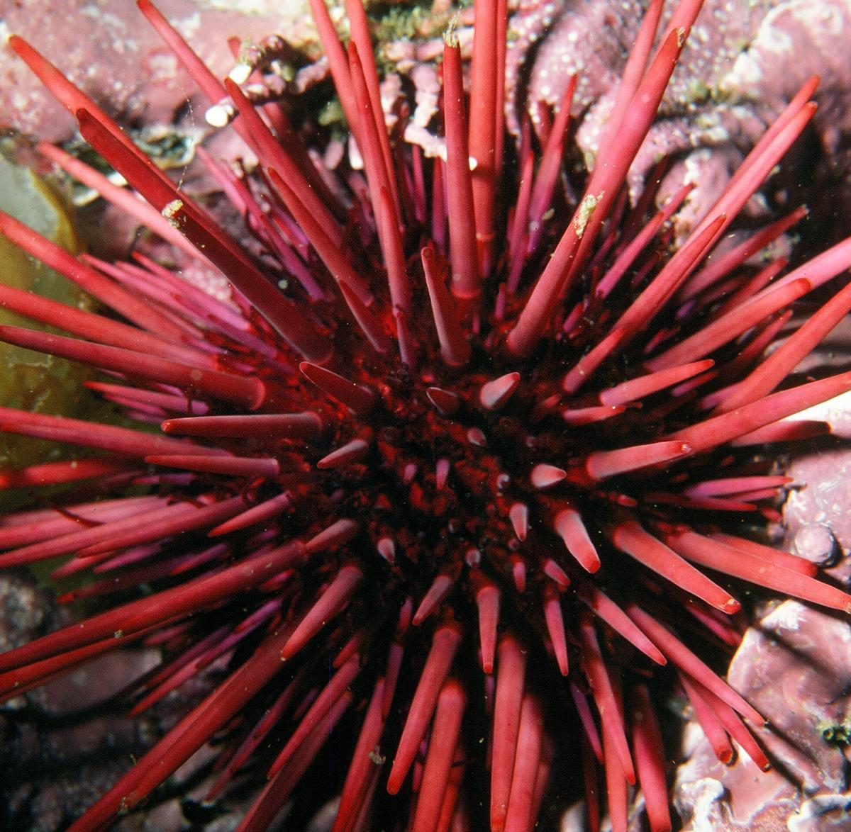
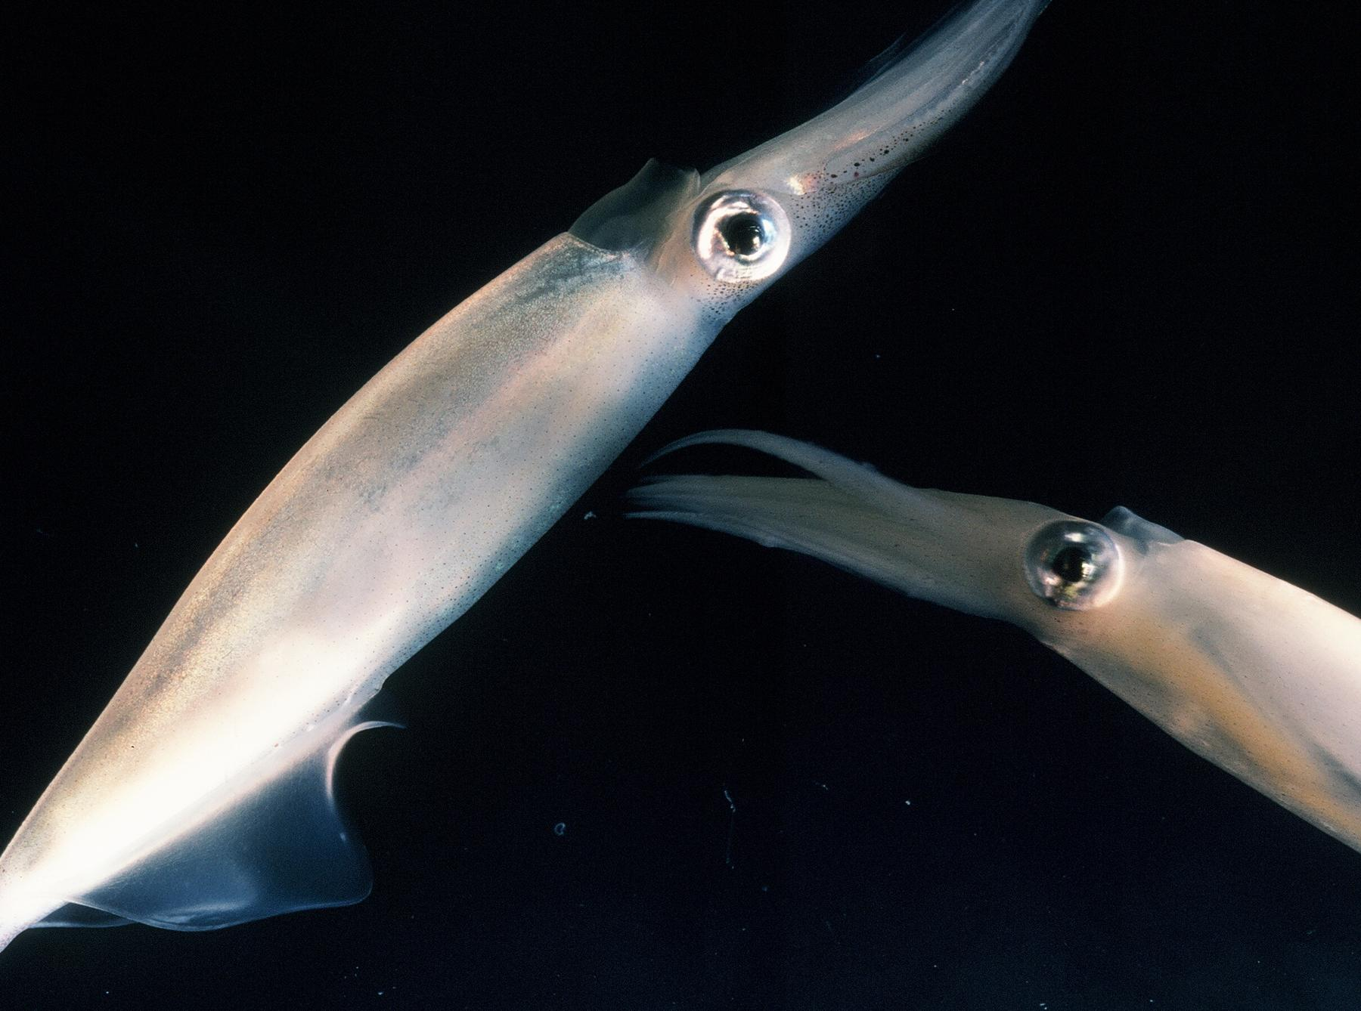
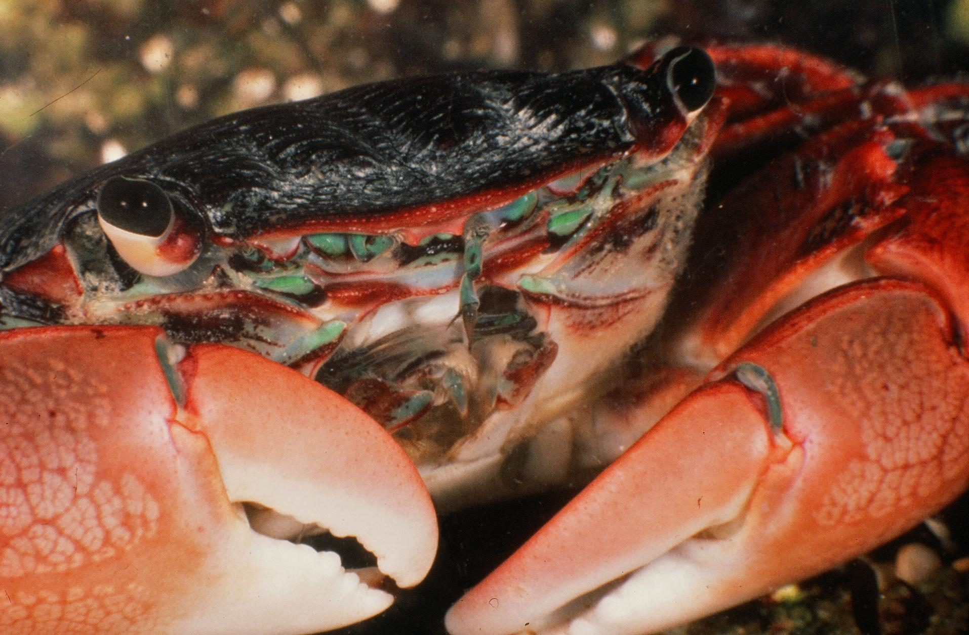
WORLD’S MOST AWESOME INVERTEBRATE

Slide 2
INTRODUCTION
You will watch nine short videos about animals from different phyla. Then you will choose an animal that you think is the most awesome and create a presentation about that animal.
Please take notes when you watch the videos.

Slide 3
LIST OF PHYLA
SPONGES MARINE ARTHROPODS
CNIDARIANS TERRESTRIAL ARTHROPODS
FLATWORMS MOLLUSCS
ANNELIDS ECHINODERMS
CHORDATES

Slide 4
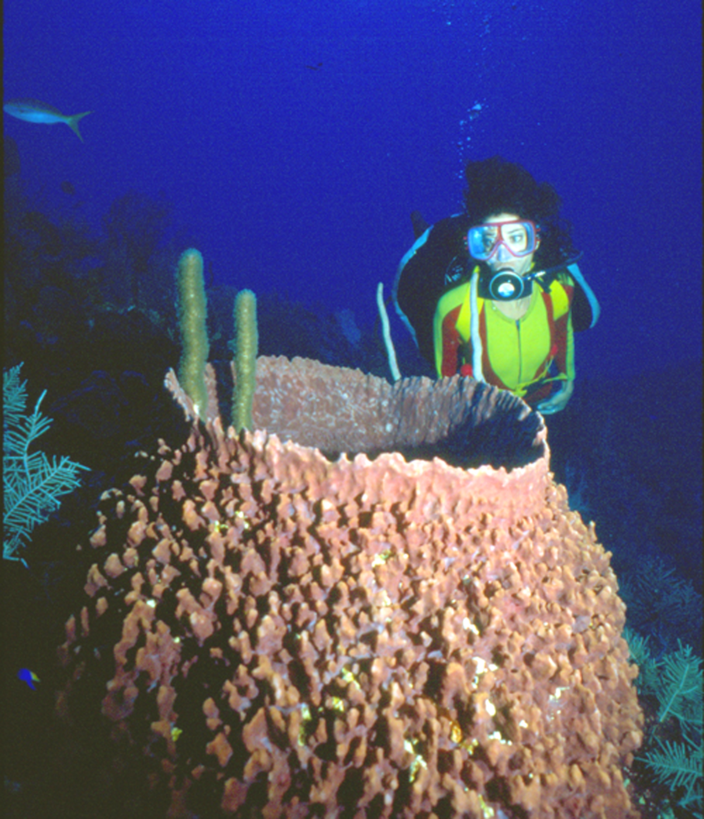
SPONGES
The ancient sponge appeared about 2.5 billion years ago—the first animal. Coming in many sizes and shapes, sponge bodies are a loose assemblage of cells held together by a special protein called collagen which is present in all animals.

Slide 5
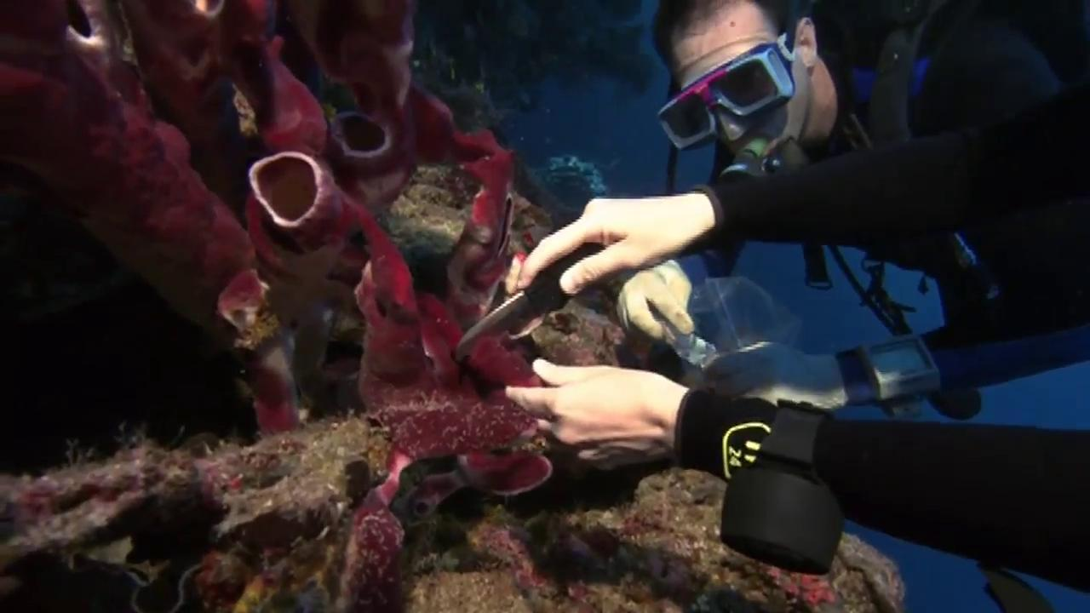
WATCH THE SPONGE VIDEO

Slide 6
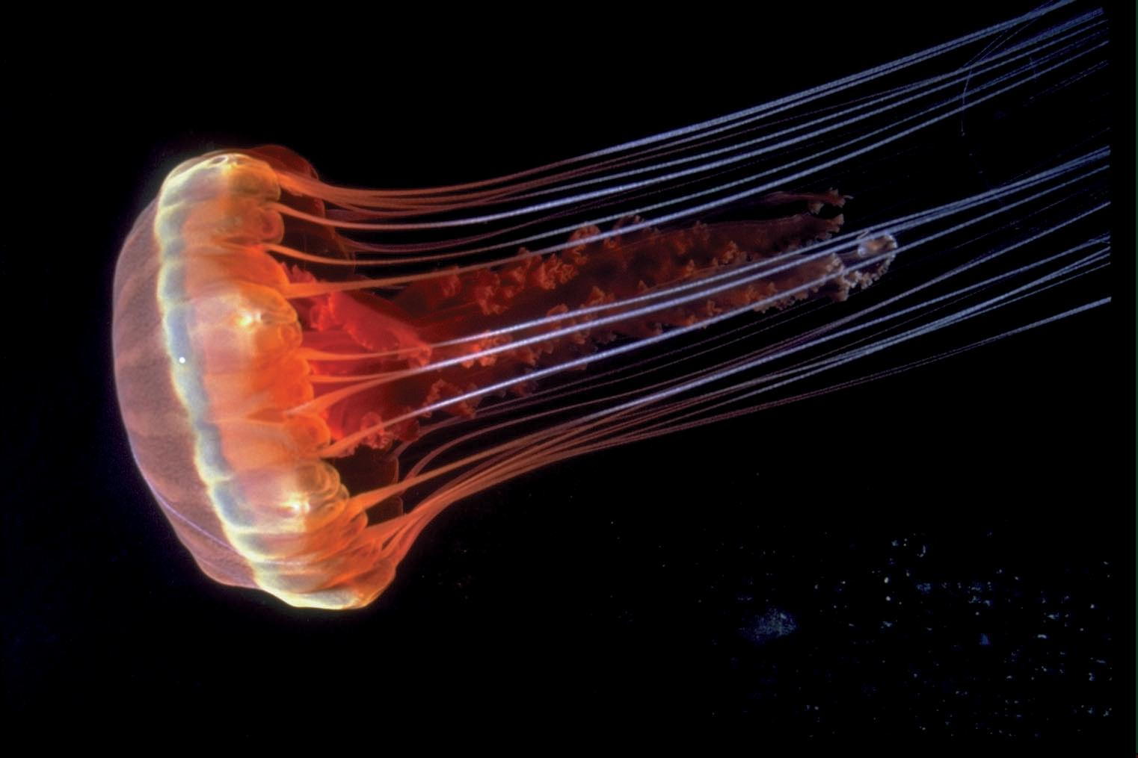
CNIDARIANS
Cnidarians were the first animals to have muscles and nerves to produce behavior. They were also the first to have a mouth and stomach to digest food.

Slide 7
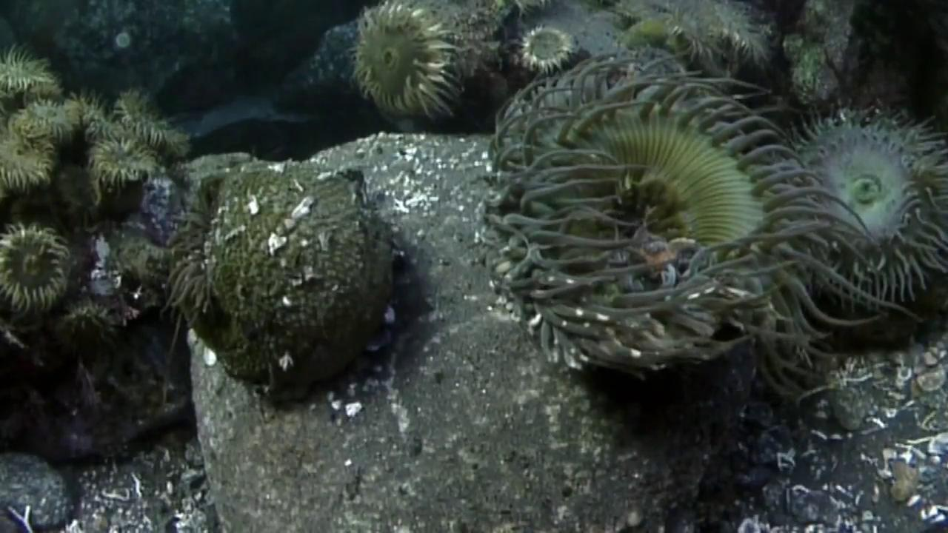
WATCH CNIDARIAN VIDEO

Slide 8
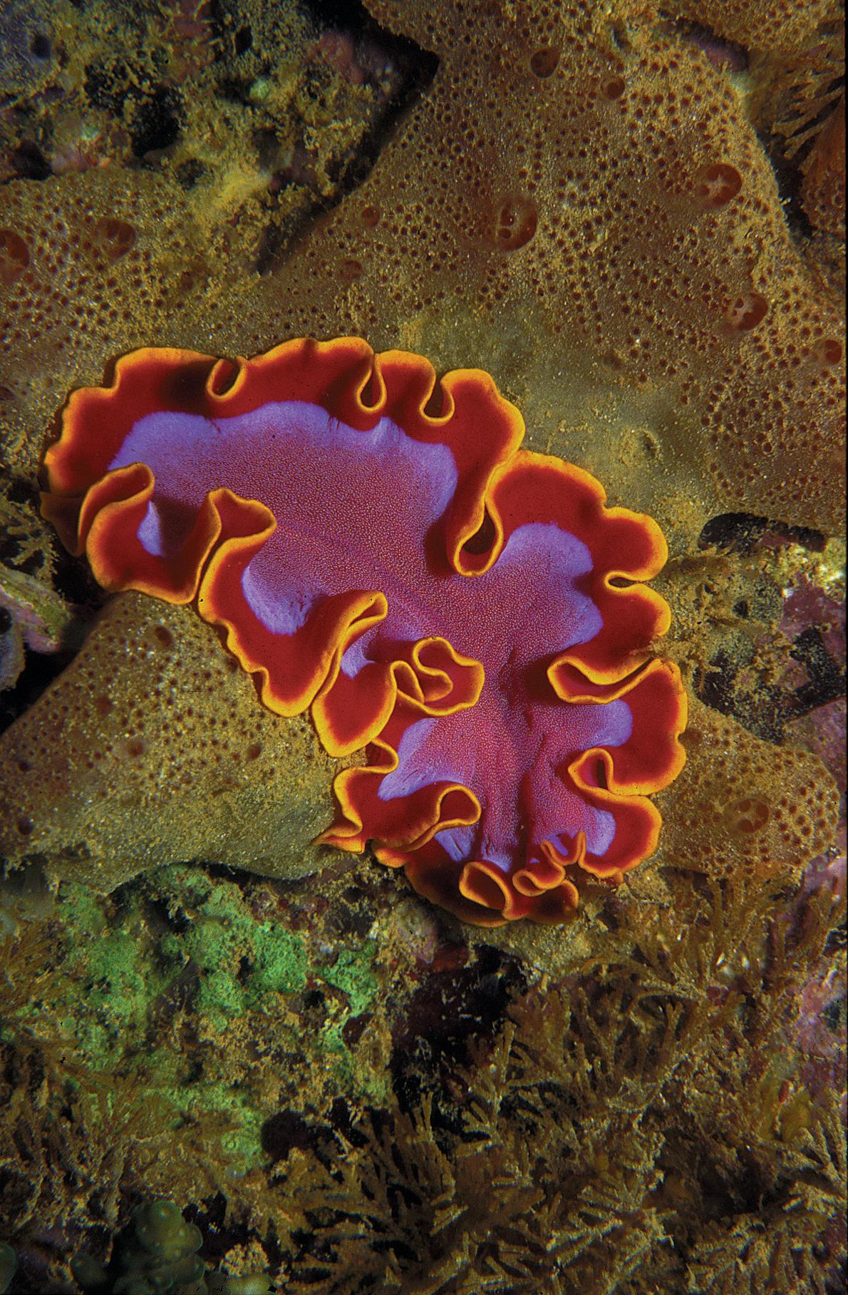
FLATWORMS
Flatworms, the first animal to hunt, are found in the ocean, freshwater, on land, and even inside other animals. The ancient flatworms were the first animals to develop a central nervous system and a head with a brain. The flatworm body is bilateral—the first body plan with that design.

Slide 9
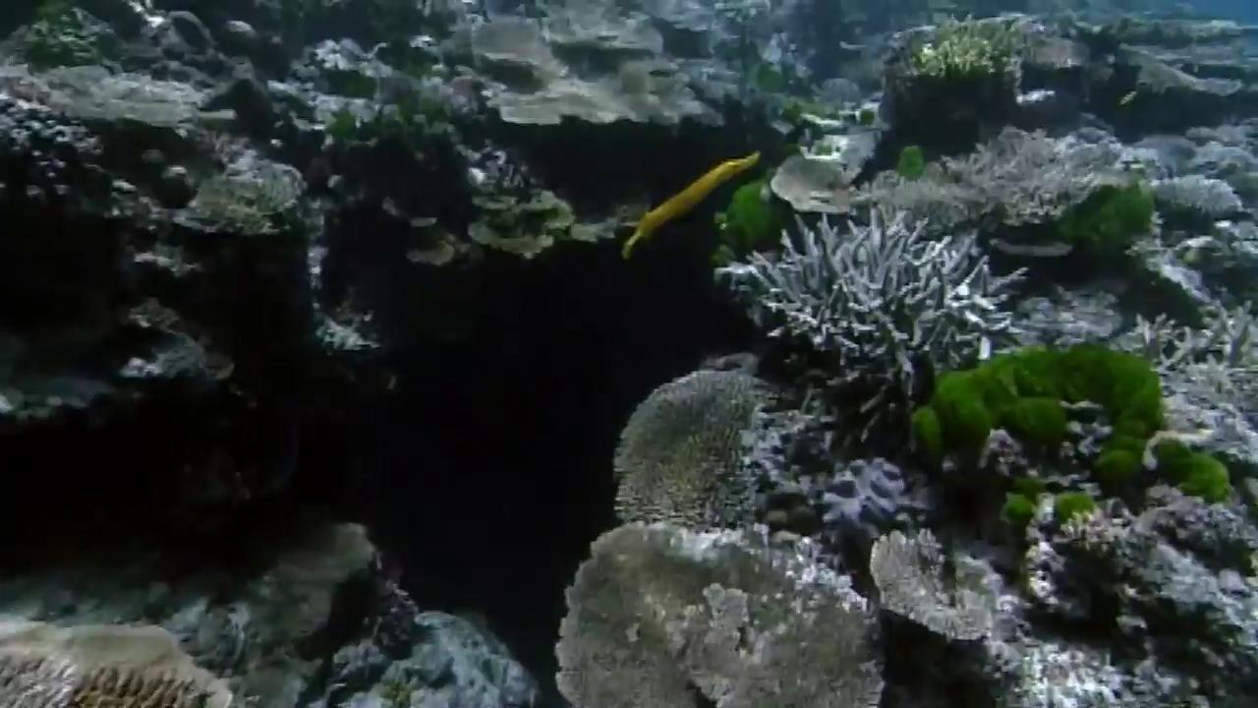
WATCH THE FLATWORM VIDEO
VIDEO

Slide 10
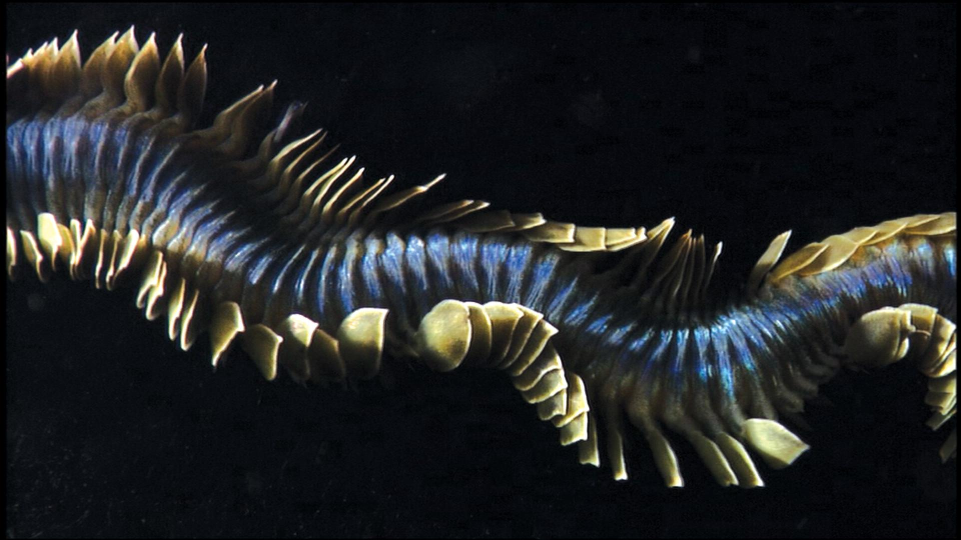
ANNELIDS
Annelids have segmented bodies, with both a nervous and circulatory system and a one-way gut. They have mastered the art of digging and live in an incredible diversity of habitats.

Slide 11
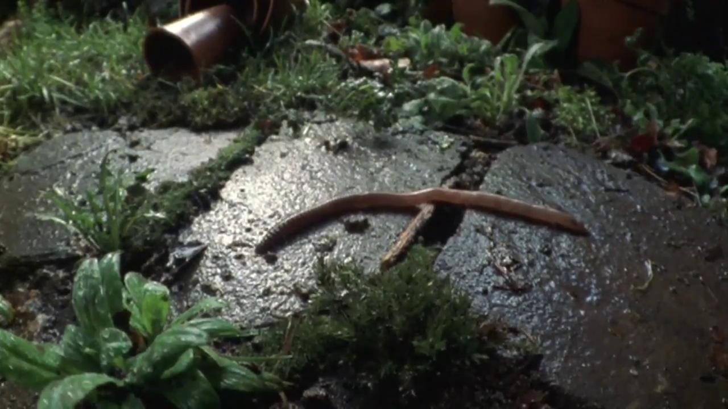
WATCH TERRESTRIAL ARTHROPOD VIDEO

Slide 12
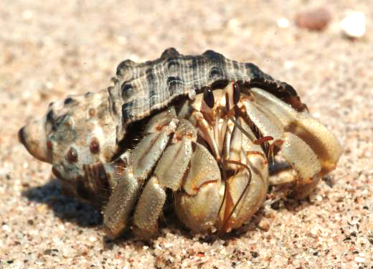
MARINE ARTHROPODS
Marine arthropods—crabs, shrimps and lobsters—have jointed appendages that are both strong and flexible, which they use for sensing the world, feeding and moving.

Slide 13
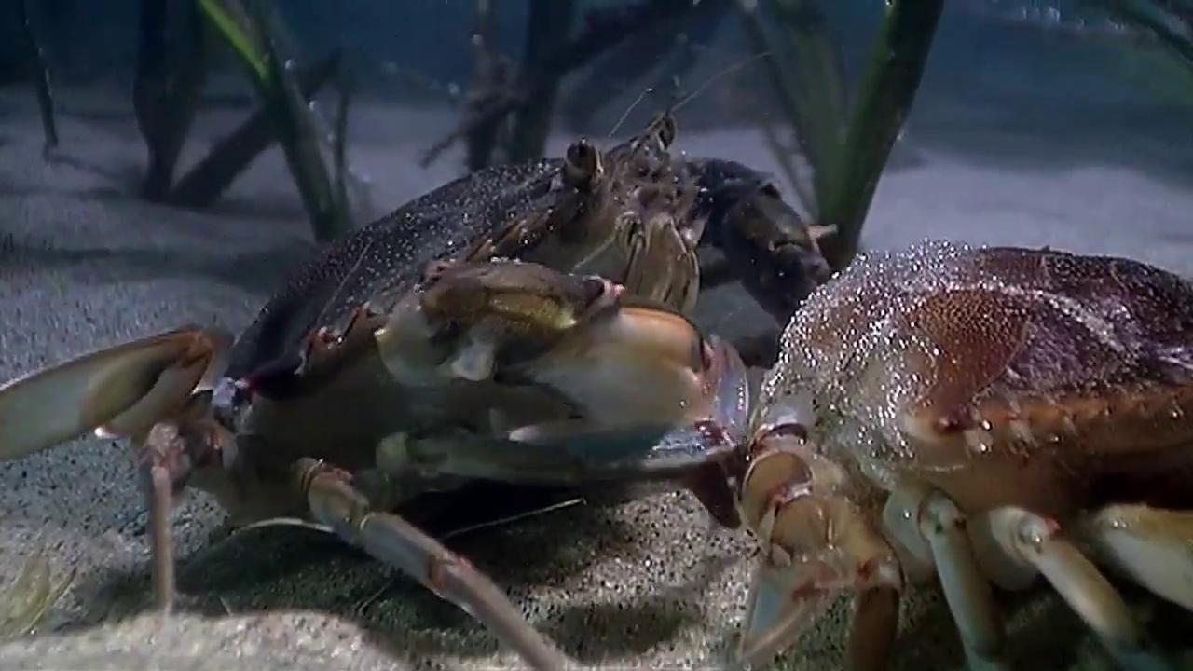
WATCH MARINE ARTHROPOD VIDEO

Slide 14
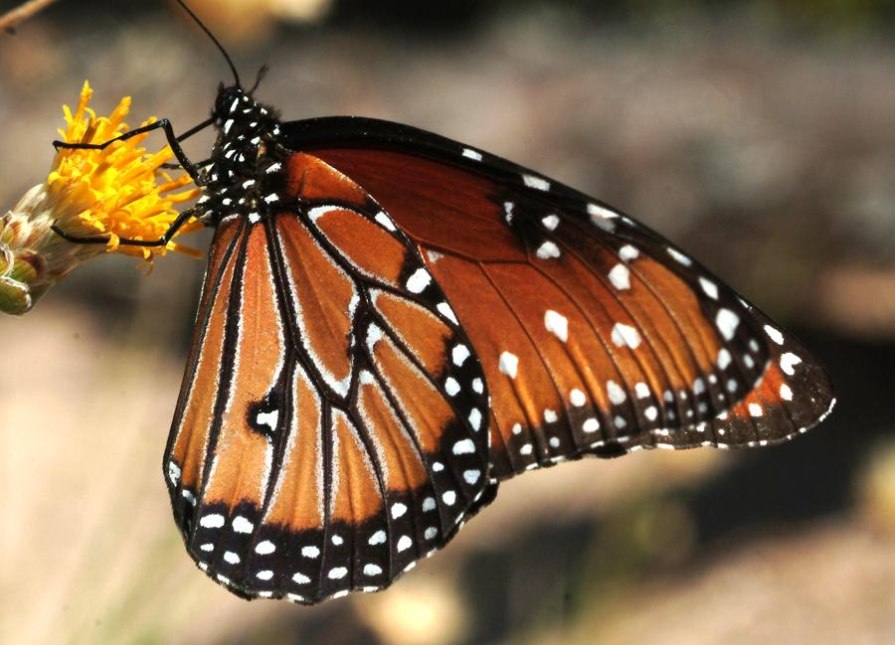
TERRESTRIAL ARTHROPODS
Arthropods were the first animals to venture onto land and spread over the earth. Their body plan allowed them to diversify and adapt to every environment, including the air, inventing new ways to extract oxygen from air rather than water.

Slide 15
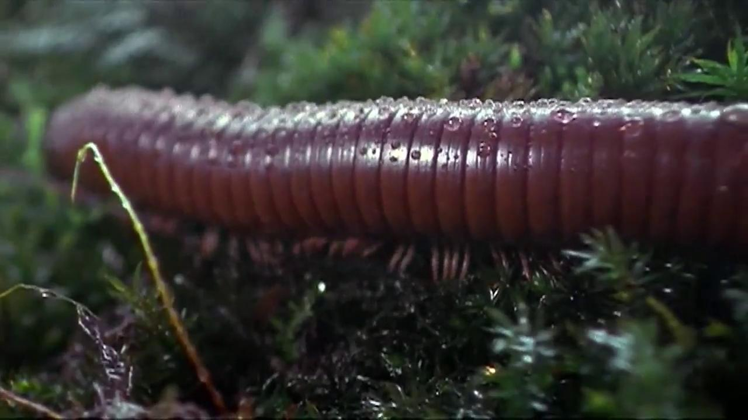
WATCH ARTHROPOD VIDEO

Slide 16
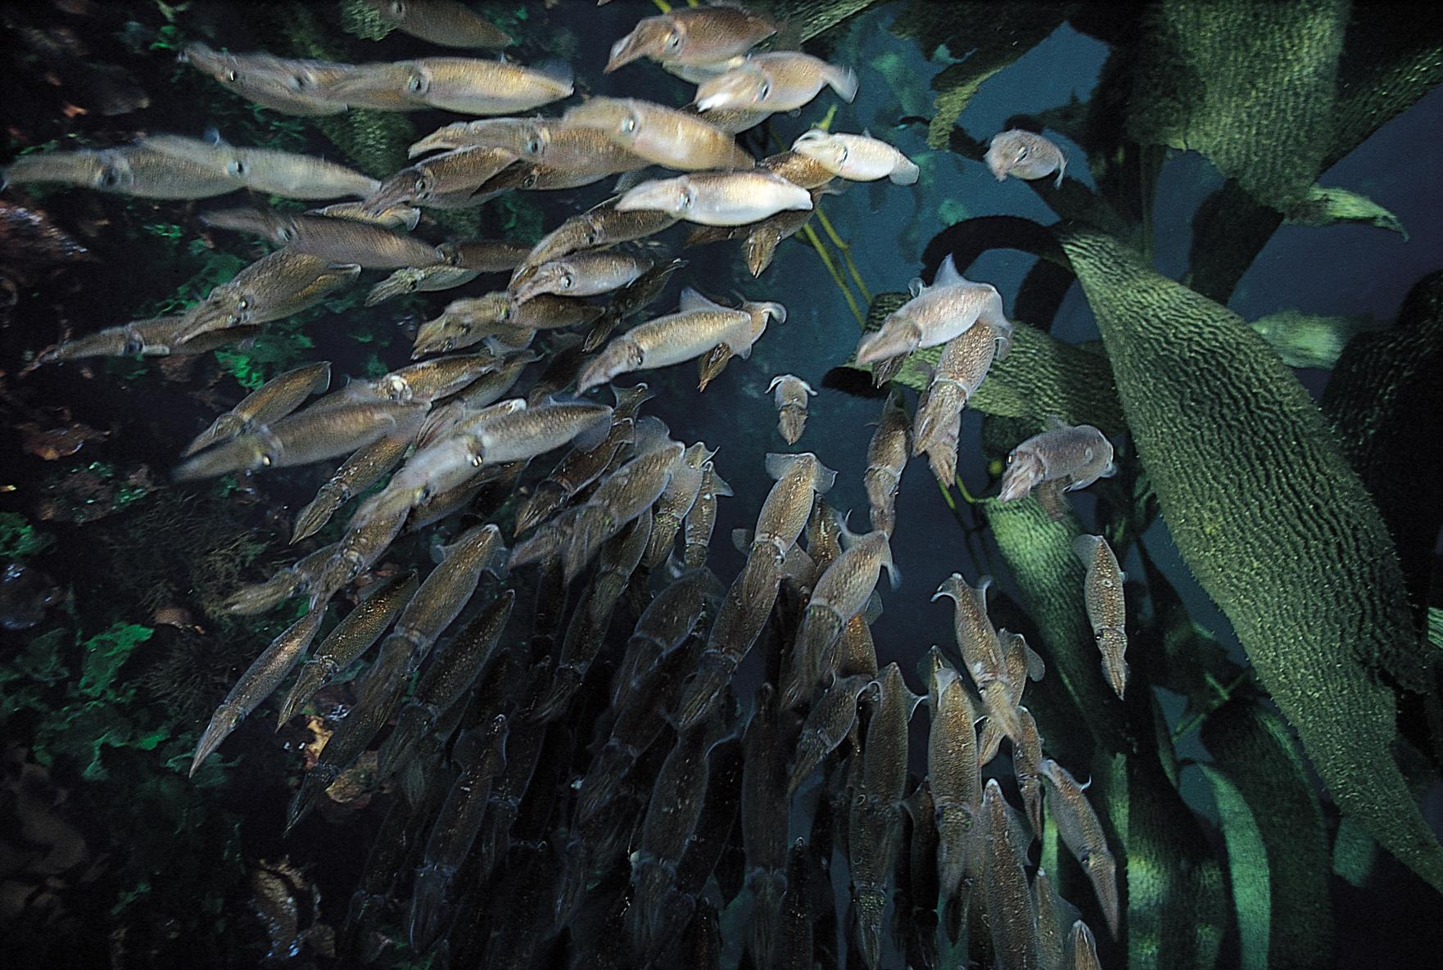
MOLLUSCS
Their basic body plan includes a foot for mobility, a mantle that secretes a shell and a radula for eating. Molluscs today show many variations on this original body plan.

Slide 17
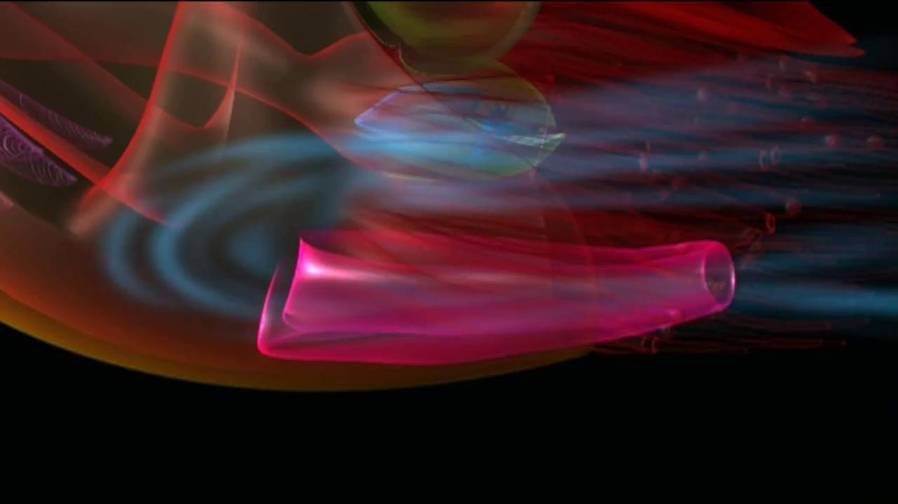
WATCH MOLLUSC VIDEO

Slide 18
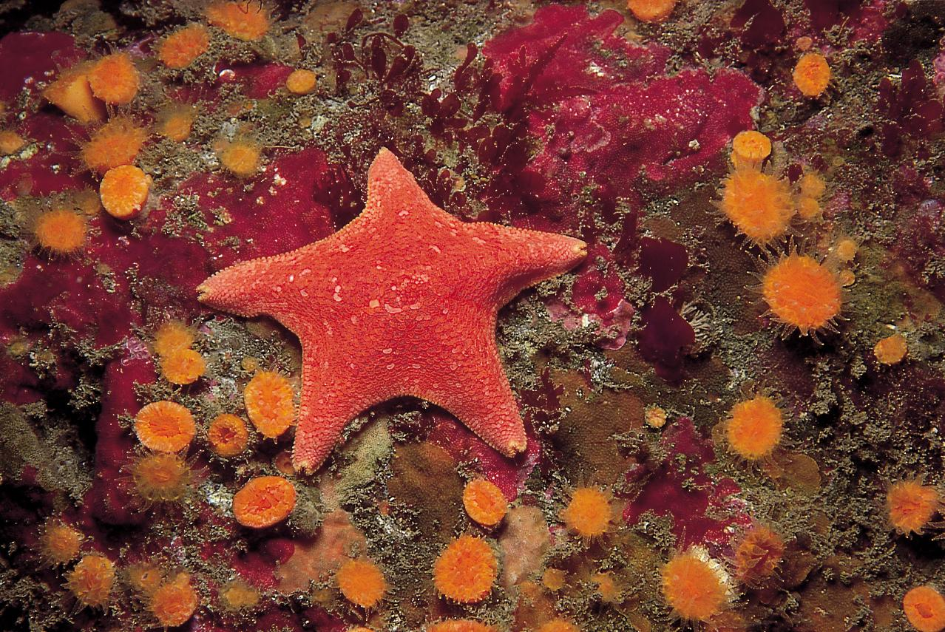
ECHINODERMS
Echinoderms are slow animals radically different from us, but they are an evolutionary success. All echinoderms have five-part symmetry.

Slide 19
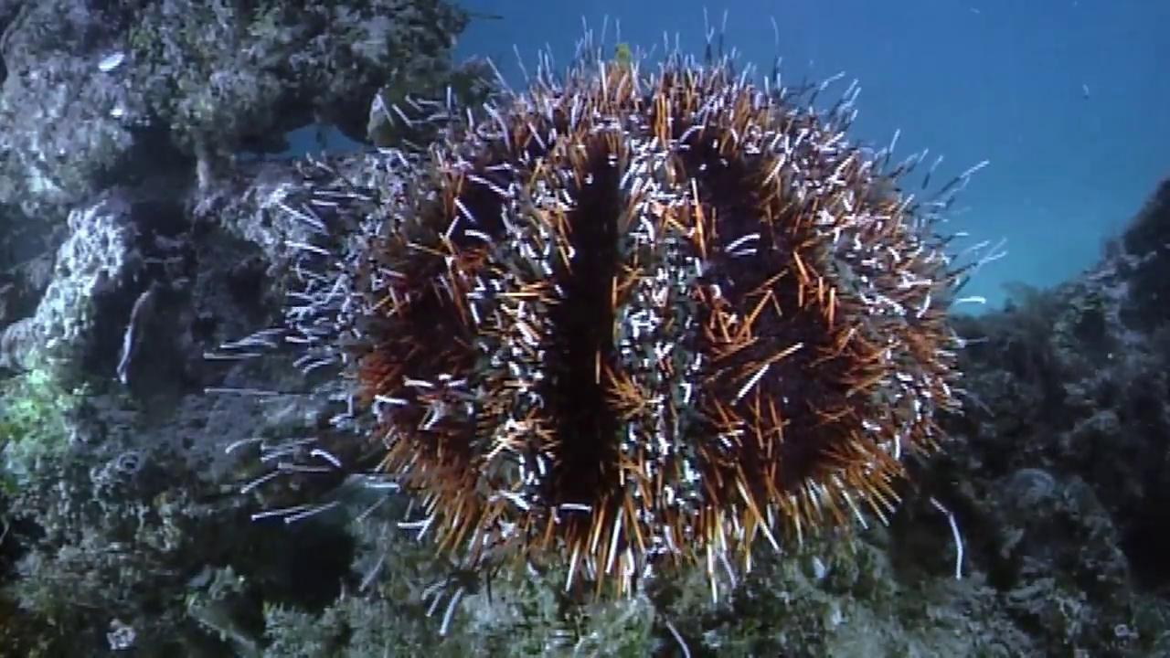
WATCH ECHINODERM VIDEO

Slide 20
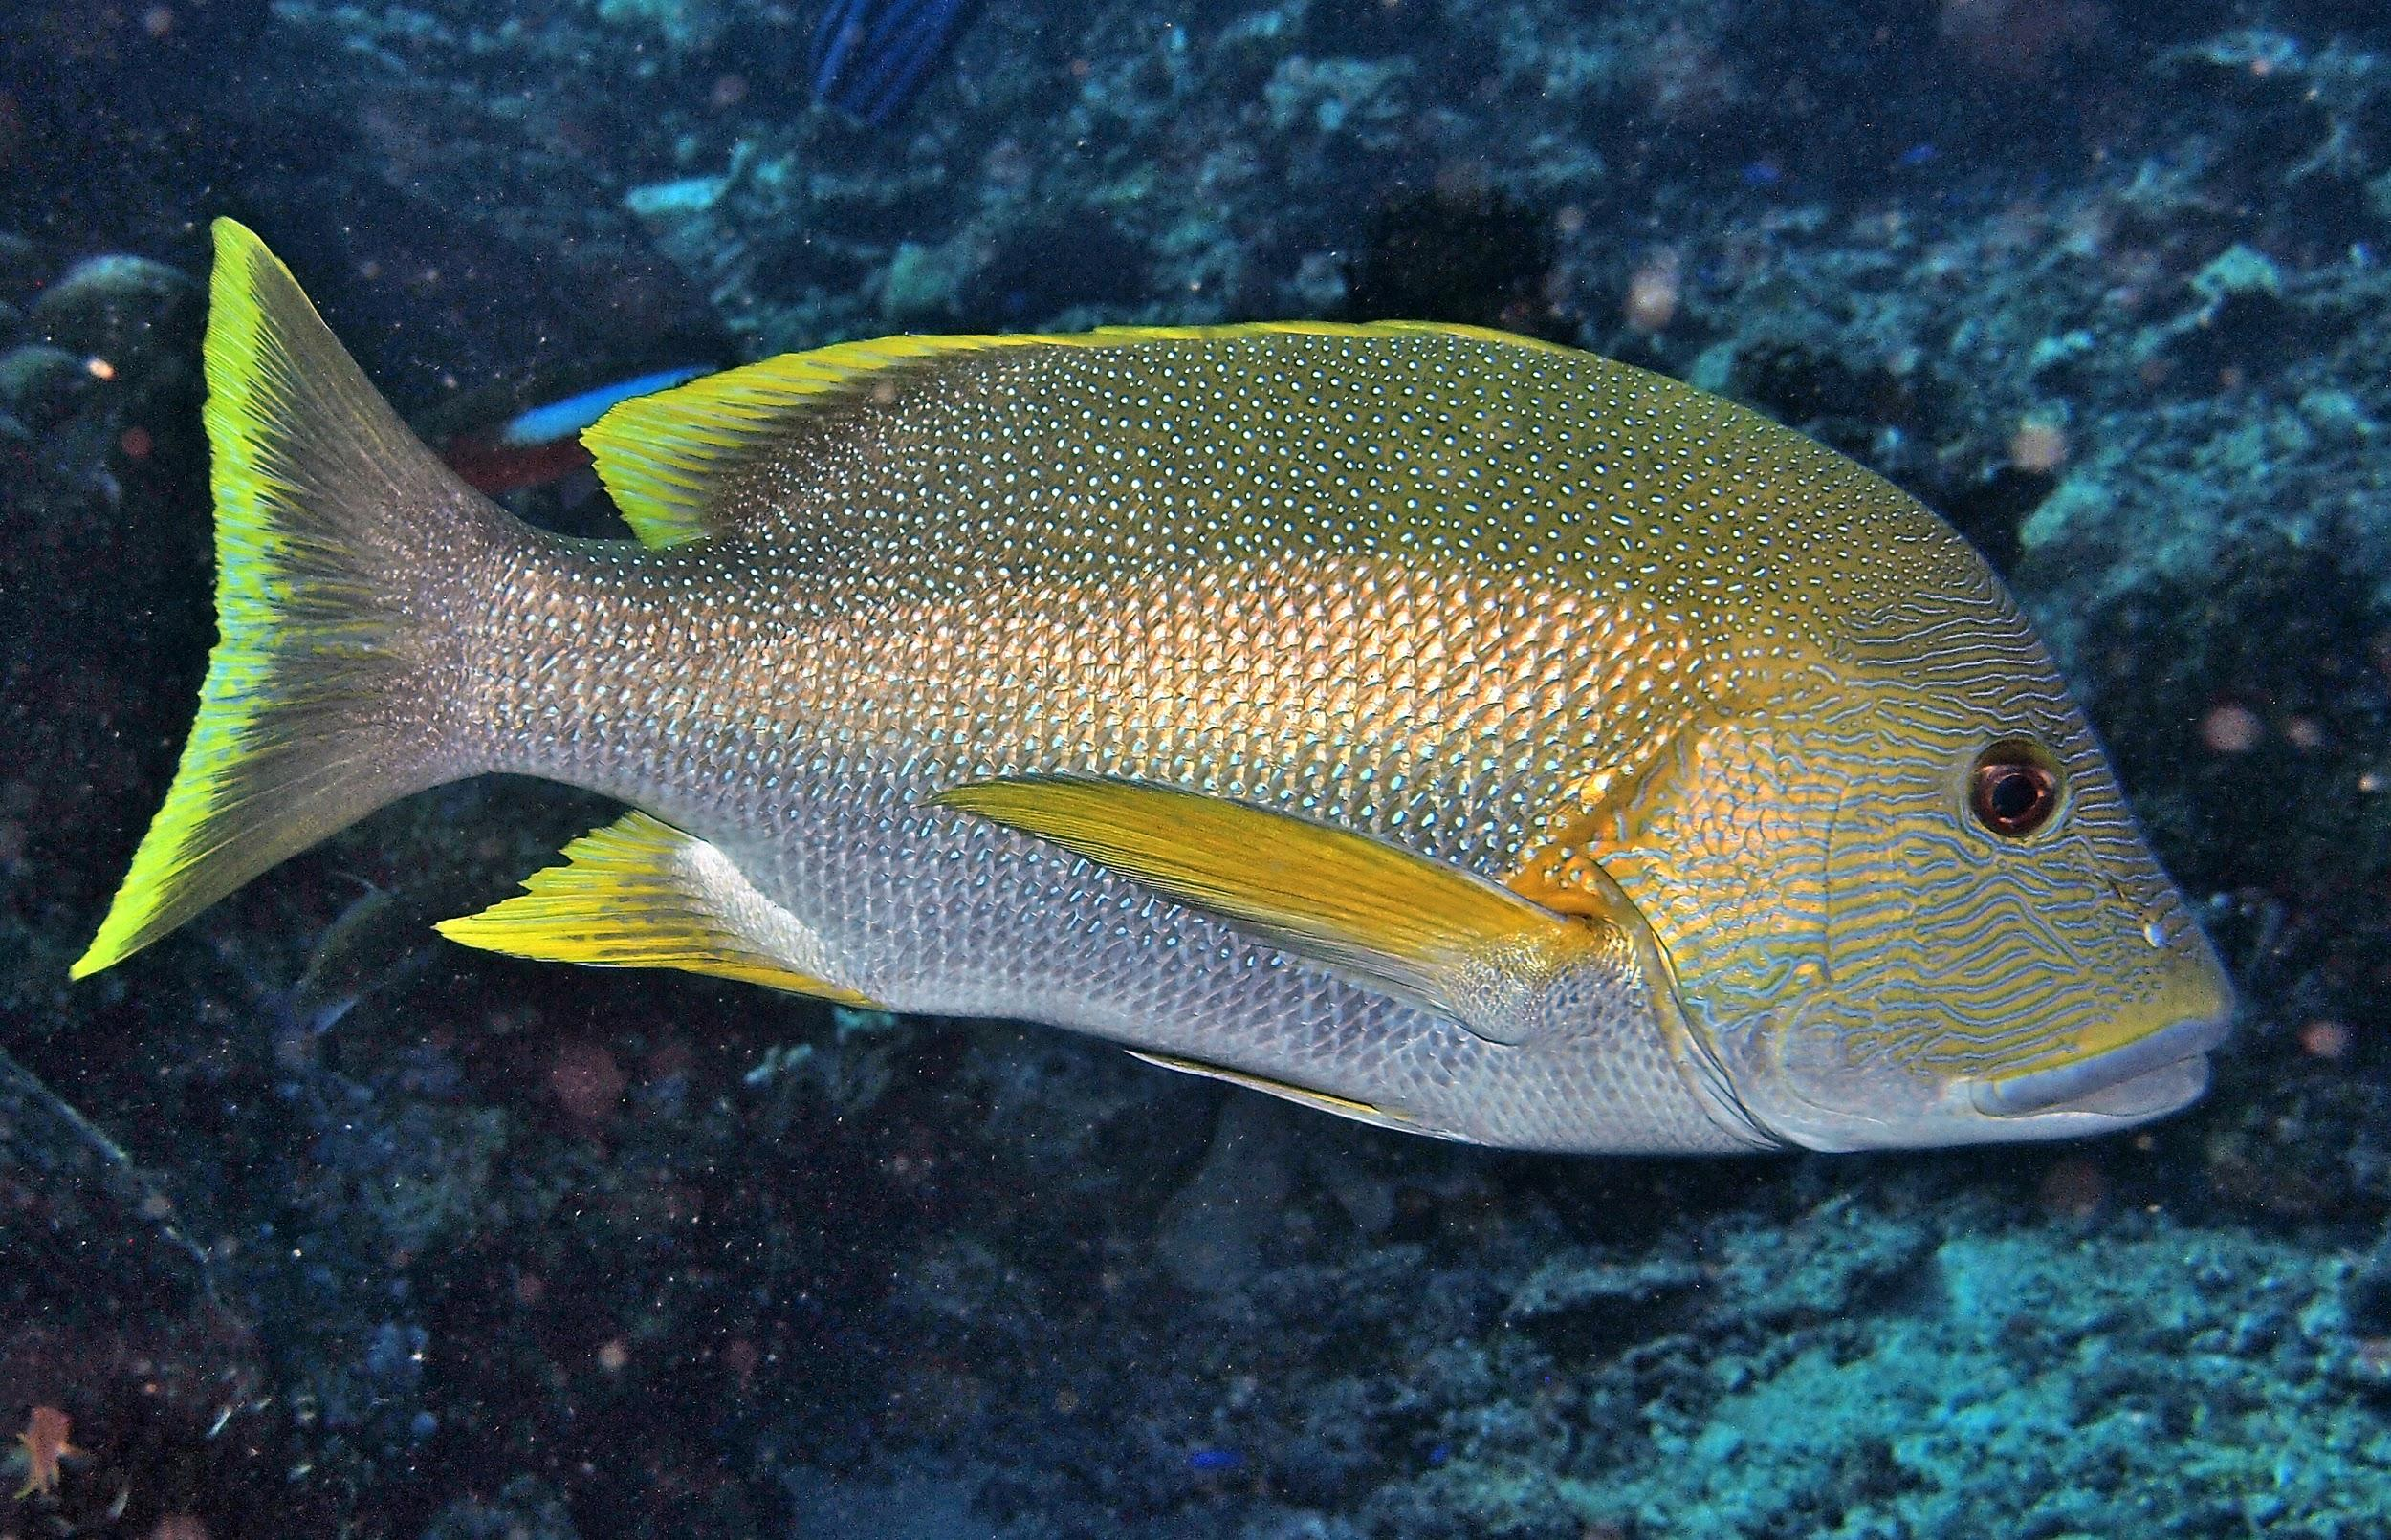
CHORDATES
Some chordates like tunicates, salps and larvaceans, have remained simple creatures without backbones. Other chordates, like fish and mammals do have backbones and are classified as vertebrates. They have four times as many genes as their simple chordate ancestors, which allowed an explosion of new forms. We are chordates.

Slide 21
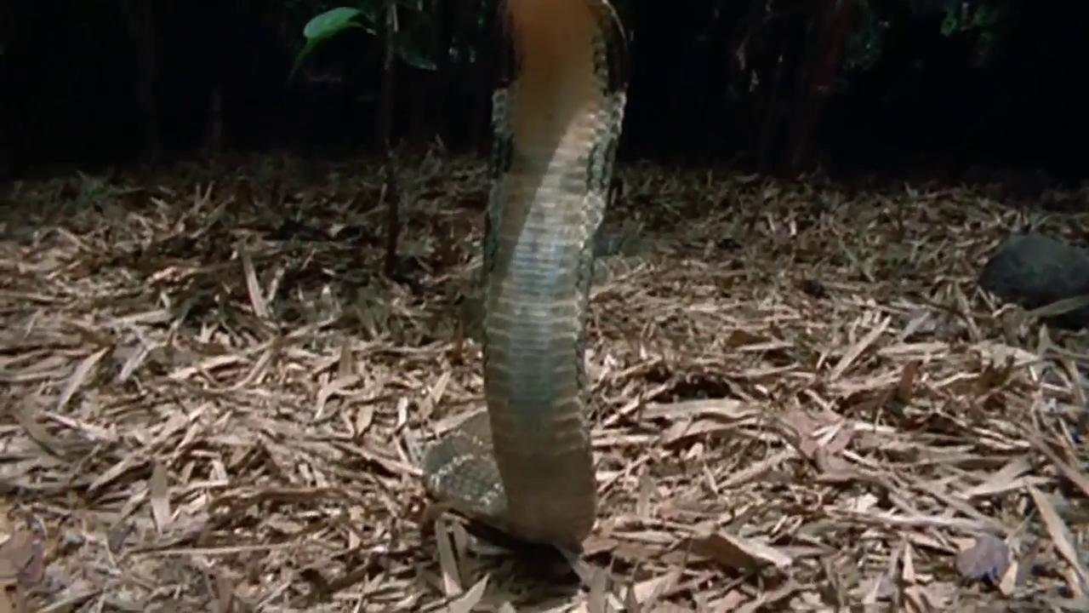
WATCH CHORDATE VIDEO

Slide 22
CHOOSE THE MOST AWESOME
Dragonfly Millipede Lobster Squid Nautilus
Crab Abalone Octopus Sea Star
Sea Urchin Jellyfish Leech Marine Annelid
Earthworm Sponge Sea Anemone Flatworm
Tunicate Sea Cucumber Coral

Slide 23
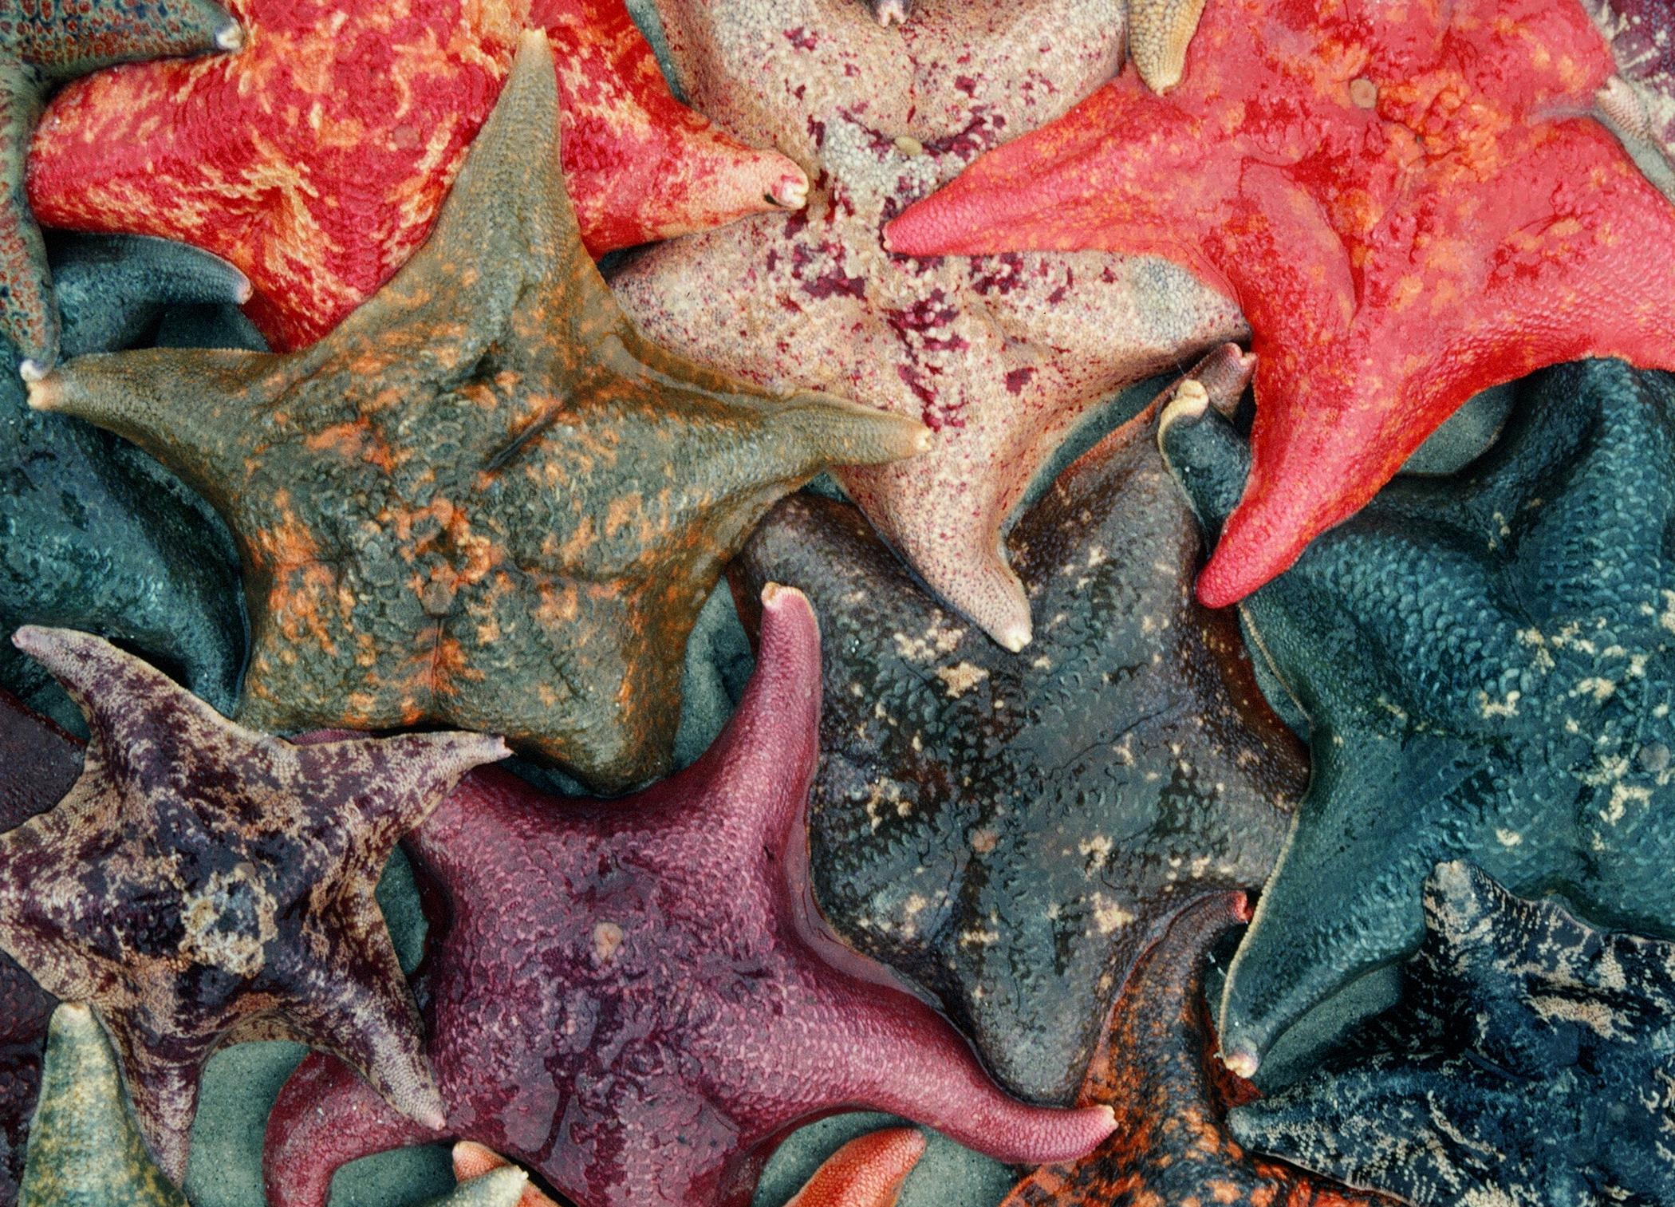
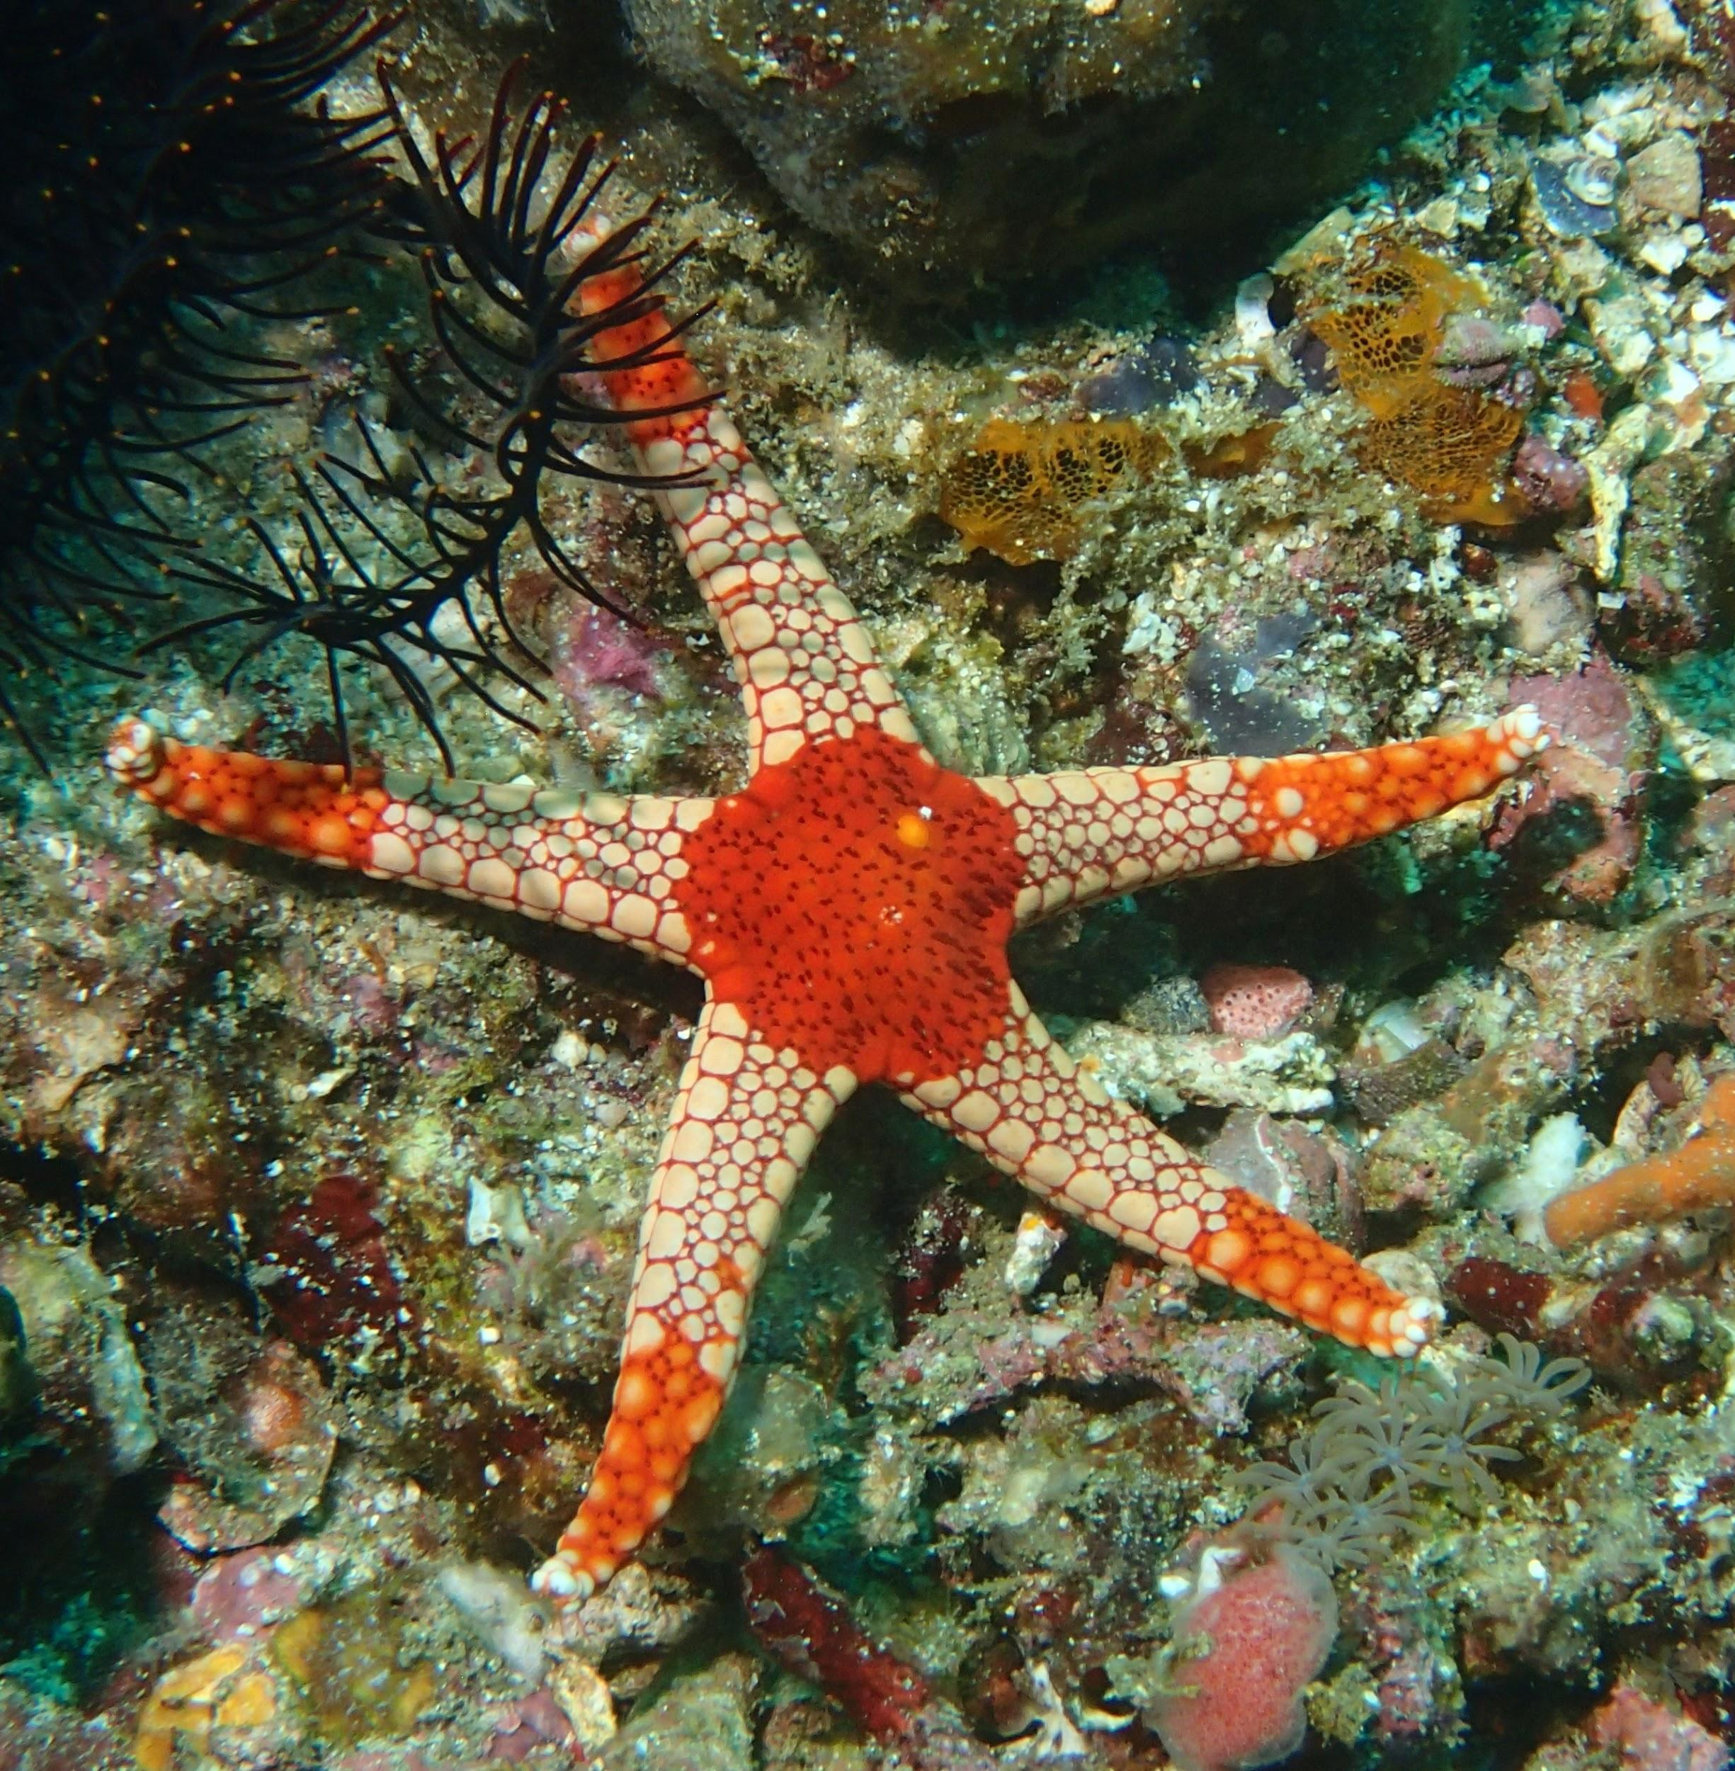
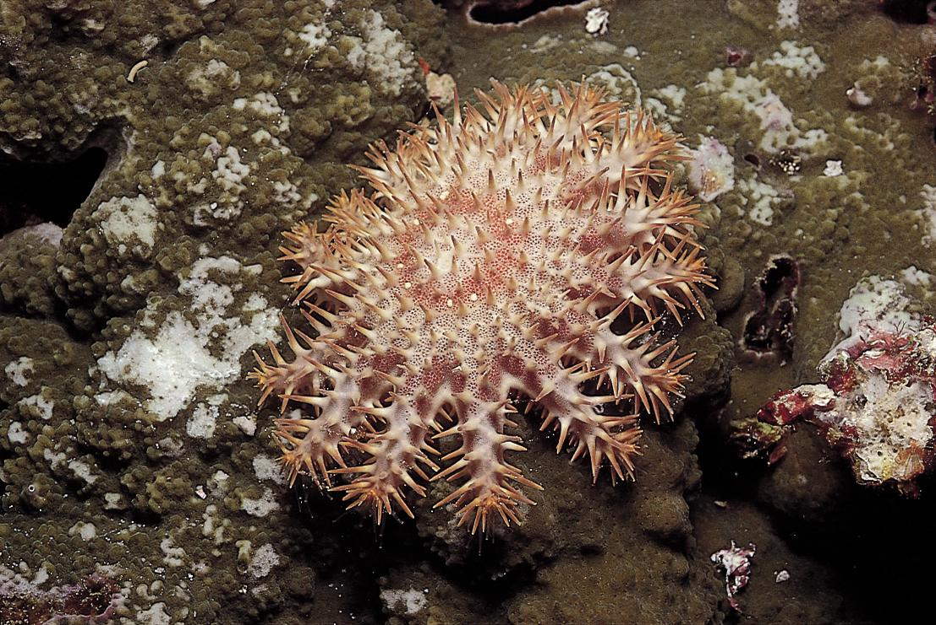
IDENTIFY THREE SPECIES
Now that you’ve chosen your most awesome group of invertebrates, identify three species in that group. Below is an example of sea stars.

Slide 24
MAKING YOUR CASE FOR THE MOST AWESOME
Think about a creative way to present your “Most Awesome Invertebrate”. What scientific information do you need to convince others?
Learn more about your invertebrate group, documenting your sources and answering the questions on the next two slides. You can look at Shape of Life, and also the Encyclopedia of Life and the Monterey Bay Aquarium.

Slide 25
WHAT TO INCLUDE page 1
1. Name of your invertebrate:
2. Phylum of your invertebrate:
3. Where does your invertebrate live?
4. How does your invertebrate move?
5. Identify 3-5 characteristics that makes your organism awesome

Slide 26
WHAT TO INCLUDE page 2
6. What other organisms, live or extinct, have the some of the same characteristics as your organism?
7. Why might very different organisms share some of the same characteristics?
8. Why would you promote your invertebrate as the “World’s Most Awesome Invertebrate”?
Write your three references for this research.

Slide 27
FIND A VIDEO
Search for a video that captures your invertebrate’s special abilities.
Look at the Shapeoflife.org website or other sites as needed.

Slide 28
CREATE YOUR PRESENTATION
Be creative -- here are some ideas for ways to convince others:
-Design a digital flyer (8 ½” x 11”) that promotes your invertebrate for the title of “World’s Most Awesome Invertebrate.”
-Draw or animate some of the key characteristics of your invertebrate
-Interview your invertebrate

Slide 29
MAKE YOUR PRESENTATION
Present your argument, showing your class and family members and arguing the case for your invertebrate to be crowned the winner.

