Slide 1
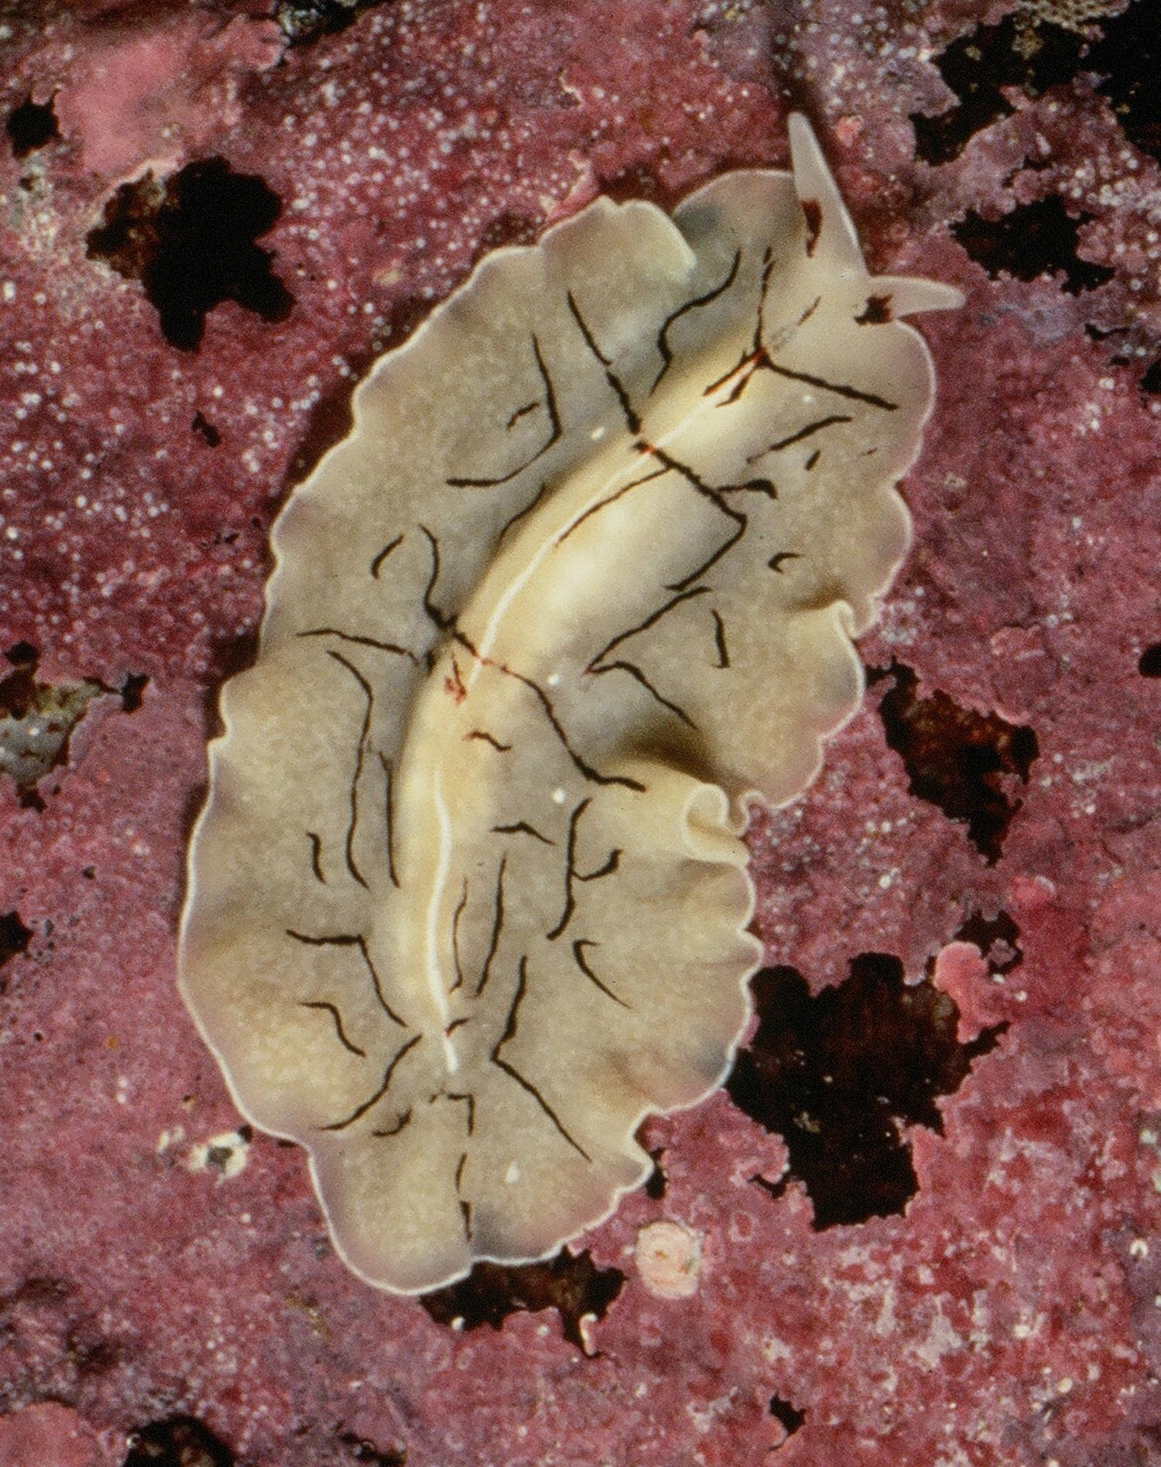
Flatworms:
the Ultimate Hunter
The Body Plan That Invented Hunting

Slide 2
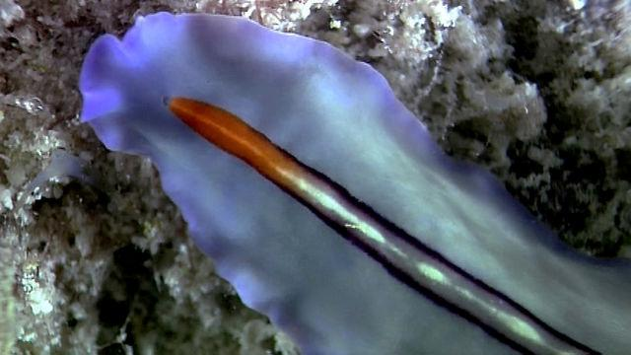
Watch Flatworms: The First Hunter. Take Notes And Answer the Following Questions
Click to Watch:

Slide 3
Where Flatworms Live
Name four habitats where flatworms live.

Slide 4
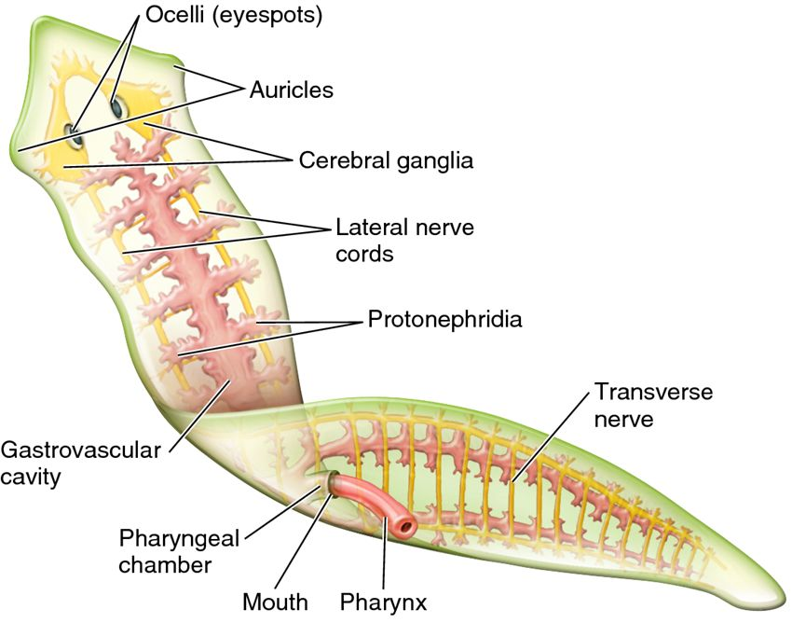
Characteristics of the First Hunter
What four body plan innovations were found in an ancient flatworm?
What is it about the flatworm body plan that makes
it a good hunter?
How do those adaptations help a flatworm hunt?

Slide 5
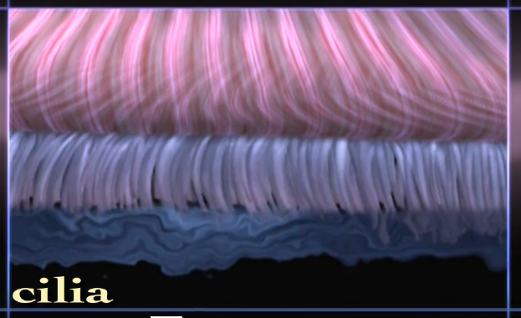
Cilia
What are cilia?
How does a flatworm use them?

Slide 6
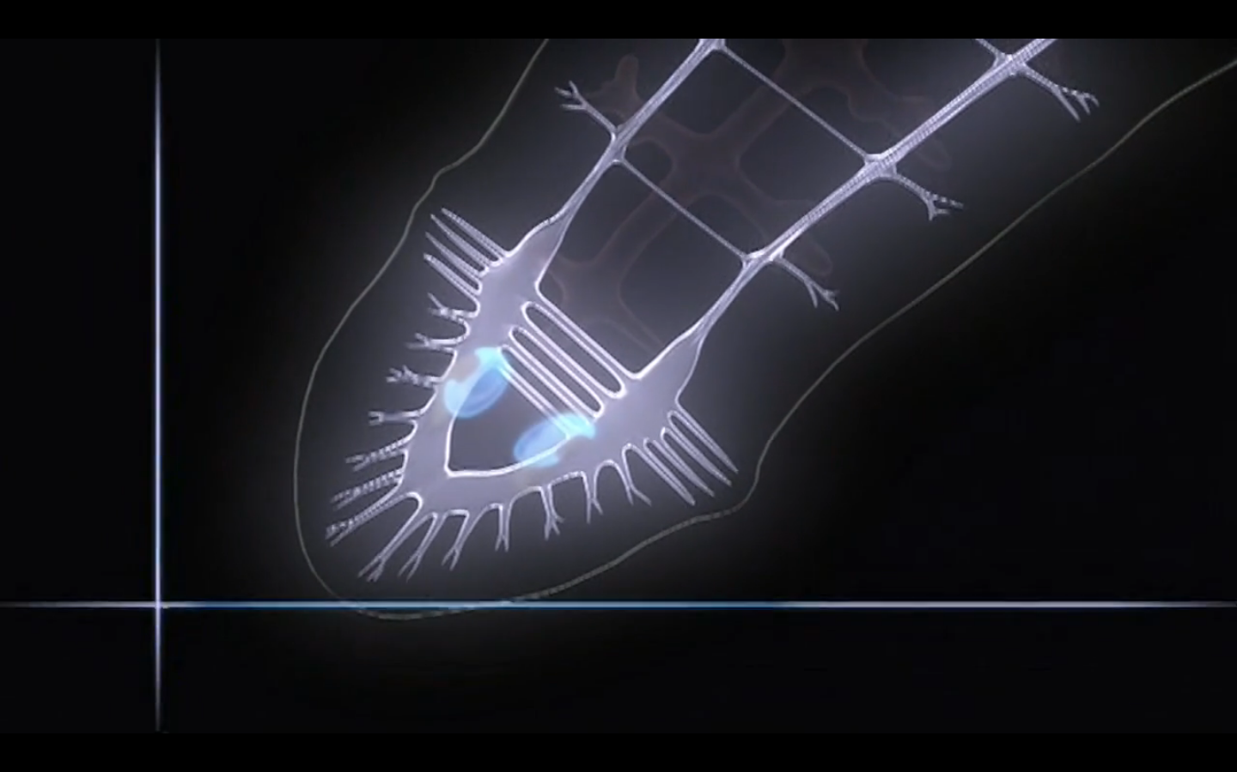
Stereo Senses
What are the advantages of stereo senses?

Slide 7
Nervous System
What are the parts of the flatworm’s nervous system?

Slide 8
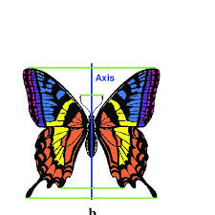
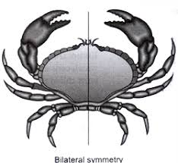
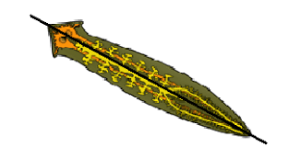
Bilateral symmetry
What are the advantages of having a bilaterally symmetrical body?

Slide 9
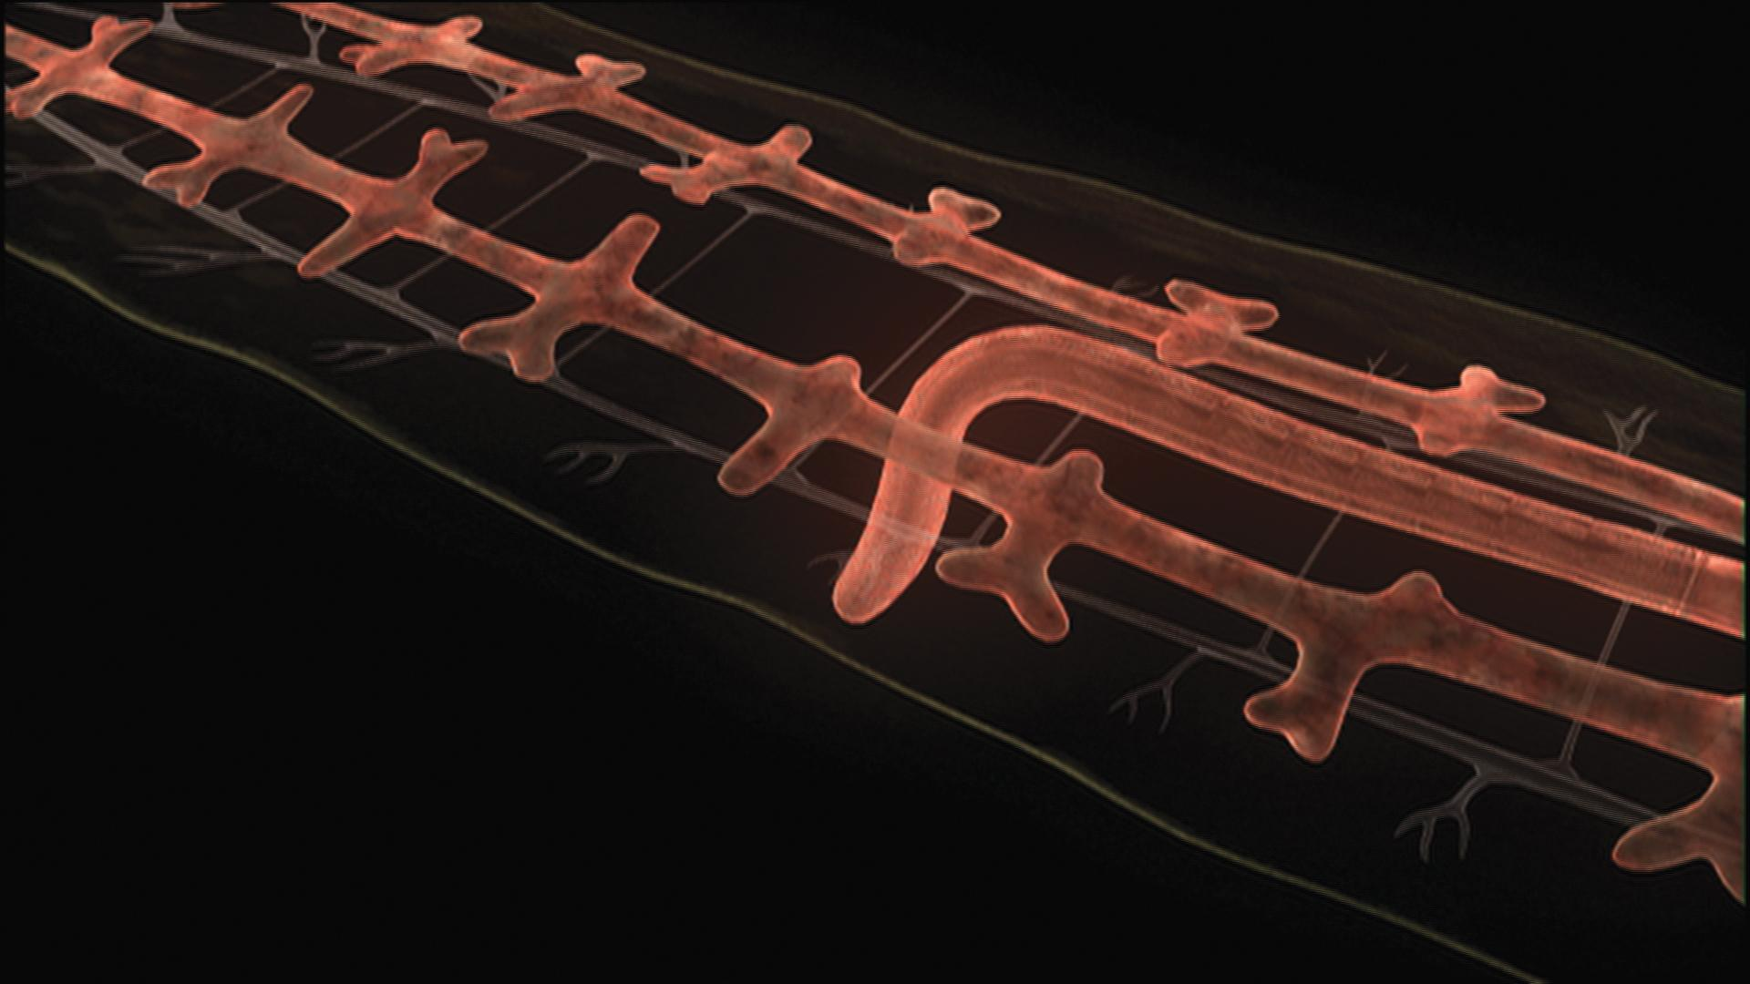
Flatworm Feeding
Where is the flatworm’s mouth?
Where is its digestive system?
What is the pharynx and how does the flatworm use it?

Slide 10
Flatworm Reproduction
What reproductive innovation in flatworms “changed the shape of life?”
What do we call an animal that produces both sperm and eggs?
What are the advantages and disadvantages of such a design?

Slide 11
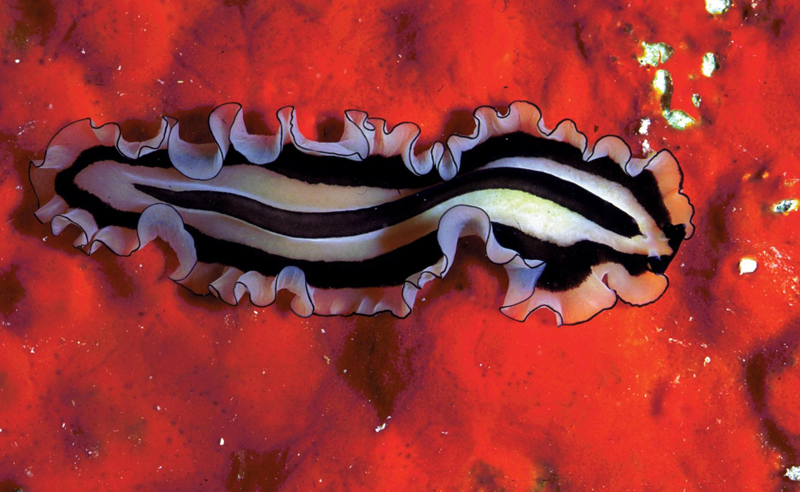
Flatworms do not have a circulatory system
What does a circulatory system do for those animals with one?
Why does a flatworm not need one?

Slide 12
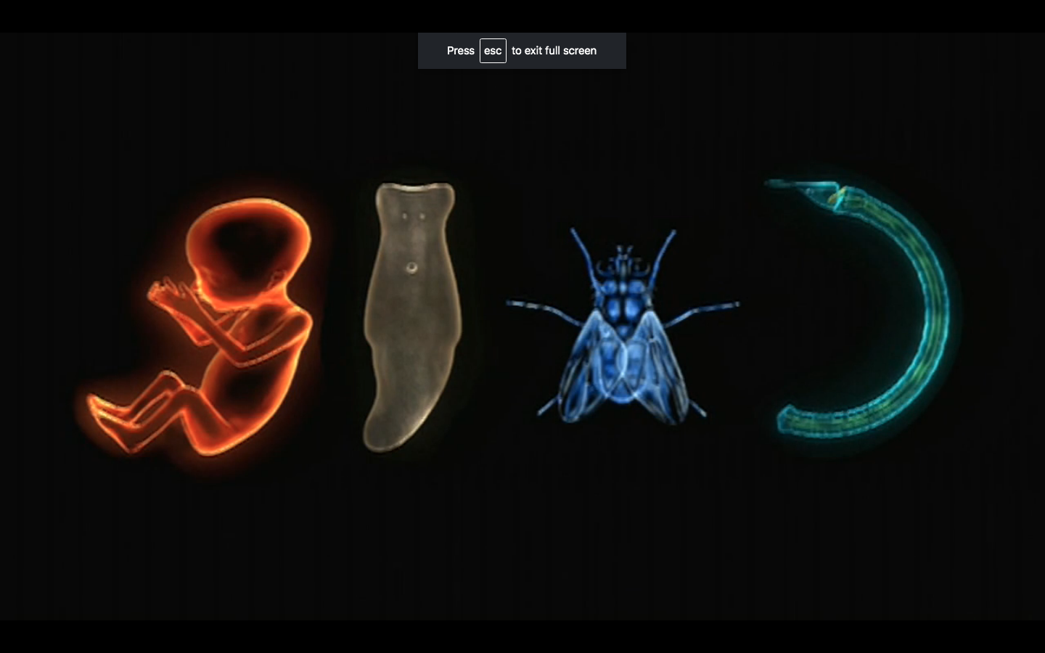
Flatworms Were The First Bilateral Animals To Have Hox Genes
Watch here:

Slide 13
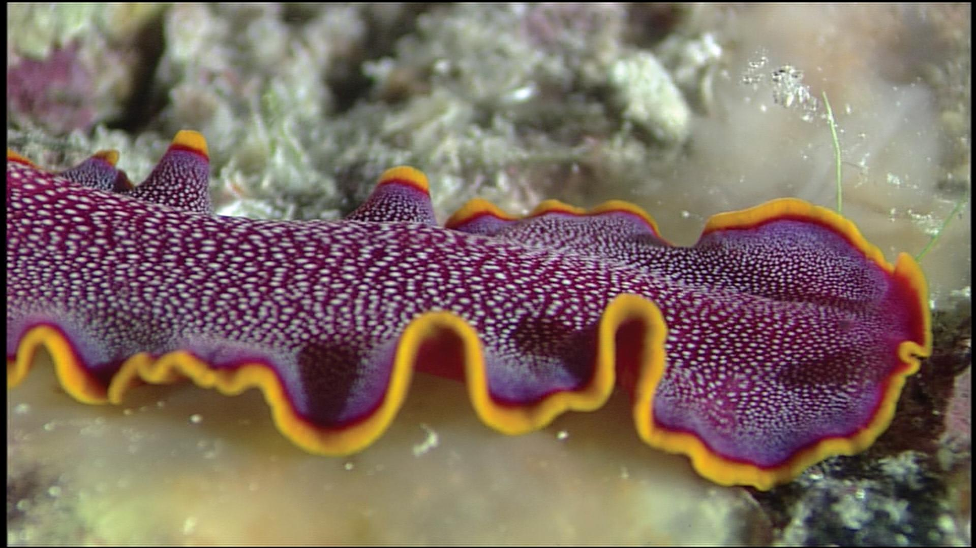
Worms And Us
What do humans and flatworms have in common?

Slide 14
Worms
Flatworms aren’t the only kind of worm. Can you name others?

Slide 15
Vocabulary
Define in your own words these vocabulary words:
Central nervous system
Bilateral symmetry
Cilia
Stereo senses
Triangulation
Pharynx
Internal fertilization
Hermaphroditic
Primordial

